Slide 1
Resonate
client training
Audience Analysis & Activation – Activation
Shipping Audiences from Resonate to DSPs and Social Networks

Slide 2

Audience Activation
Getting Started: Orientation​​
Getting Started: Audience Building - Build your Custom Audiences or Personas ​
Onboard and Analyze First-Party Data: Tag Creation & Deployment
Pre-Requisites for this Module

Slide 3
In this module you will:
Configure partner accounts
Identify audiences for activation
Configure and manage an audience delivery
Activate an audience on facebook

Slide 4
Configure partner accounts

Slide 5
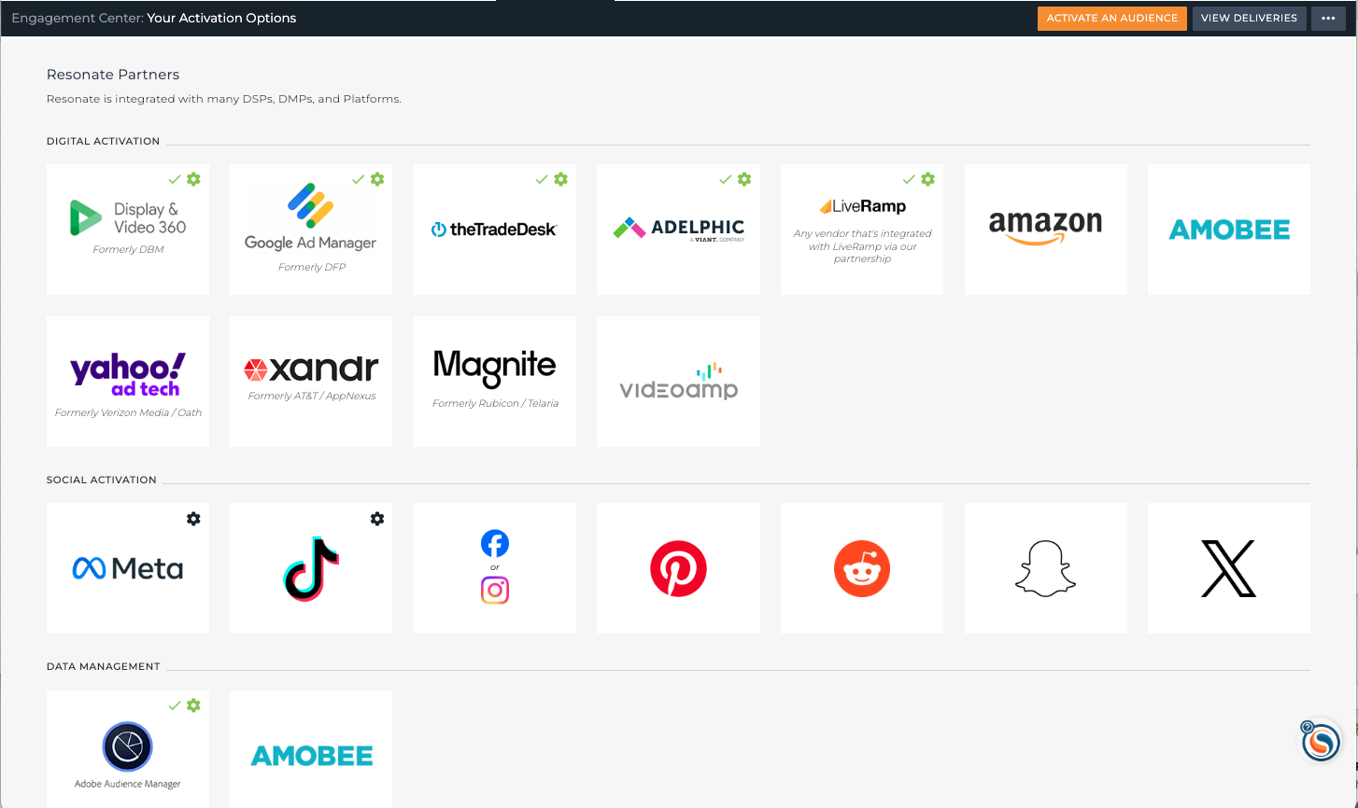
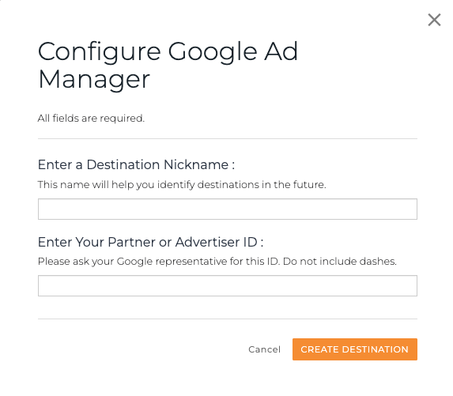
Configure partner accounts
Ex. Google marketing platform configuration
Go to the Engagement tab
Configure Partner Account
  Click the Gear icon on Google Ad Manager
Create Destination
  Click Create New button
  Enter Destination Name
  Select Product
  Enter Partner or Advertiser ID
Note: You can also create a new partner configuration later on in the activation process when you are selecting your Partner and Destination.

Slide 6
Identify audiences for activation

Slide 7
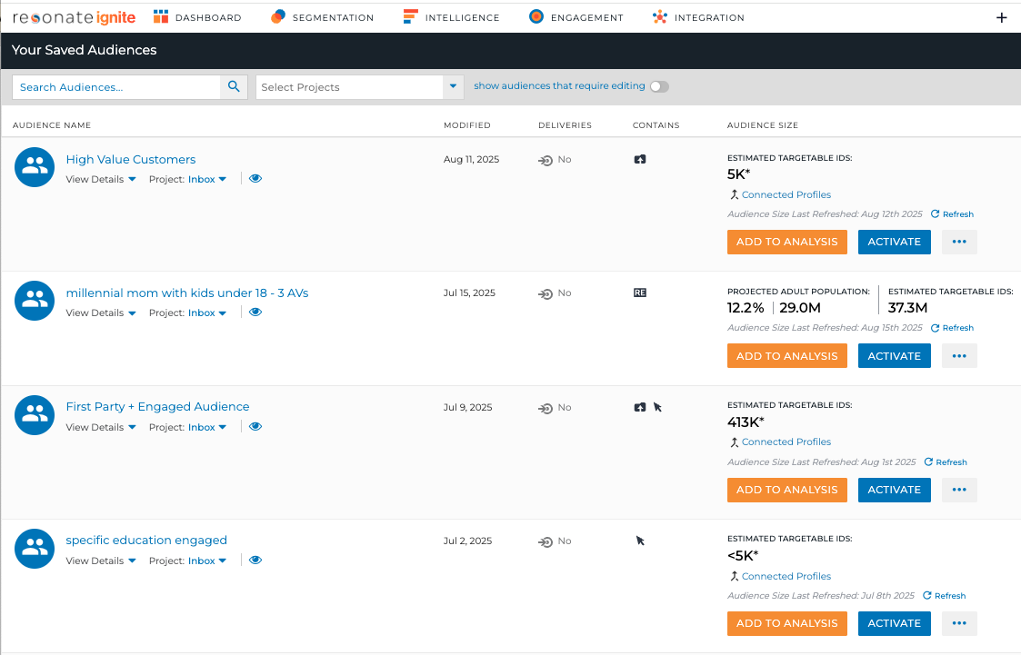
Activate audiences
List Icon - Audiences – Select Audience - Activate
Notes:
You can activate your audiences from the Your Saved Audiences page. Get there by clicking the list icon then audiences, then find your audiences and click the Activate button.

Slide 8
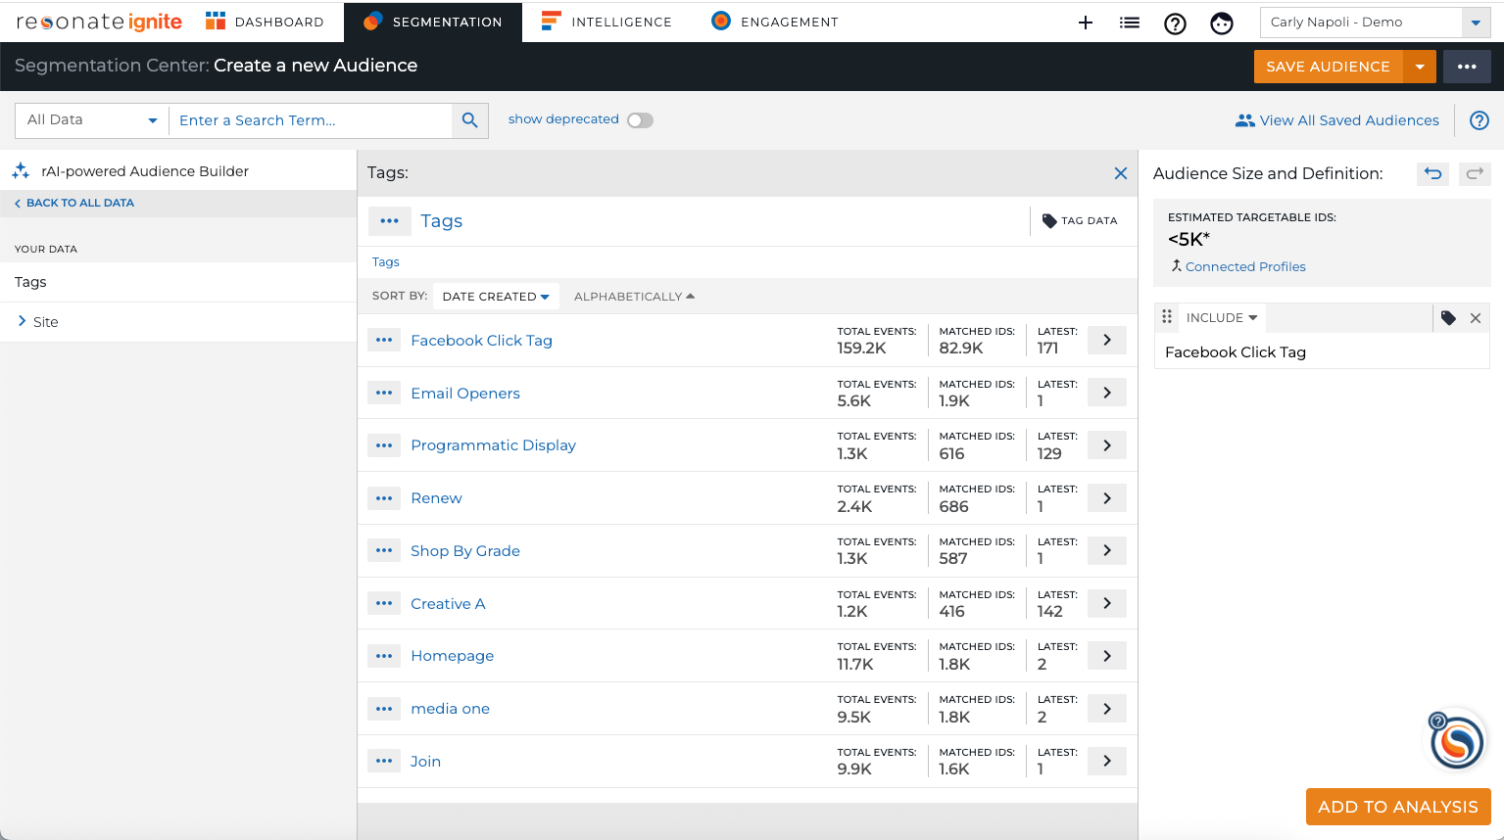
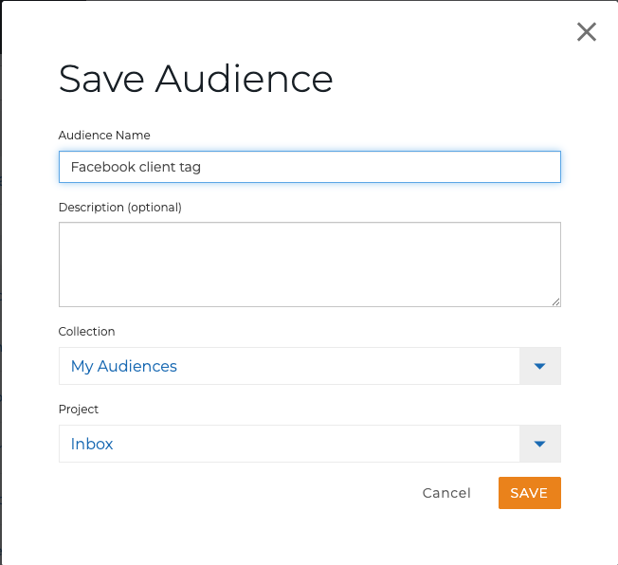
Activate a tag audience – step 1
Save Tag as Audience before Activation
Segmentation - select Tags in Taxonomy
Find your Tag, add to Audience Definition
Click Save
Name new Tag audience
Note: You CAN combine Tag + Survey data for activation for increased precision
  For ex, males coming to your home page
  Pro Tip: To Activate a Tag, you must first save it as an audience.

Slide 9
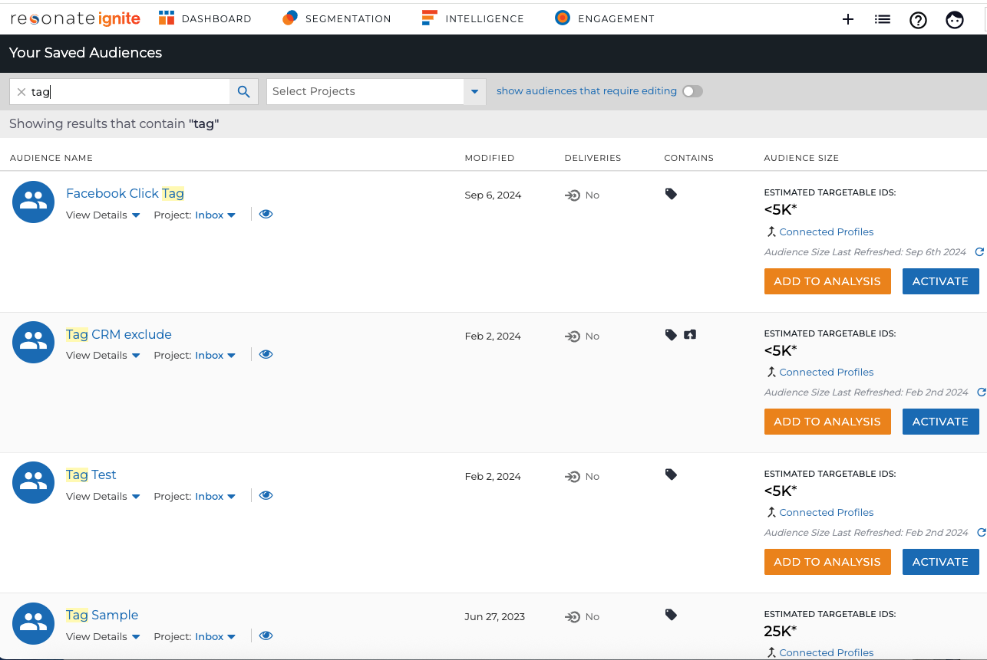
Activate a tag audience – step 2
How to activate your audience
Navigate to Your Saved Audiences page - Click the List icon –tags
Scroll or search for the audience you want to activate
Hit the Activate button

Slide 10
Configure and manage an audience delivery

Slide 11
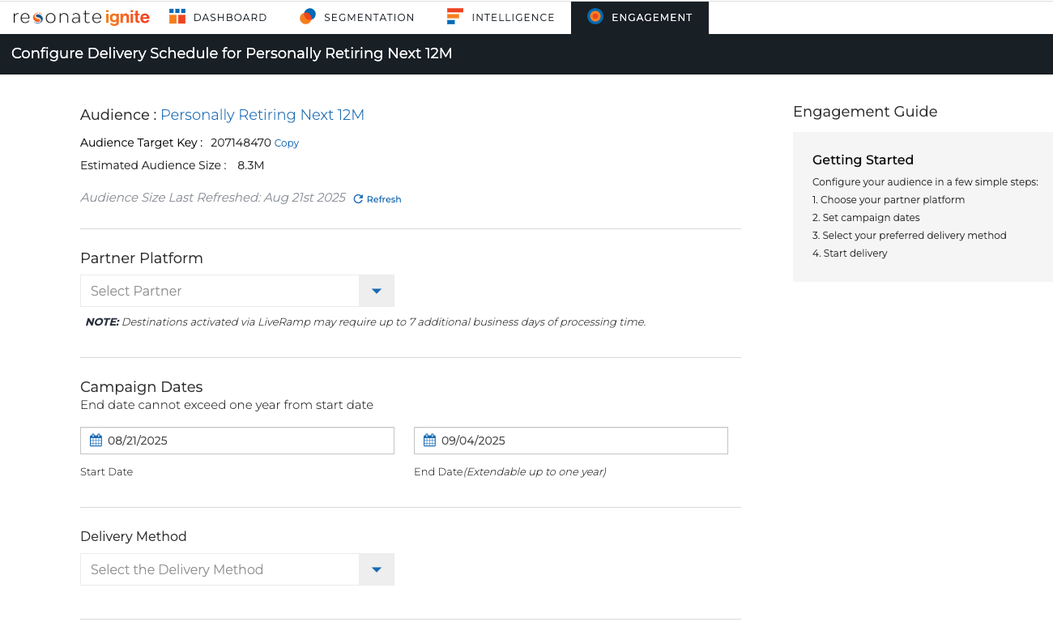
Configure audience delivery schedule for audiences built with Resonate Elements
Configure the Audience Delivery Schedule:
Choose Partner
Select Start and End Dates
Enter Segment ID
Click Start Delivery

Slide 12
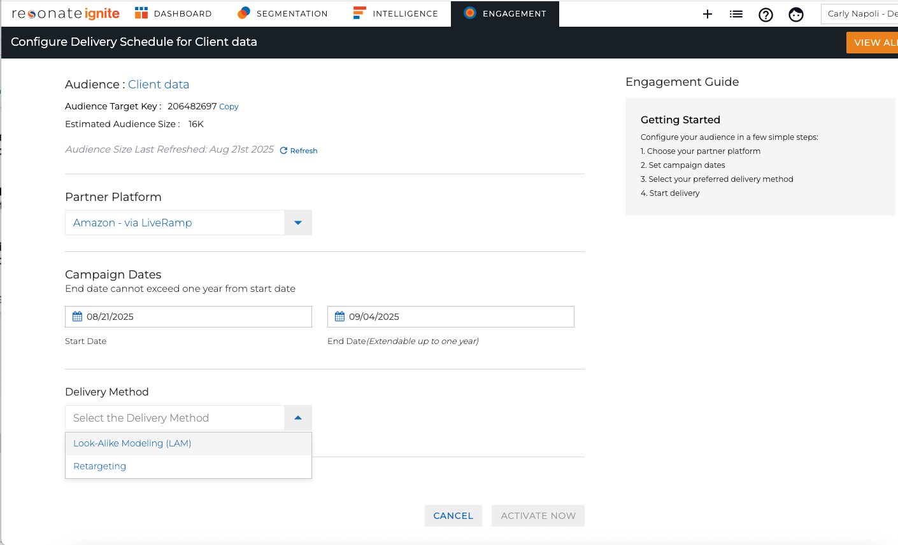
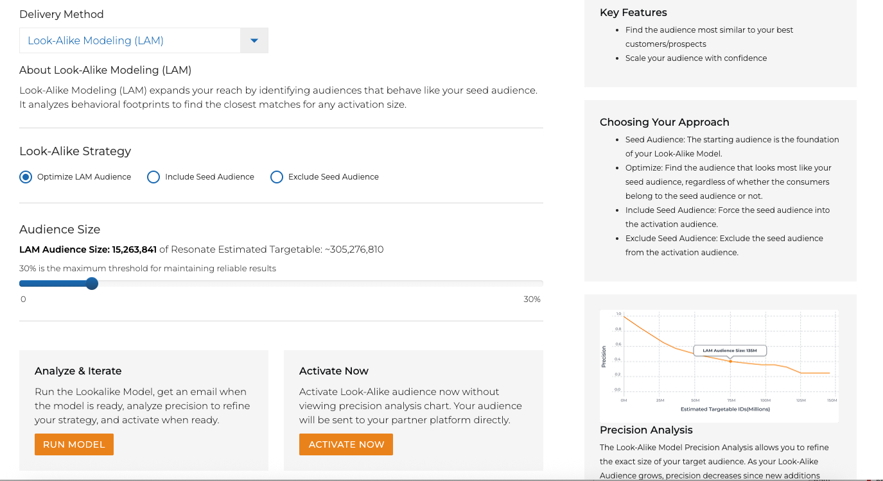
Tag and first-party audience audience delivery methods
Select from two delivery methods:
Retargeting:
  Based on past observed behaviors
  Retargeting people who were served the tag in the past 30 days
Look-Alike Modeling (LAM)
  Target people who look similar to the selected audience

Slide 13
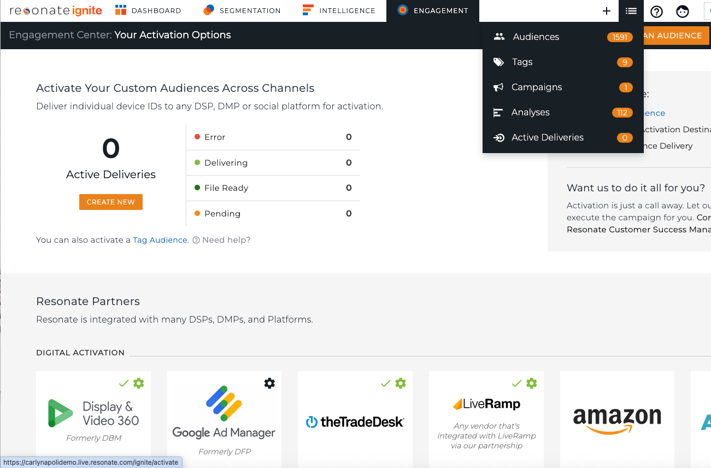
Manage deliveries
View your deliveries. You can do this in one of two ways:
Click List Icon – Deliveries
or
Click Engagement – View All Deliveries

Slide 14
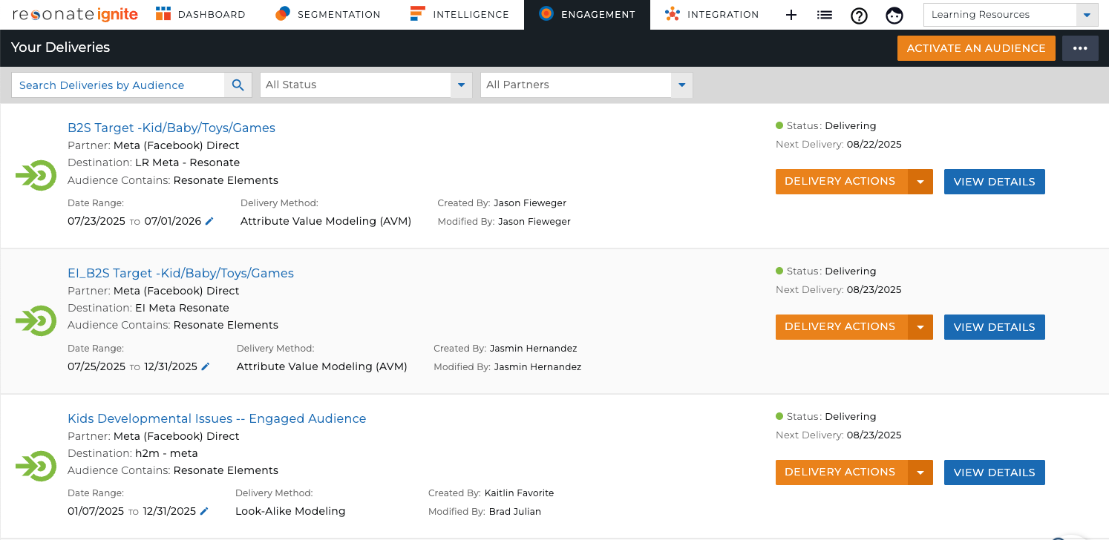
Your deliveries page
Locate the Audience on Delivery Page
Search by name, or filter by status or destination
Manage Deliveries
Errors will bubble to the top
View status: Completed, Delivering, Pending, Paused, Error
Stop/Pause/Resume Delivery
Edit Dates, View Details

Slide 15
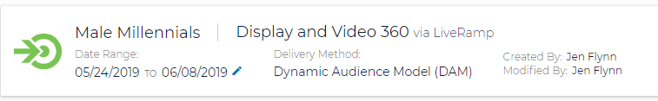
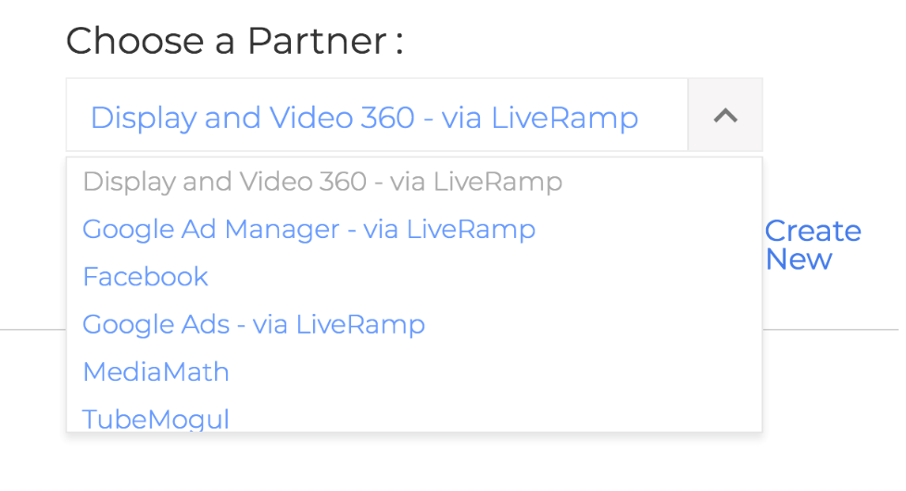
Multi-channel audience delivery
An audience can have several deliveries
Follow the steps for activation and select a different partner each time
Measure and compare the effectiveness of each channel using Audience Crosstab

Slide 16
Activate an audience on Meta

Slide 17
Meta delivery options
Resonate enables activation to Facebook in three ways:
Meta (Facebook) Direct (Recommended)
                See this article on how to set Resonate up as a Business Partner in Meta: https://support.resonate.com/hc/en-us/articles/21483820640663-Adding-Resonate-as-a-Business-Partner-in-Meta-Facebook-BETA
              See this article on how to Set up Meta Delivery in Ignite Platform: https://support.resonate.com/hc/en-us/articles/22328111080727-Setting-up-Meta-Facebook-Delivery-in-Ignite-Platform-BETA
Social MAID List Upload
See this article for how to upload the data here: https://support.resonate.com/hc/en-us/articles/115005526463-How-to-Activate-in-Facebook
LiveRamp Integration
See the article for how to activate via LiveRamp here: https://support.resonate.com/hc/en-us/articles/17655123791127-How-to-activate-to-Facebook-via-LiveRamp-

