Slide 1
Resonate Client Training
Audience Building​
Build your Custom Audiences or Personas for Research and/or Activation

Slide 2
Audience Building
Pre-Requisites for this Module
Getting Started: Orientation- Getting Your Resonate Account Configured for Success

Slide 3
In This Module You Will:
Build a basic Audience of Male Millennials
Create an Audience in Segmentation Center
Use rAI-powered Audience Builder
Search and Add the Relevant Attributes to your Audience Definition
Understand Audience Metrics and Save Your Audience
Build a more sophisticated Audience of Sporty Male Millennials who don’t ski
Add additional attributes
Use AND/OR logic build your precision audience - ANDs, ORs, Excludes
Learn about using Geography data
Learn where to Manage Audiences and how to create Audiences with “Save as”
Understand Limited Attributes

Slide 4
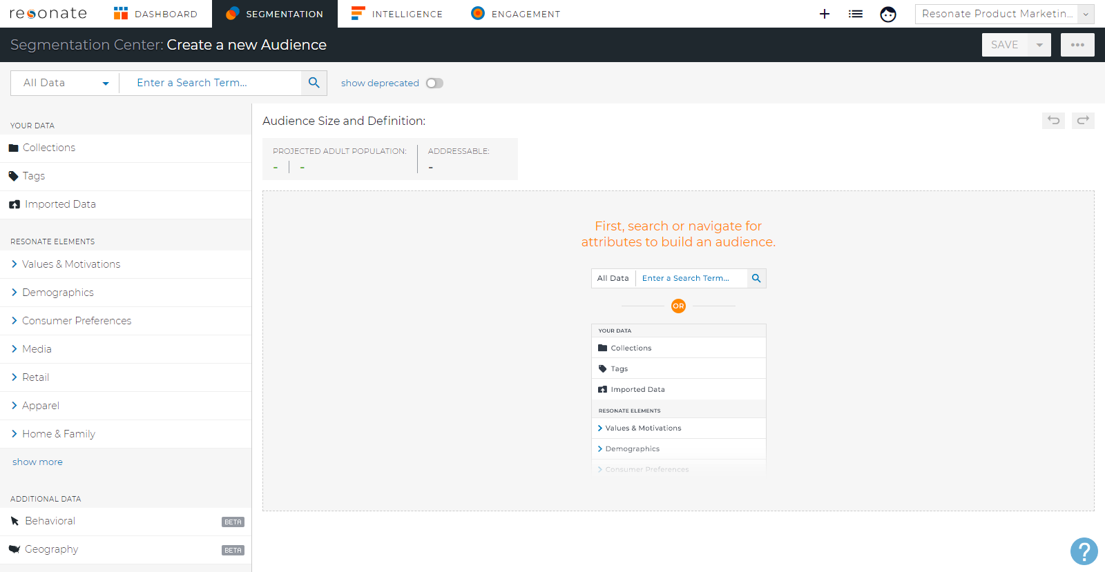
Create an Audience in Segmentation Center
An Audience is a specific group of people defined by attributes and can be used for research and activation. ​
Click Segmentation in top the navigation menu

Slide 5
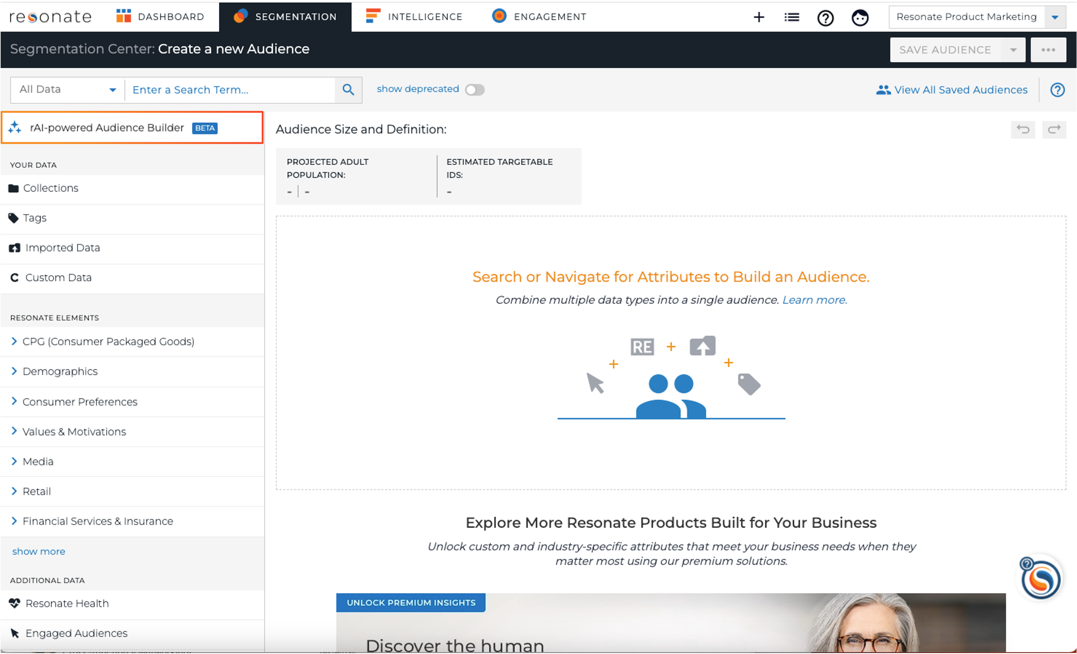
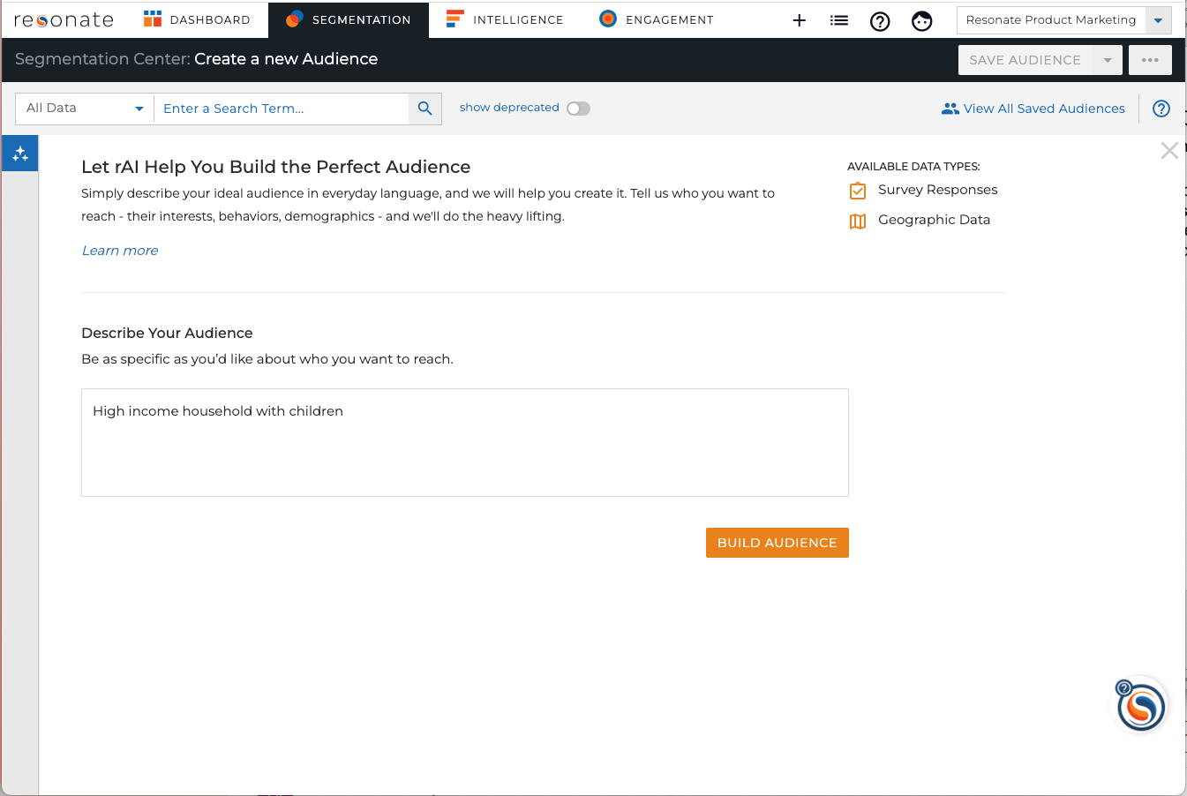
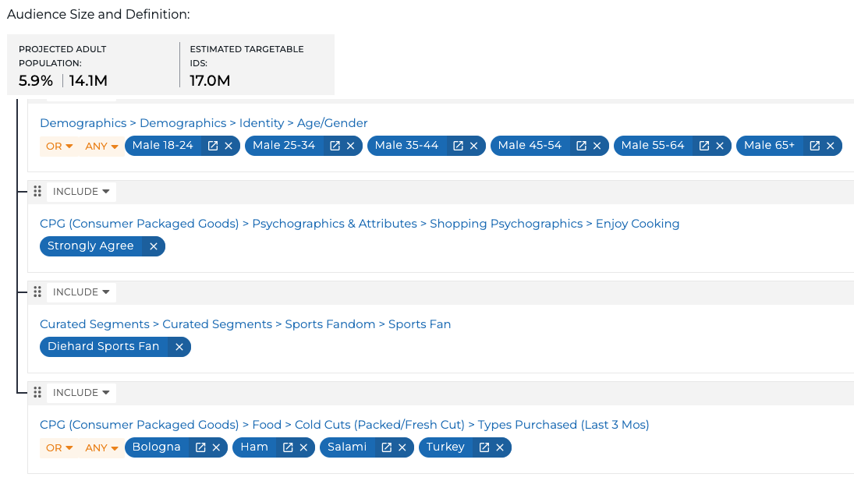
Use rAI-powered Audience Builder
Save time audience building by simply typing in plain English the audience you want to create.
Use broad value-based audience descriptions to help with discovery like ‘build an audience of people who like a lot of excitement in their lives’ which can be an aspirational audience used in developing a messaging strategy.

Slide 6
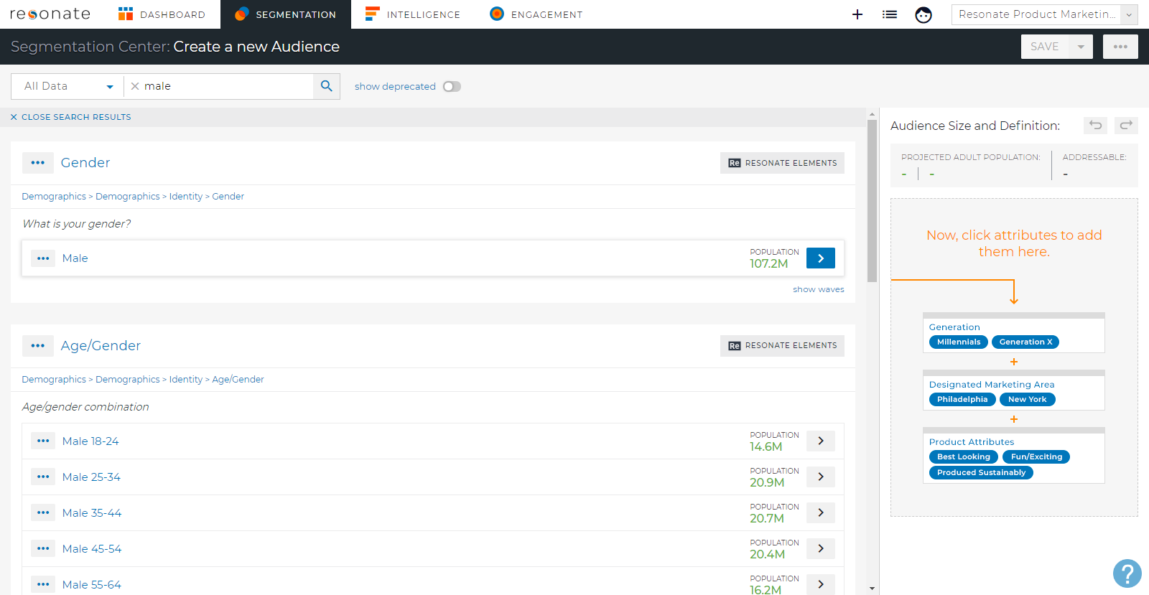
Search for Attributes
An Attribute is any individual trait or characteristic that you can use to define or understand an audience, ex. Male or Female.
We want to create an audience of Male Millennials.
Search for Male:
Type “Male” into the search box
Search is fastest
You can also navigate the taxonomy
Notes:
Search for Male:
Type “Male” into the search box.
Search is the quickest way to find attributes.
You can also navigate the taxonomy in the left panel to find attributes.

Slide 7
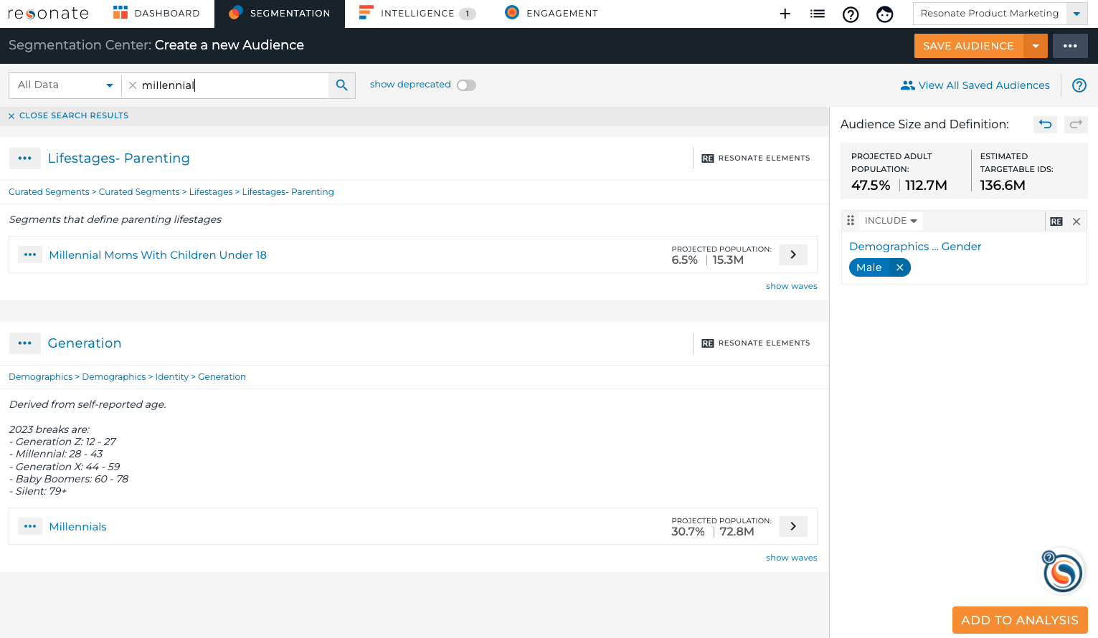
Add the Relevant Attributes
Click on Male
Include in your Audience Definition
Audience Size updates as you add Attributes
Note Breadcrumb under Attribute name
Search for Millennials
Include in your Audience Definition
Pro Tip: Millennials are born between 1981 – 1996 and are ages 23-38. See what ages define each generation.
Notes:
Click on an attribute to add it to your audience definition in the right hand panel
As you add attributes to your audience definition, the audience size updates!

Slide 8
Understanding Audience Metrics
Our data updates nightly, so these numbers may fluctuate
Projected Adult Population: The number of unique people in the audience. The percentage represents the share of the total online adult population (18+) that fall into your audience definition.
Estimated Targetable IDs: Estimated Targetable is the available number of IDs within Resonate’s ID Graph that can be activated for this audience
Our Male Millennial Audience 47.5% of the total U.S. Online Adult Population (OAP) which is 112.7M people that we’ve seen across 136.M modeled devices.
Pro Tip: We recommend keeping audience sizes between 2% - 15% of the Projected Adult Population.
Notes:
Projected Adult Population: The number of unique people in the audience. The percentage represents the share of the total online adult population (18+) that fall into your audience definition.
Estimated Targetable IDs: Estimated Targetable is the available number of IDs within Resonate’s ID Graph that can be activated for this audience
Pro Tip: We recommend keeping audience sizes between 2% - 15% of the Projected Adult Population. 2% indicates the point at which wide-scale strategic investments can have an impact, while 15% indicates the point at which an audience may start to look like the rest of the population.

Slide 9
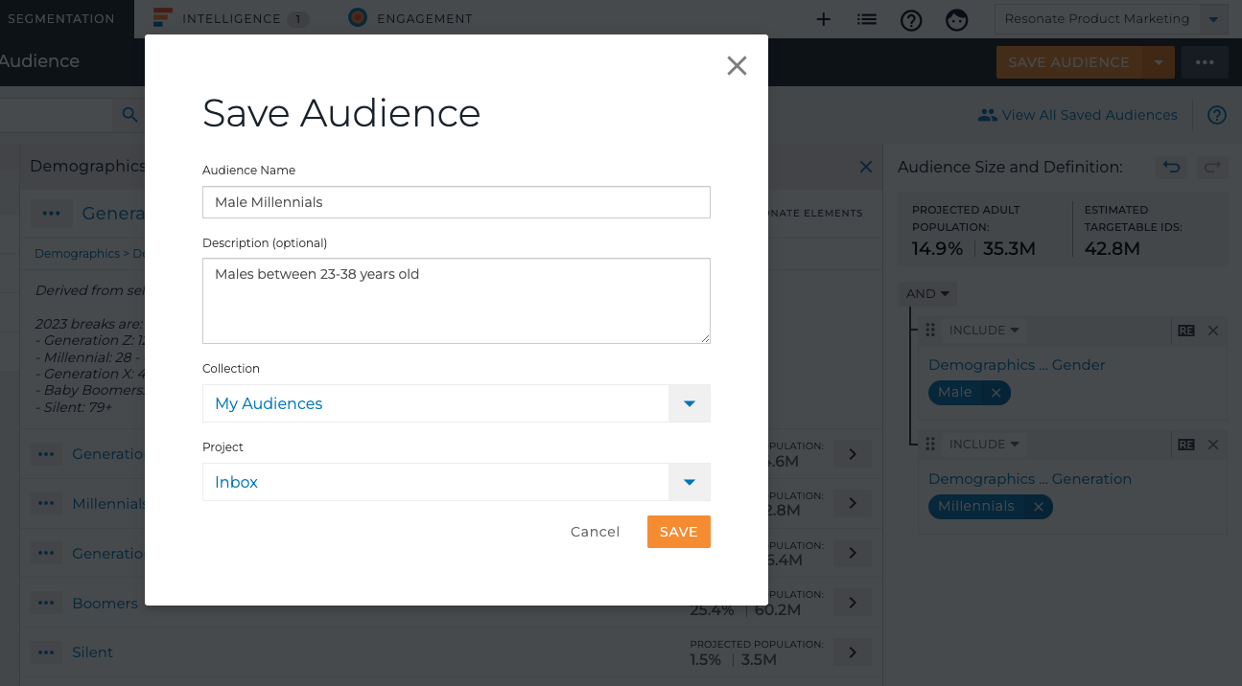
Save Your Audience
Click on the Save Audience button in the top-right corner
Give your audience a name
Optionally provide a description
Save to the default My Audiences Collection
Save to the default Inbox Project
Pro Tip: Your Saved Audiences are visible to other users in your account. You can rename or delete audiences at any time.
Notes:
Click on the Save button in the top-right corner
Give your audience a name – you can call it “Test” for now, and you can rename it or delete it later.
Optionally provide a description, like “Males between 25-34”
Save to the default My Audiences Collection
Save to the default Inbox Project
Saved Audiences are visible to other users in your account.

Slide 10
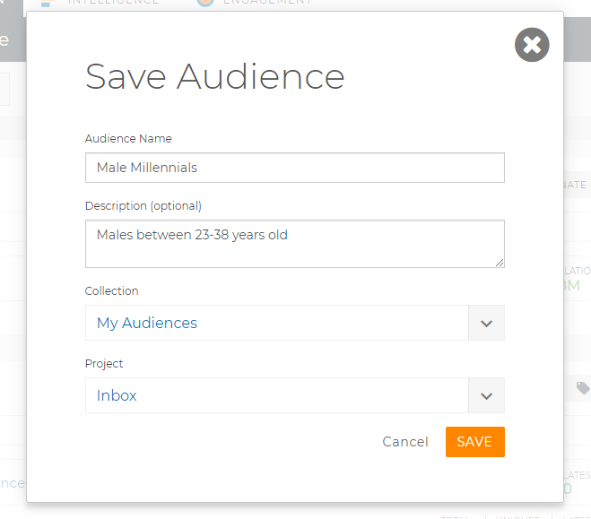
Collections & Projects
When you save an audience, you’ll save it to a collection and a project.
Collections: A place to save audiences and attributes. The default collection is My Audiences.
We’ll learn more about Collections in a bit.
Projects: A way to group and filter your audiences, tags and analyses. The default project is Inbox. Client Admins can create additional projects.
Notes:
When you save an audience, you’ll save it to a collection and a project.
Collections: A place to save audiences and attributes. The default collection is My Audiences.
Later, you’ll learn how to create collections & save attributes to collections to help you save time when audience building and when analyzing audiences.
Projects: A way to group and filter your audiences, tags and analyses. The default project is Inbox. Client Admins can create additional projects.

Slide 11
Easy Right? Let’s Get More Sophisticated
Add Attributes, and play with Audience Logic: ANDs, ORs, Excludes, etc

Slide 12
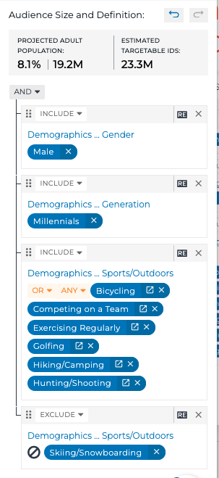
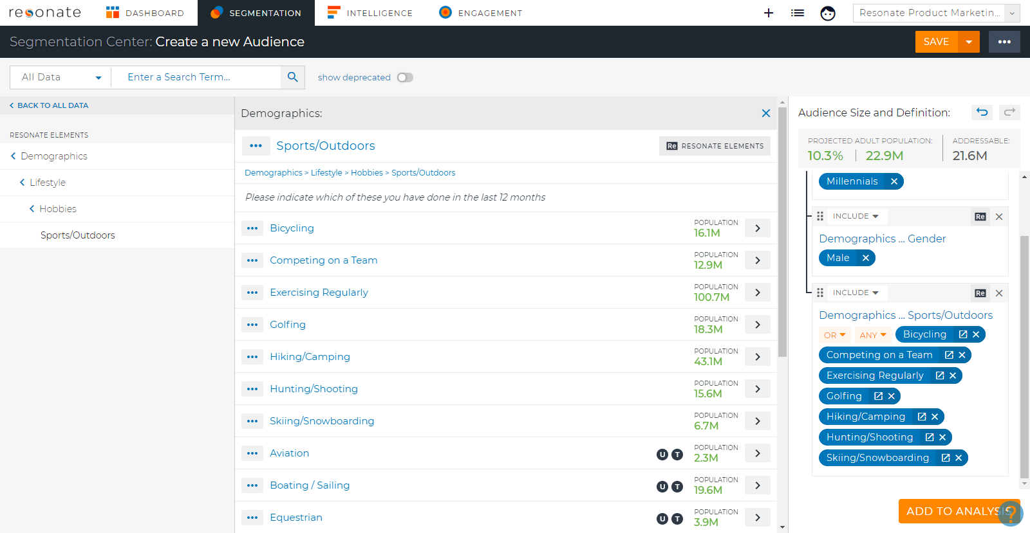
Create a Male Millennial Audience who is Sporty, but doesn’t Ski/Snowboard
Navigate the Taxonomy
Demographics – Lifestyle – Hobbies – Sports/Outdoor
Add Bicycling, Competing on a Team, Exercising Regularly, Golfing, Hiking/Camping, Hunting/Shooting, Skiing/Snowboarding
By default, attributes are added as ANDs and attribute values from the same attributes are grouped together as ORs
Notes:
Now let’s create a male millennial audience who is sporty, but doesn’t ski or snowboard.
Go to Create – Create an Audience.
Search for Male
Add Male 25-34
In the left taxonomy, click Demographics – Lifestyle – Hobbies – Sports/Outdoor. Alternatively you could search for Sports.
Add Bicycling, Competing on a Team, Exercising Regularly, Golfing, Hiking/Camping, Hunting/Shooting and Skiing/Snowboarding.
Audience size is 6.5% of the population, 11.8M people
By default, attributes are added as ANDs, and like attributes are grouped together with OR.

Slide 13
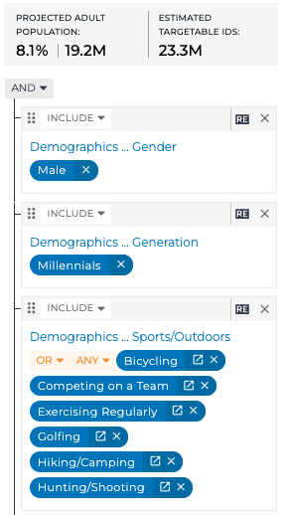
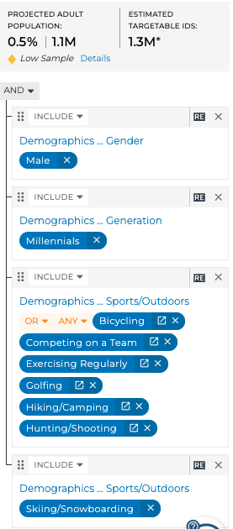
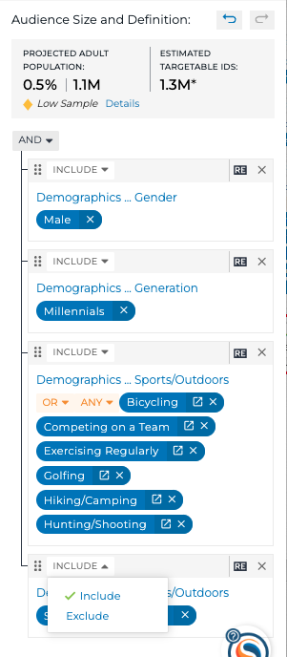
Exclude Skiing
Click Split Attribute icon on Skiing/Snowboarding
Skiing/Snowboarding is split out on it’s own
Click Include and switch to Exclude
Male Millennials who do any of the following: bike, compete on a team, exercise regularly, golf, hike/camp, or hunt/shoot, or ski/snowboard.
Male Millennials who do any of the following: bike, compete on a team, exercise regularly, golf, hike/camp, or hunt/shoot
AND ski/snowboard.
Notes:
But we want to exclude the Skiing/Snowboarding attribute.
Click Split Attribute Icon on Skiing/Snowboarding.
It gets split out on it’s own group in the audience definition.
Notice how the Audience Size changed? 0.5%
To exclude this attribute from the audience definition, click OR, then Exclude OR.

Slide 14
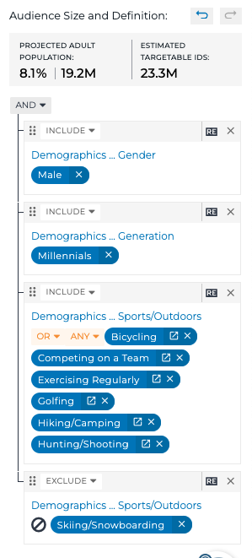
Sporty Male Millennials who don’t Ski
Reading an Audience Definition in English
Male Millennials who do any of the following: bike, compete on a team, exercise regularly, golf, hike/camp, or hunt/shoot
and don’t ski or snowboard.
Pro Tip: Always a best practice to read your finalized audience out loud in English!
Notes:
So now we have Male Millennials who do any of the following: bike, compete on a team, exercise regularly, golf, hike/camp, or hunt/shoot and don’t Ski or Snowboard. There are 6% of them.

Slide 15
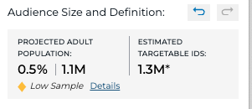
Audience Building Best Practices
Audience Size Rule of Thumb 2% - 15%
The lower threshold of 2% indicates the point at which a wide-scale strategic initiative can start to have some impact.
The upper threshold of 15% indicates the point at which an audience may start to look like the rest of the population, and there will be fewer insights that are clear and actionable differentiating that audience from the total population.
Always exceptions to this rule – use your best judgement.
Pro Tip: We recommend keeping audience sizes between 2% - 15% of the Projected Adult Population.

Slide 16
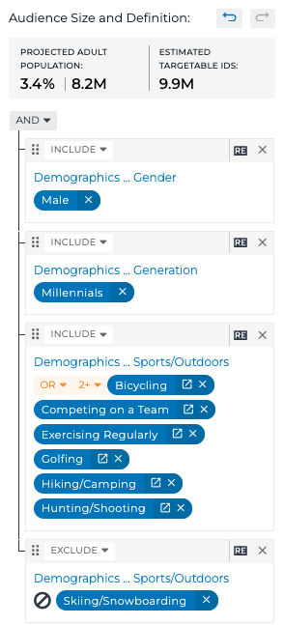
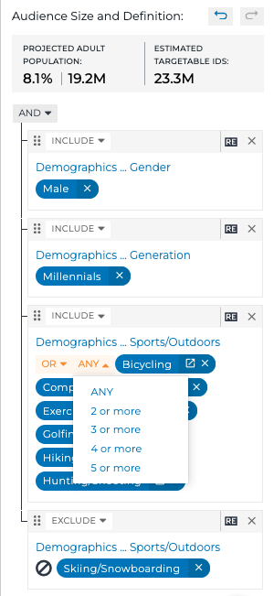
Make Audiences More Specific using Any, 2 or more, 3 or more, etc
Click Any – select 2 or more
New audience is 3.4%
Reading an Audience Definition in English:
Male Millennials who do 2 or more of the following: bike, compete on a team, exercise regularly, golf, hike/camp, or hunt/shoot and don’t ski/snowboard.
For now, put 2 or more back to ANY
Pro Tip: Use the Undo/Redo icons at the top of your Audience Definition

Slide 17
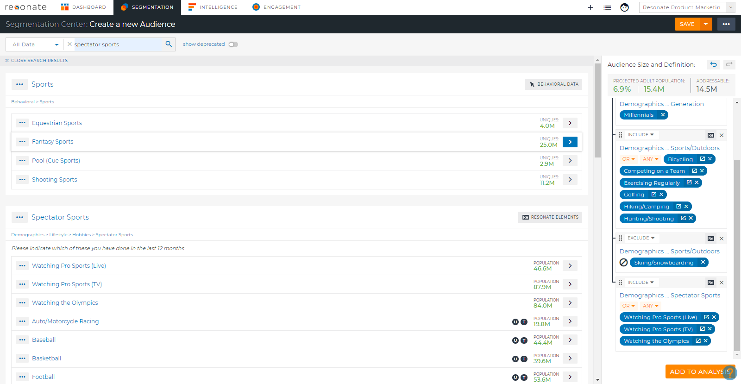
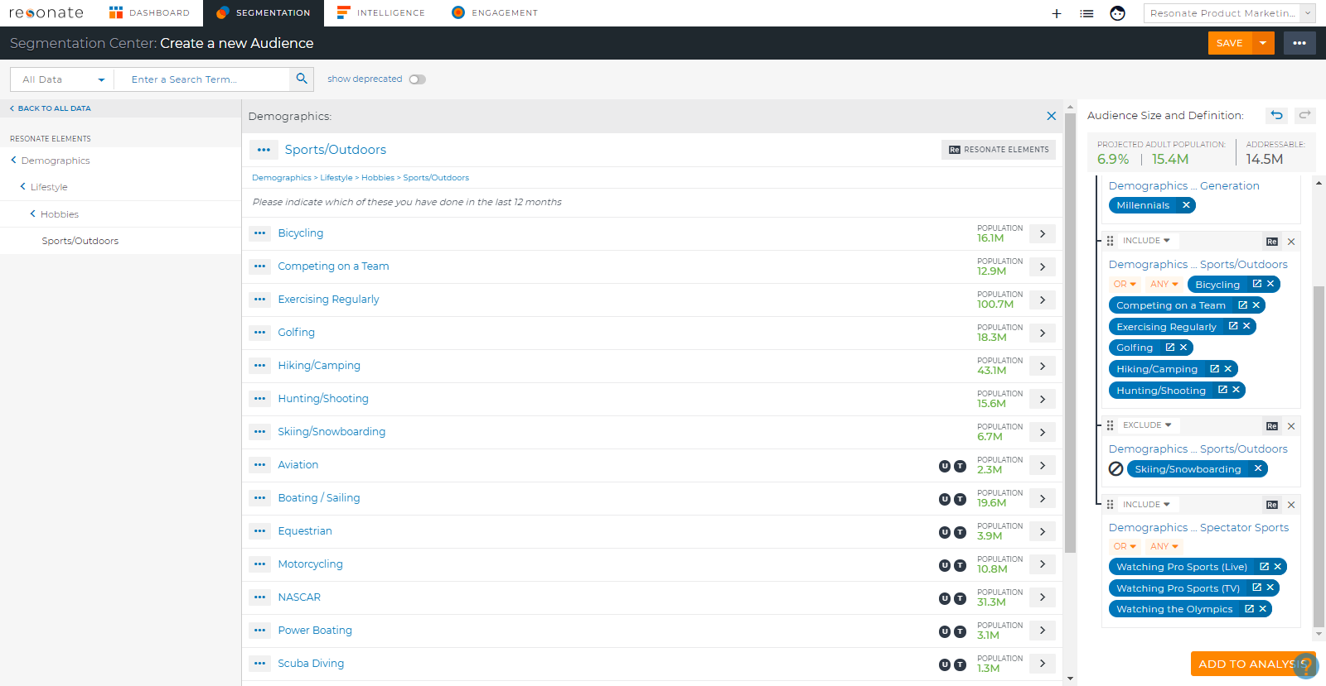
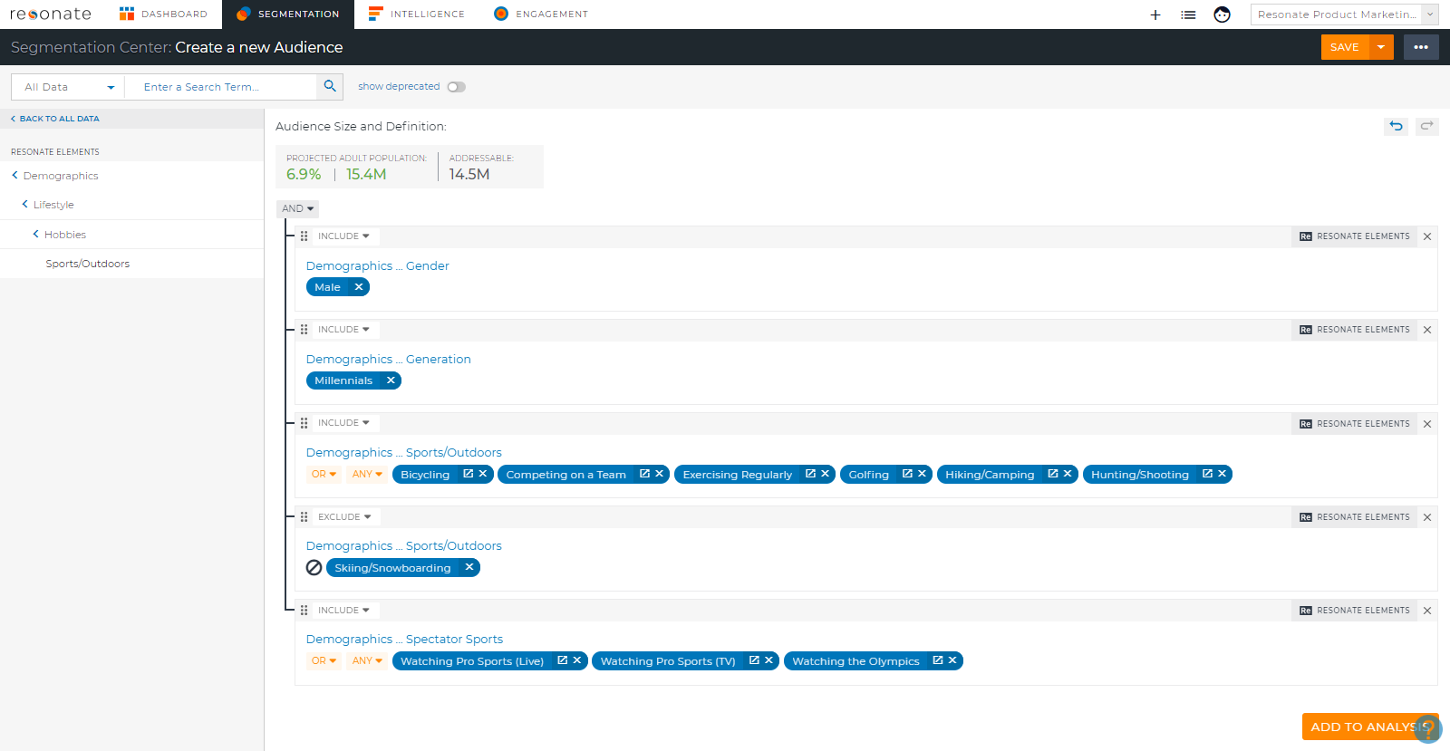
Creating More Complex Audiences
Search for Spectator Sports
Add Watching Pro Sports Live and on TV, and Watching the Olympics.
Click Close Search Results and then the X icon in the middle panel to expand your Audience Logic and see your Audience Definition full screen.
Notes:
Once you add attributes to your audience, you can toggle the AND/OR options to create more complex audiences as well as drag and drop to group attributes for more complex groupings.
Let’s add Watching Spectator Sports to our audience definition
Search for Spectator Sports
Pro Tip: click the arrow icon next to “Audience Size and Definition” to see your audience definition full screen.

Slide 18
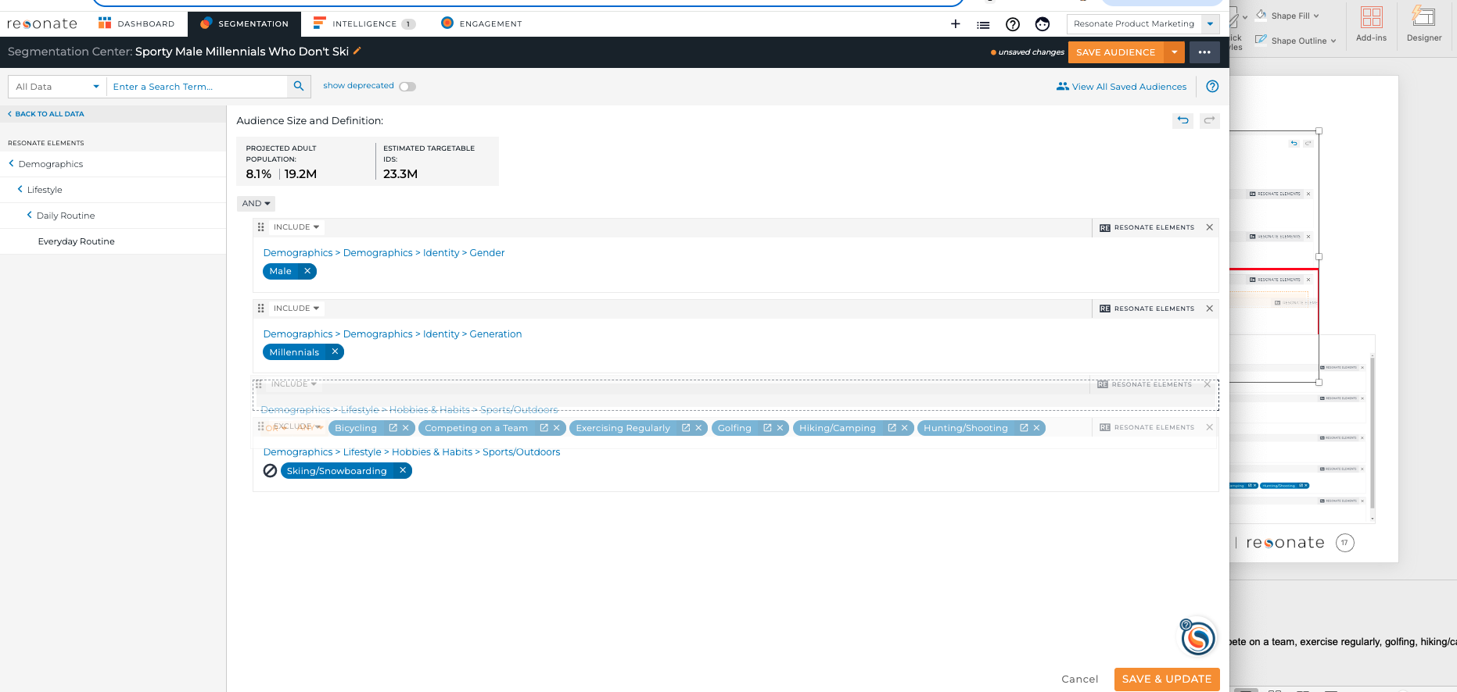
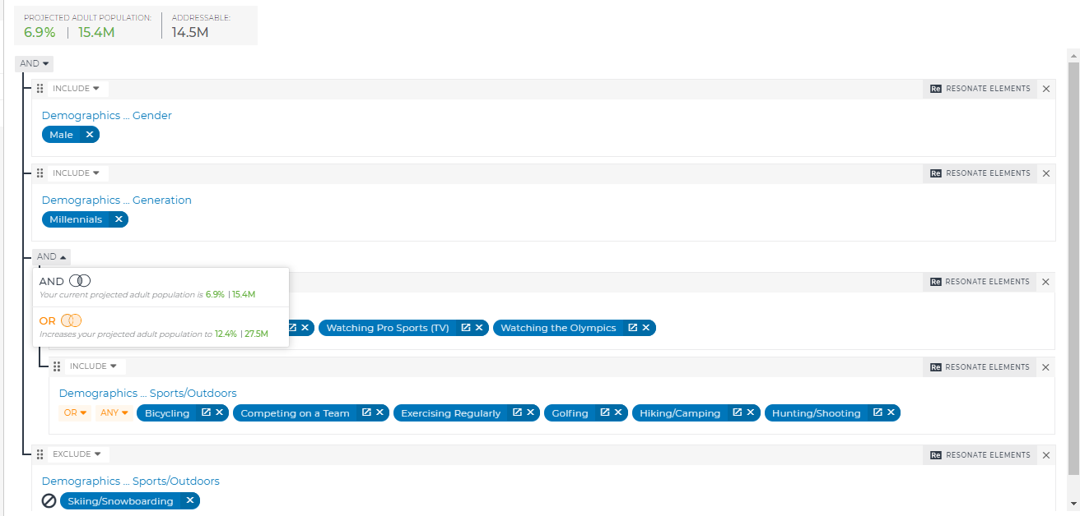
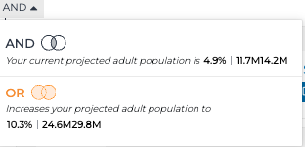
Drag and Drop
Drag the Spectator Sports group and Drop into the included Sports/Outdoors group.
Flip the AND at that grouping to OR
Notice the audience size preview and helpful venn diagram!
Notes:
and drag and drop to group them with the sports/outdoor attributes.
Then toggle the AND to OR.
Now our audience definition reads as: Male Millennials who do any of the following: watch pro sports live or on TV, watch the Olympics OR do 2 or more of the following: bicycling, compete on a team, exercise regularly, golfing, hiking/camping or hunting/shooting but NOT Skiing/snowboarding.

Slide 19
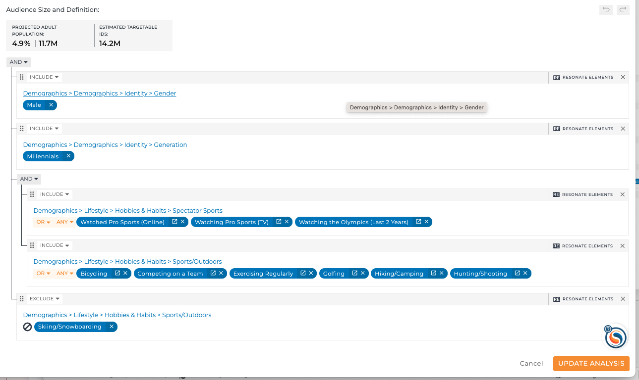
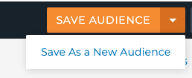
Save Audience
Read in English:
Male Millennials who do any of the following: Watch Pro Sports Live, Watch Pro Sports on TV, Watch the Olympics, OR any following: bike, compete on a team, exercise regularly, golf, hike/camp or hunt/shoot but don’t ski or snowboard
Save the audience as Sporty Male Millennials who don’t Ski
Pro Tip: Use the “Save As a New Audience” feature when building similar audiences to save time Audience Building!

Slide 20
Recap: Using AND/OR logic to build precision audiences
Attributes are AND’d together by default
Attribute values in the same attribute are OR’d together by default
Can toggle ORs to ANDs and vice versa
Can Exclude Attributes
Can define Any, 2 or more, 3 or more, 4 or more
Drag and Drop to Group Attributes

Slide 21
Managing Audiences

Slide 22
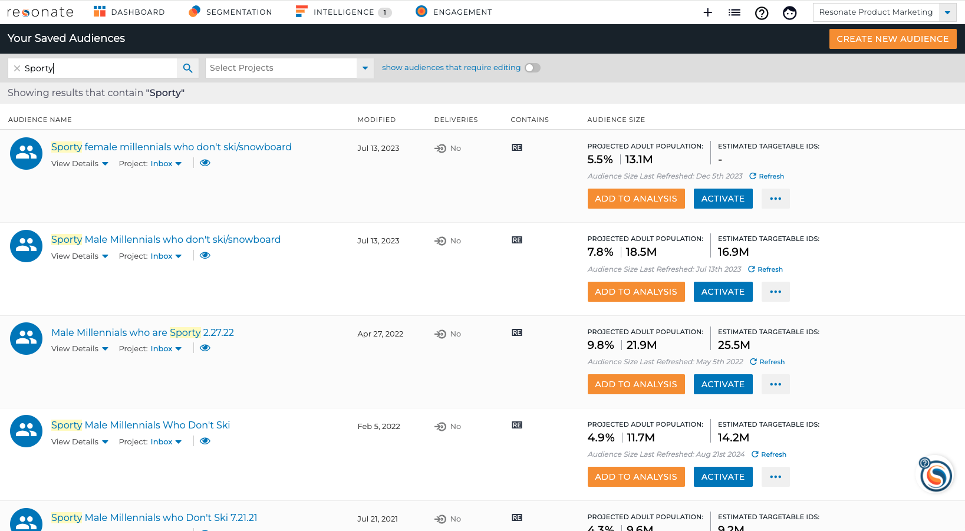
Manage Saved Audiences
List Icon – Audiences
Most recently saved audiences are at the top
Search by Audience name or filter by Projects
Easily Add to Analysis or Activate
Ellipsis menu: Edit name or description, clone, delete, View Audience, Export
View Details: See who created the audience and when
Notes:
To view, edit, rename, clone, delete your audiences, go to Manage – Audiences.
Here you’ll be able to search for your Audiences, or filter by Project
From here you can easily Add the audience to an analysis, activate on the audience,

Slide 23
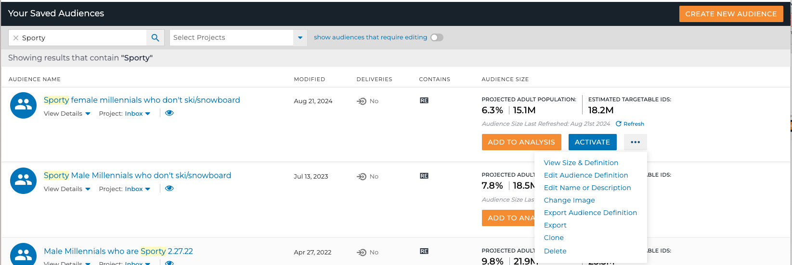
Short Cut: Create an Audience with "Save As a New Audience"
List Icon – Audiences
Search for Sporty
Find Sporty Male Millennials who don’t ski
Ellipsis button – View Size & Definition
Pro Tip: Use the “Save As a New Audience” feature when building similar audiences to save time Audience Building!
Notes:
A huge time-saver for our clients is using "Save as" to create new audiences from existing ones.
Remember our sophisticated Sporty Male Millennials who don’t ski? Let’s use "Save as" on them to turn them into Sporty Female Millennials who don’t ski.
We’ll go to Manage – Audiences
Search for Sporty and find our Sporty Male Millennial audience.
Click the More button icon – then View Audience
You’ll be taken to the Audience Builder

Slide 24
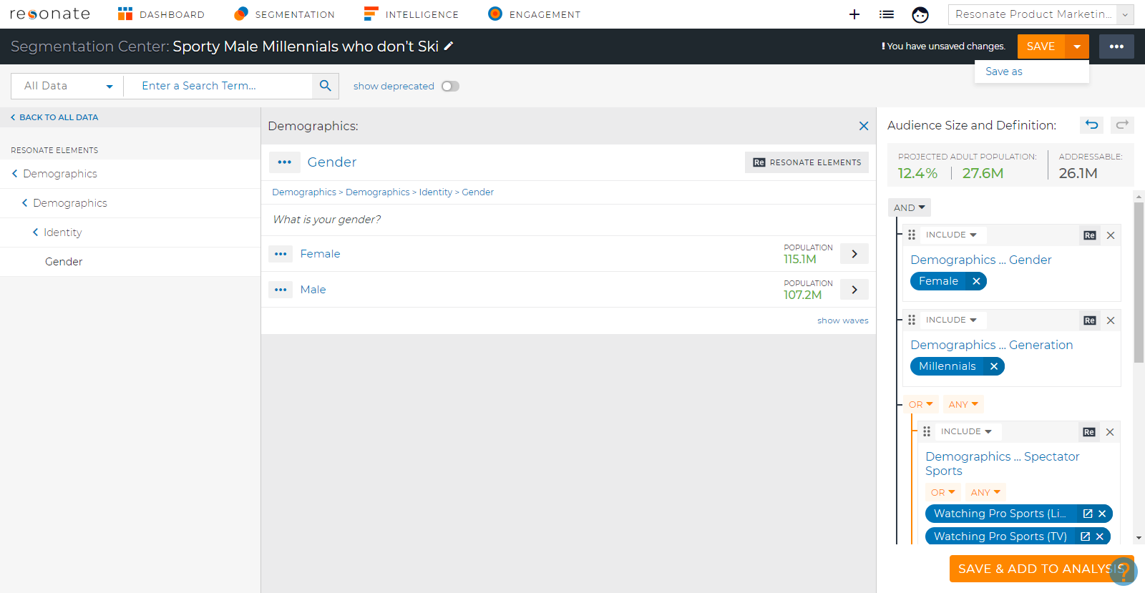
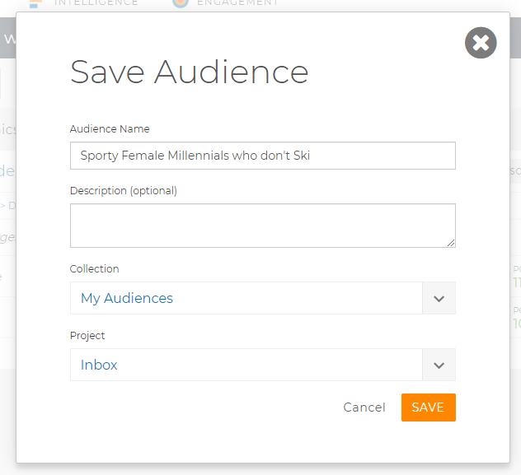
Swap Male for Female
Click Demographics… Gender in audience definition
Add Female
Remove Male
Save Audience down arrow – Save As a New Audience
Pro Tip: Clicking on the Attribute name in the audience definition brings you to that spot in the taxonomy and saves you time when audience building!
Notes:
In the Audience Builder we can easily swap out Male 25-34 for Female 25-34.
Click Age/Gender in Audience Definition. This is another time-saver! Clicking on the name of the Attribute in your audience definition will show all the corresponding attribute values in the middle panel.
Add Female 25-34
Remove Male 25-34
Click on the down caret by the Save button – click “Save As”
Name your new audience – Sporty Female Millennials who don’t ski.
Your new audience will be shown at the top of the Your Saved Audiences page.

Slide 25
Understanding Limited Attributes

Slide 26
Limited Attributes
Some attributes are Limited
Limited attributes can only be combined with other Resonate Elements in audiences
Limited attributes denoted with L icon
You CAN activate on a limited attribute
You CANNOT see limited attributes as insights against a Tag Audience
Notes:
Attributes are limited when our data science team cannot create a predictive model that enables us to predict insights or combine attributes with other data types beyond Resonate Elements when audience building.

Slide 27
Why are Attributes Limited
There are 3 main reasons why certain attributes are limited
3rd party - we do not create predictive models on 3rd party attributes
Low Sample - an attribute value that has not enough survey responses for our data science team to develop a predictive model
Too many single select options for a survey question which prevents our data science team from creating a predictive model - but there are work arounds!
Individual Ages, ex, 18, 19, 20. a. Age Groups (ex. 18-24) are not limited, use this instead
Employment Industry a. Employment Status, Department, Role and Company size are not limited, use this instead
Notes:
Attributes are limited when our data science team cannot create a predictive model that enables us to predict insights or combine attributes with other data types beyond Resonate Elements when audience building.
There are 3 main reasons why certain attributes are limited:

Slide 28
Using Limited Attributes – Can Do’s
Be combined in an audience with Resonate Element attributes
Be saved in an audience to activate and ship to DSPs.

Slide 29
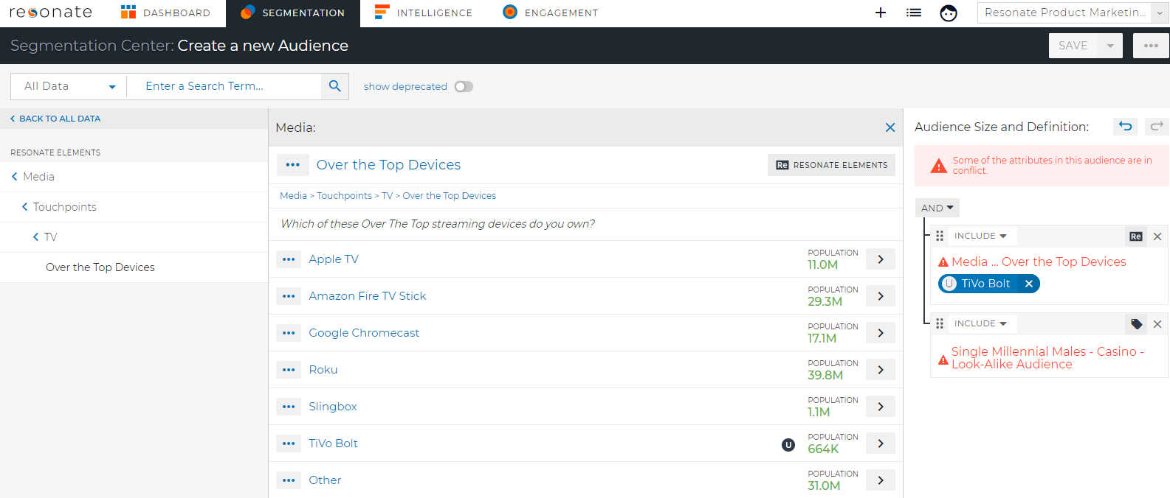
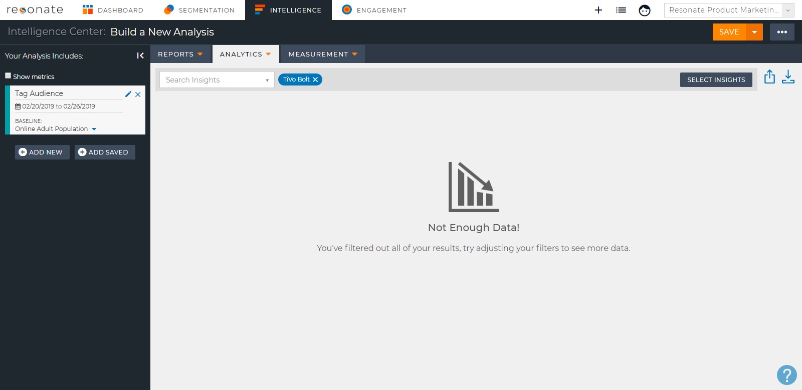
Using Limited Attributes – Can’t Do’s
Be combined in an audience with the following data types: Tag, Behavioral Attribute, 1st party data attribute, or 3rd party segment attribute.
Be seen as insights when analyzing an audience that contains any of the following data types: Tag, Behavioral, 1st party data, or 3rd party segment.
We recommend against using limited attributes in audience definitions that you wish to measure in Audience Crosstab, as limited attributes do not produce results when crossed with a tag.

Slide 30
Audience Building– Training Summary
What You Have Learned
Pro Tips
Build a basic Audience
Build a more sophisticated Audience
Using Geography Data
Manage Audiences
Save Audiences with ”Save As a New Audience”
Limited Attributes
Saved audiences are shared with other users in your account
Collections are also shared with other users in your account
Click Arrow icon in Audience Builder to expand Audience Definition to full screen
Using “Save As a New Audience ” is a big time saver
FAQs
For Additional Help
Q: What is the recommended audience size?
A: Our rule of thumb is 2% - 15% - but there are always exceptions, use your best judgement!
Q: What is your recommendation for Audience Logic (ANDs and ORs)?
A: Keep things AND’d together as a default, until you're comfortable with sophisticated audience building. And read the Audience Definition in English as a last step.
Check out these articles in the Resonate Knowledge Base
How do I create an Audience?
Audience Metrics and Addressable Audience
Creating a new Audience from an existing one (Save as & Clone an Audience)
Geography Data

Slide 31
Quiz!
What is the fastest way to find an attribute you’re looking for?
When attribute values are added to Audience Definition – is the default AND or OR?
What is the recommended audience size?
Where do you go to Manage your Audiences?
What can you NOT do with a limited attribute?
Can you activate an audience with a geo attribute?
Notes:
Use Search or rAI-powered Audience Builder
AND between attributes. OR’d together for attribute values in the same attribute.
5%-25%
Manage tab – Audiences
You cannot see a limited attribute as an insight against a Tag
Yes, but we recommend using the geo-targeting capabilities in your DSP for the most timely geo location data.

Slide 32
Next Up
Next Module:
Module 3 – Audience Analysis: Curated Reports – Quick Answers to Common Questions

