Slide 1
Resonate Client Training
Engaged Audiences –
Understand and Target based on Recent, Deterministic Consumer Behavior

Slide 2
Engaged Audiences
Pre-Requisites for this Module
Getting Started Module 1: Orientation
Getting Started Module 2: Audience Building - Build your Custom Audiences or Personas
Audience Analysis & Activation Module 1: Audience Analysis - Curated Reports - Quick Answers to Common Questions
Audience Analysis & Activation Module 4: Audience Analysis - Deep Analytics - Gain a Thorough Understanding of Consumers

Slide 3
In This Module You Will:
Understand the differences between Standard and Custom Engaged Audiences
Understand the source of Engaged Audiences
Learn how Engaged Audiences can help with both scale and precision
Learn how you can analyze Engaged Audiences
Activate Engaged Audiences

Slide 4
Why are Engaged Audiences valuable?
See who is reading and engaging with your business topics online
Gain a quick, real-time understanding of who is consuming content about your business topics online.
Understand these consumers with our 15K+ Resonate Elements to develop more relevant content and messaging and activate at scale.
Dive even deeper into topics relevant to your unique business with Custom Engaged Audiences using your own hyper-targeted keywords.

Slide 5
Standard vs. Custom Engaged Audiences

Slide 6
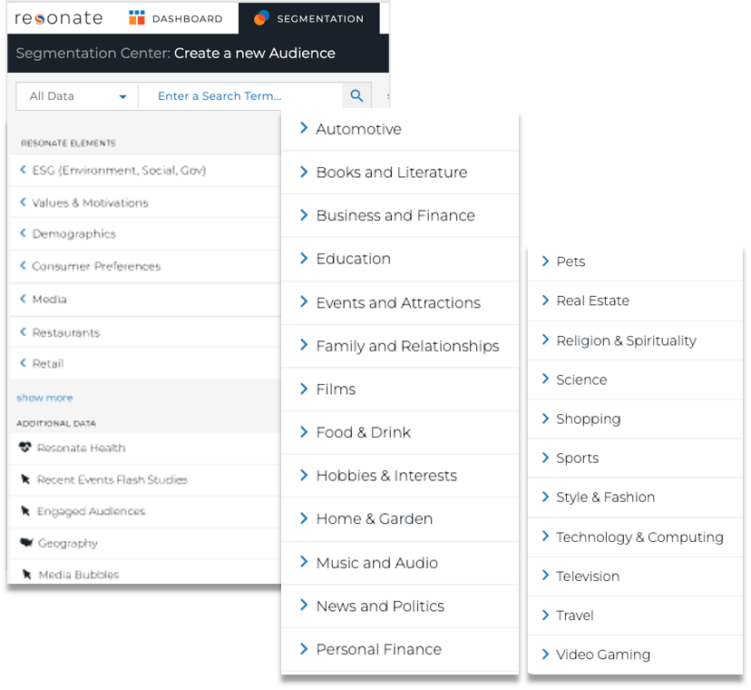
Standard Engaged Audiences
1,000+ Standard IAB Topics in Your Account
Standard Engaged Audiences are a set of 1,000+ topics available for all clients in the Resonate platform from Day 1
This data is extracted from our larger list of 30,000 topics in our behavioral data feed using Natural Language Processing (NLP)
We leverage the Interactive Advertising Bureau (IAB) taxonomy to curate the Standard Engaged Audiences in the platform

Slide 7
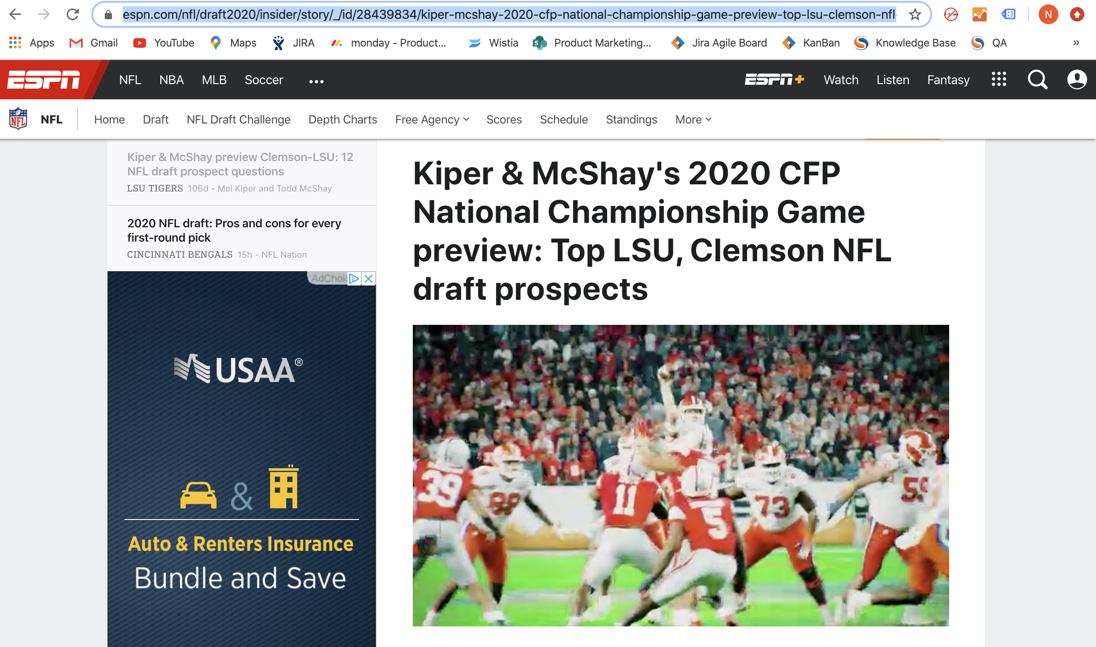
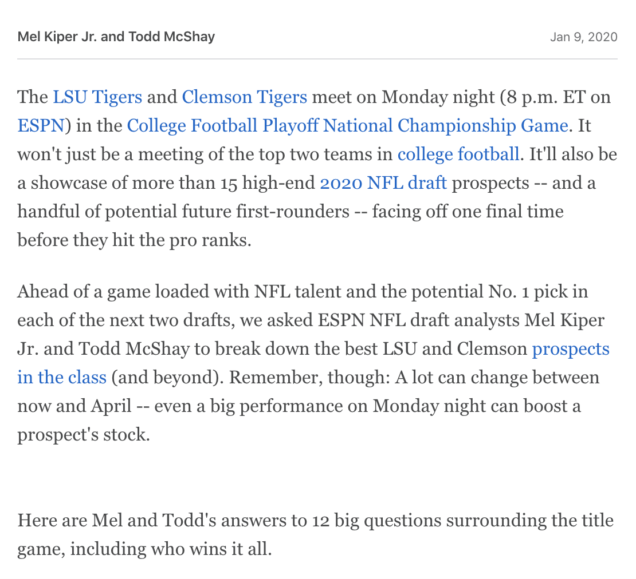
Custom Engaged Audiences
Use your custom, hyper-targeted keywords
https://www.espn.com/nfl/draft2020/insider/story/cfp-national-championship-game-preview-top-lsu-clemson-nfl-draft-prospects
The custom version of Standard Engaged Audiences using your custom hyper-targeted keywords specific to your business
Built from pulling keywords from singular URLs on ad supported sites
These audiences are created by Resonate and loaded into your Resonate account in 3-5 days. Monthly and one-time deliveries are available
URL Keywords

Slide 8
Standard vs. Custom Engaged Audiences
Item | Custom Engaged Audiences | Standard Engaged Audiences
Number of Audiences​ | Purchased with Professional Services | Unlimited​
Implementation Path​ | Call your Customer Success Manager Lead time typically 2 weeks | Self-serve Immediately available
Recency of Data​ | 30 days (typically)​ | 31 days​
Frequency of Data Refresh​ | Refreshed​ when requested by the client | Refreshed weekly​
Location in Platform​ | Loaded as a Tag​ into the client’s account by CSMs | In the taxonomy for audience building​
URL Level Analysis | Available as a custom Professional Services offering | Not Available

Slide 9
What is Standard Engaged Audiences?

Slide 10
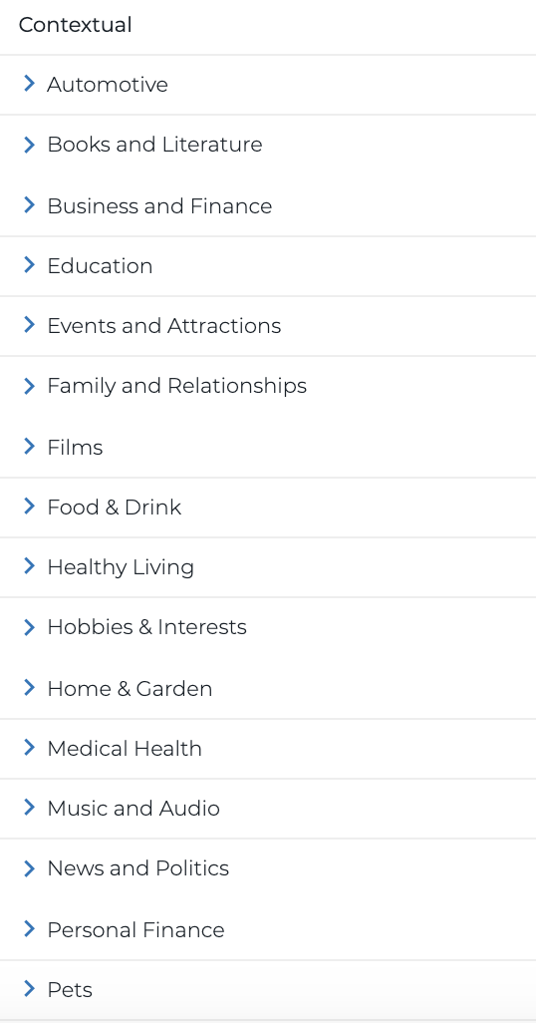
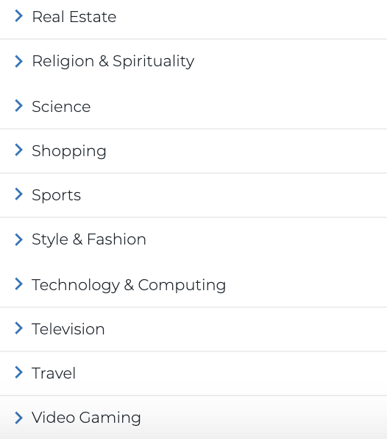
What are Standard Engaged Audiences?
What is it?
Static list of 1,000+ topics across 26 categories
Where does it come from?
From Resonate’s behavioral data feed that also informs our predictive models for Resonate Elements
Using Natural Language Processing (NLP)
Capturing consumers who recently viewed a topic
31-day look-back window refreshed every 7 days (typically late Friday night)
How do you use it?
Build audiences
Analyze - View survey-based insights
Activate
Notes:
We observe 30,000 behavioral topics via our behavioral data stream that helps inform our predictive models.
From our behavioral data feed, we used our Natural Language Processing (NLP) tool to extract a static list of 531 Behavioral topics that people are consuming online. These Behavioral attributes are then available in the platform to build audiences, view survey-based insights, and activate.
The list of Behavioral topics is static. Every 7 days we refresh the 30-day look-back window to capture people who recently viewed content about a topic.
Activate on audiences with multiple Behavioral attributes, including tags. Activating on a Behavioral attribute + Survey attribute is NOT currently possible, but coming soon.

Slide 11
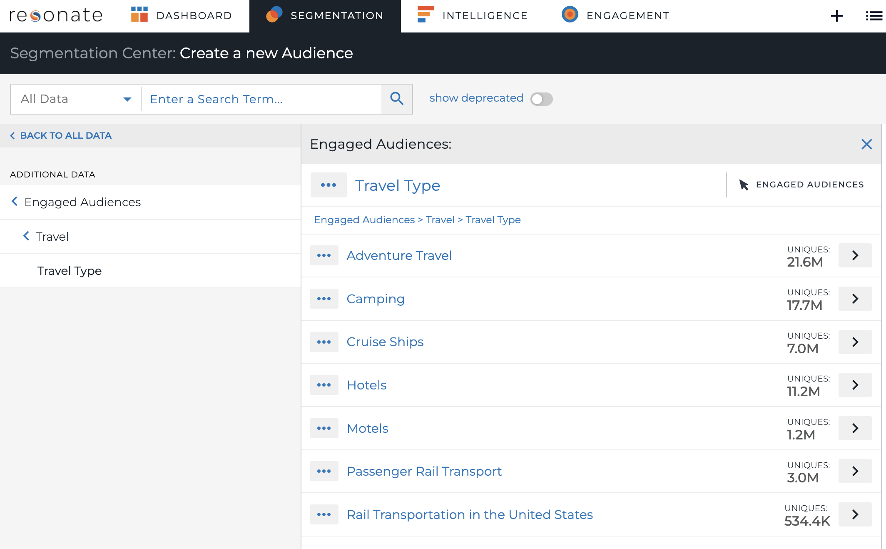
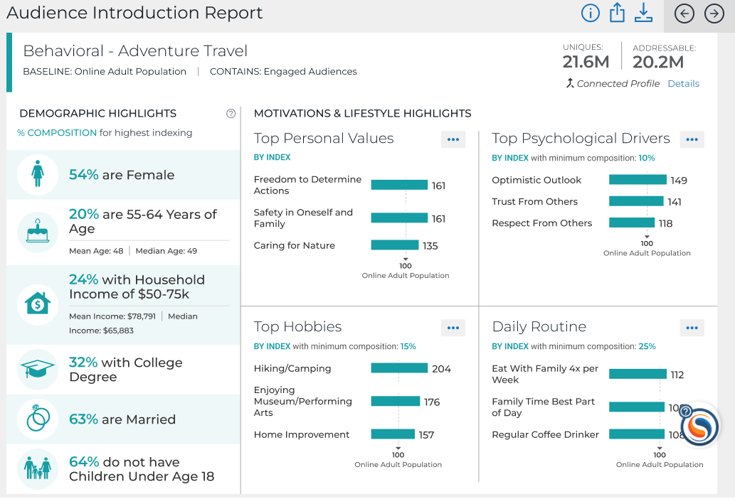
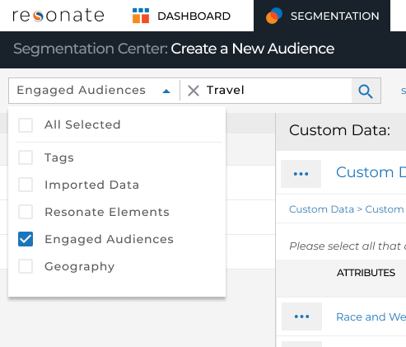
Recognizing Engaged Audiences
Breadcrumbs on Attribute Values and in Audience Definition
Engaged Audiences mouse pointer icon on Attribute Values and in Audience Definition
Search by data type
Curated Reports display data source
Notes:
Now let’s take a closer look at Behavioral Attribute Values.
The Resonate platform indicates when an attribute values is gained from our Behavioral data:
The breadcrumb below the attribute shows where in the Taxonomy the attribute is located
You will see a B icon, for Behavioral, by the name of an attribute values when it’s added to the Audience Definition
When searching, use the data source Filter to find Behavioral data values faster
The data sources are also displayed in our curated reports as well: In the screenshot above, you see the Audience Introduction Report informing you that your audience consists of Survey and Behavioral Data

Slide 12
The Benefits of Engaged Audiences

Slide 13
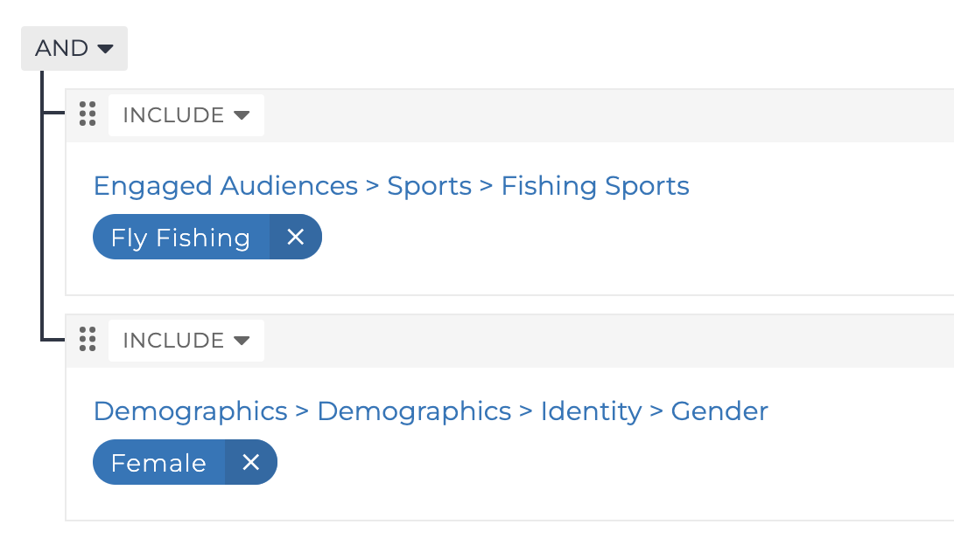
Create an Audience of Females who read about Fly Fishing
Create – Create an Audience
Search for Fly Fishing
Search for Female
Save Audience as Females Reading about Fly Fishing

Slide 14
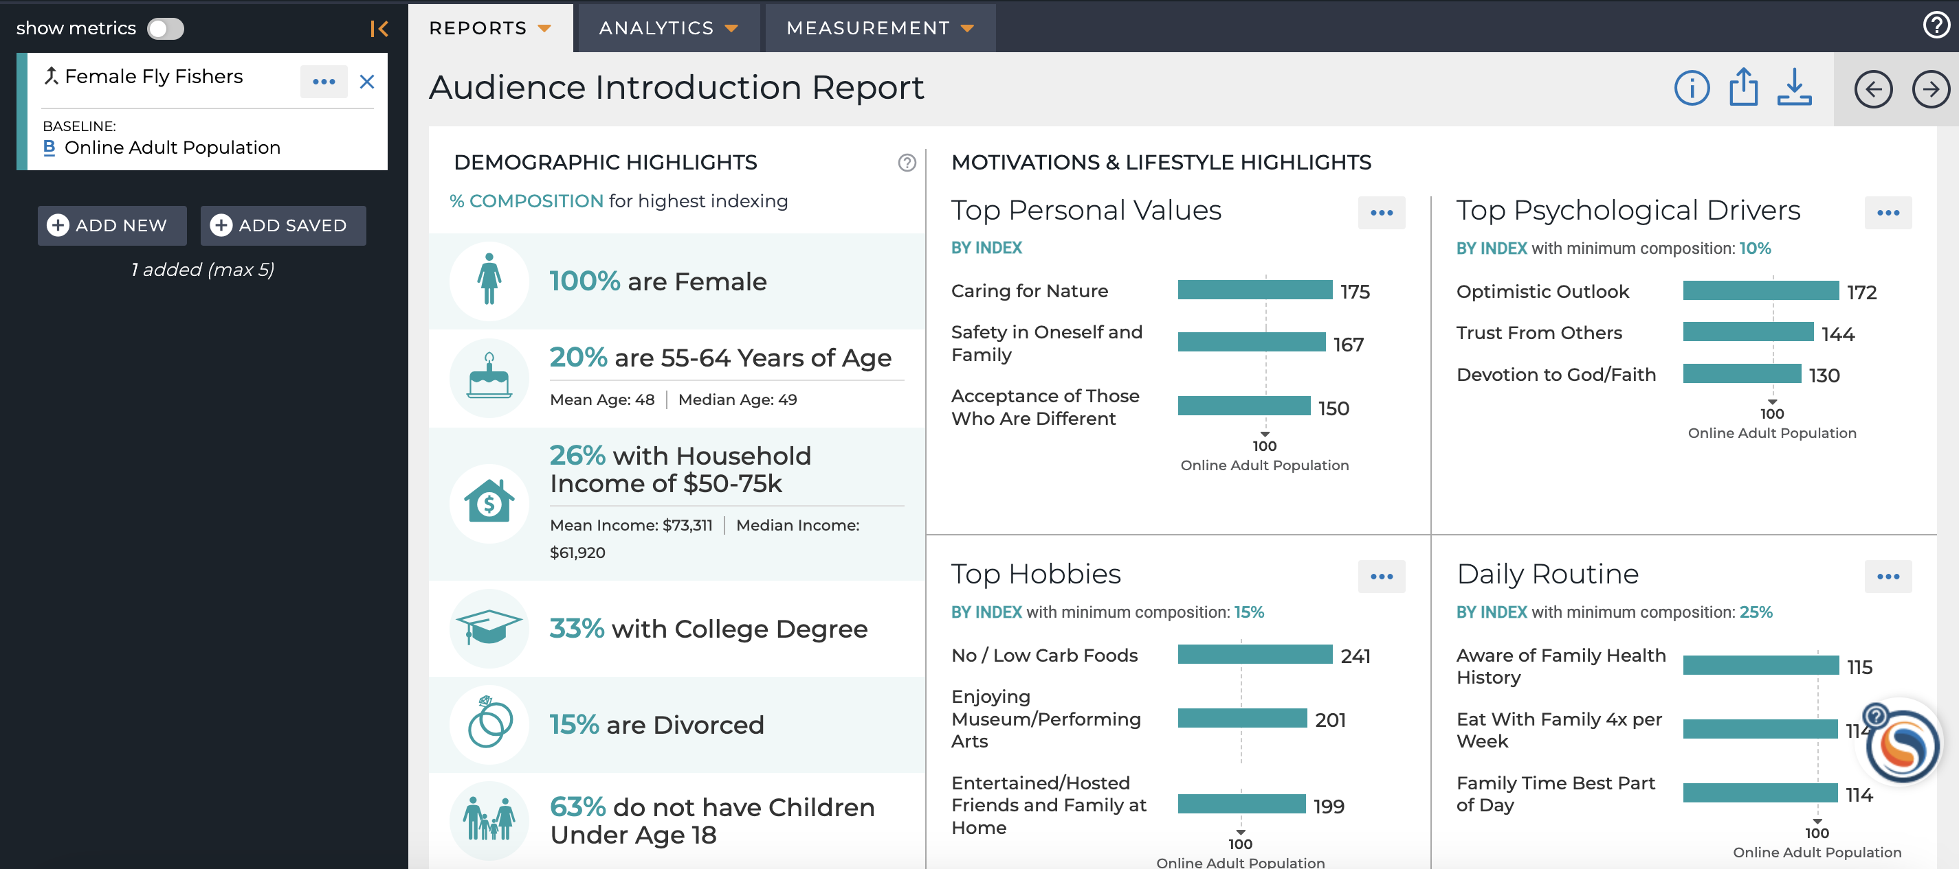
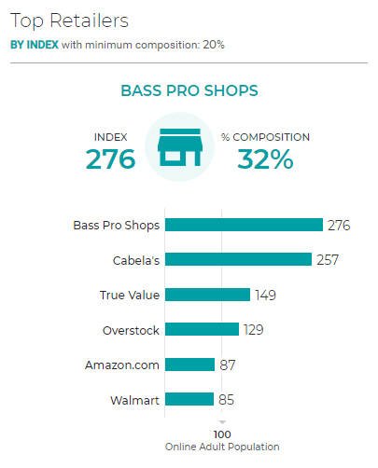
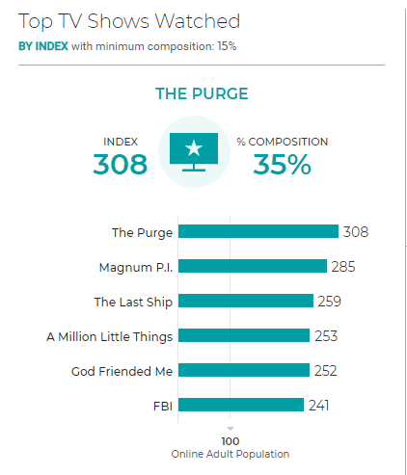
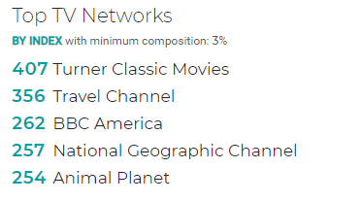
Benefit: Insights on People Who Consumed Topics Online
Research and Understanding
Psychographics
Media Consumption
Brand Affinity
Notes:
Get insights on people who have consumed specific topics online,
Using Resonate’s curated reports, you can quickly gain understanding of Behavioral audiences’ demographic composition, media consumption, brand affinity and psychographics.
In this example, you can see a plethora of useful information on Females who consumed content on fly fishing. For instance, this audience cares for their friends and family, they prefer active vacations and they want to be trusted and respected by others. You will find them shopping at Bass Pro Shops and watching Travel Channel and the National Geographic Channel. Use these learnings to inform you creative and messaging strategies!

Slide 15
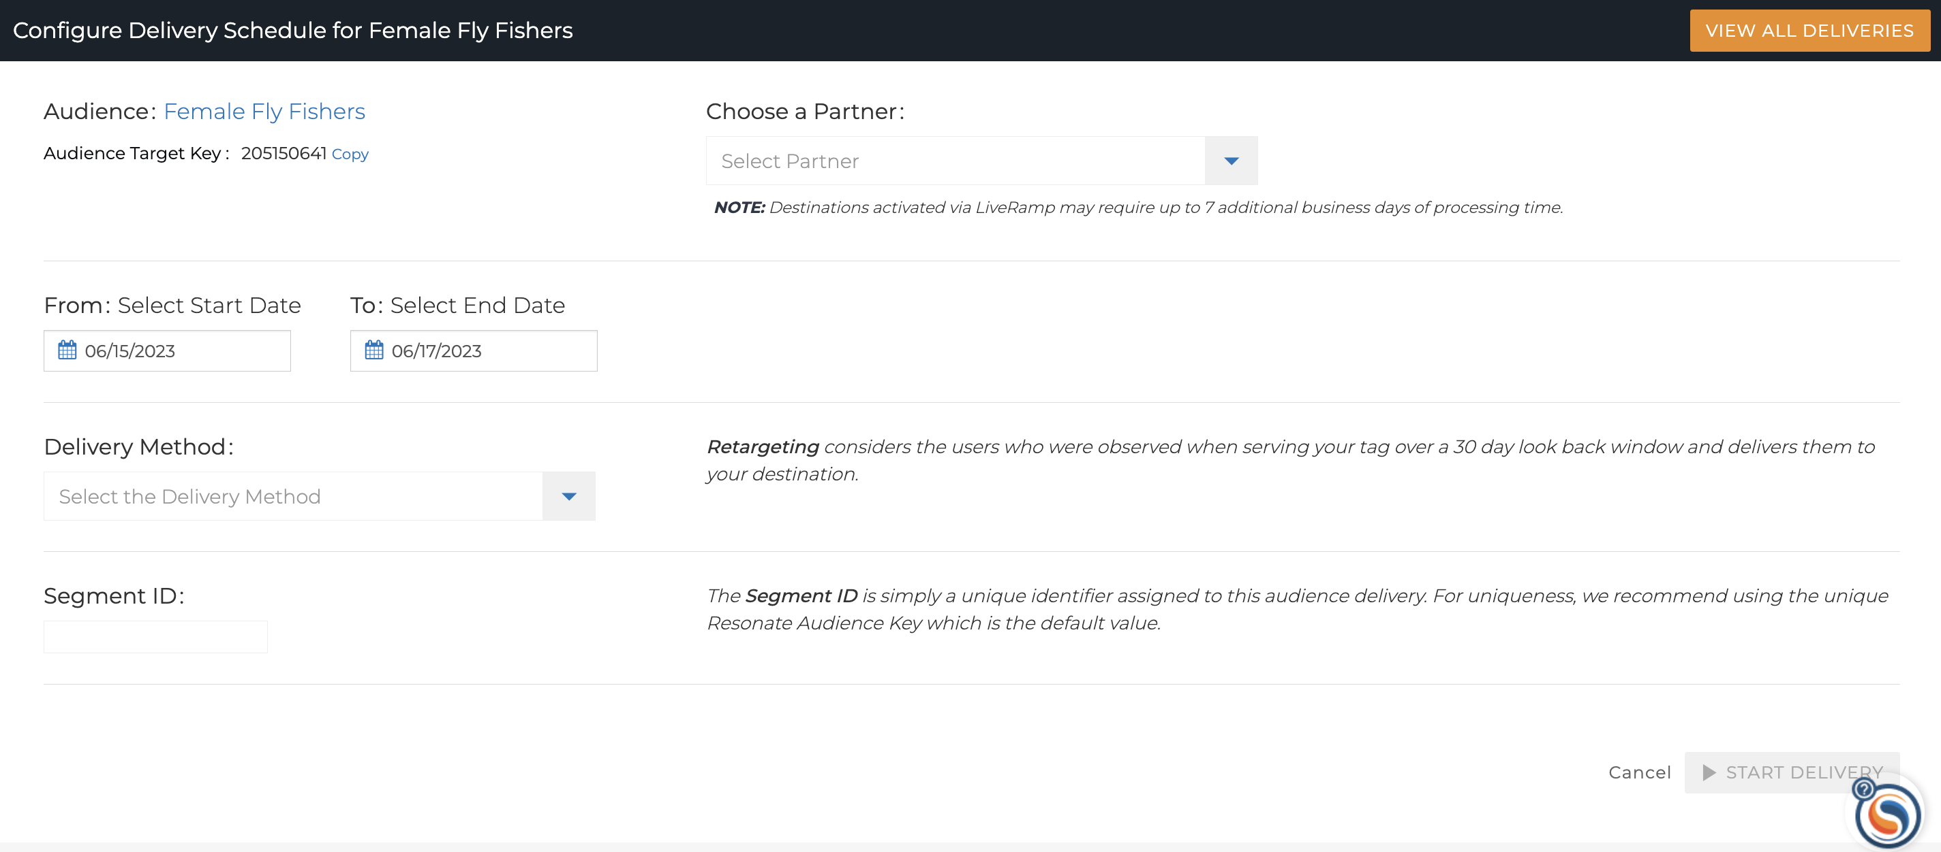
Benefit: Increase Precision with Engaged Audiences
Add precision to audiences
Target these in-market audiences NOW with relevant creative that aligns to Resonate’s insights to increase performance
Activate directly through the platform by finding your Engaged Audience and clicking Activate
Notes:
Behavioral provides 1,000+ attributes in the taxonomy, allowing clients to build more custom and precise audiences.

Slide 16
Audience Metrics for Engaged Audiences

Slide 17
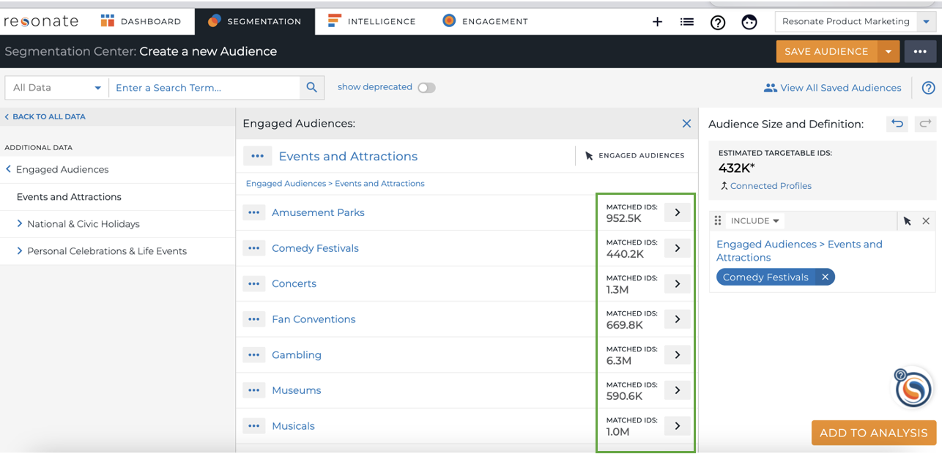
Audience Metrics for Engaged Audiences
Estimated Targetable IDs: the estimated available number of IDs within Resonate’s ID Graph that can be activated for an audience
Matched IDs for Engaged Audiences: the total number of IDs that represent your audience for insights

Slide 18
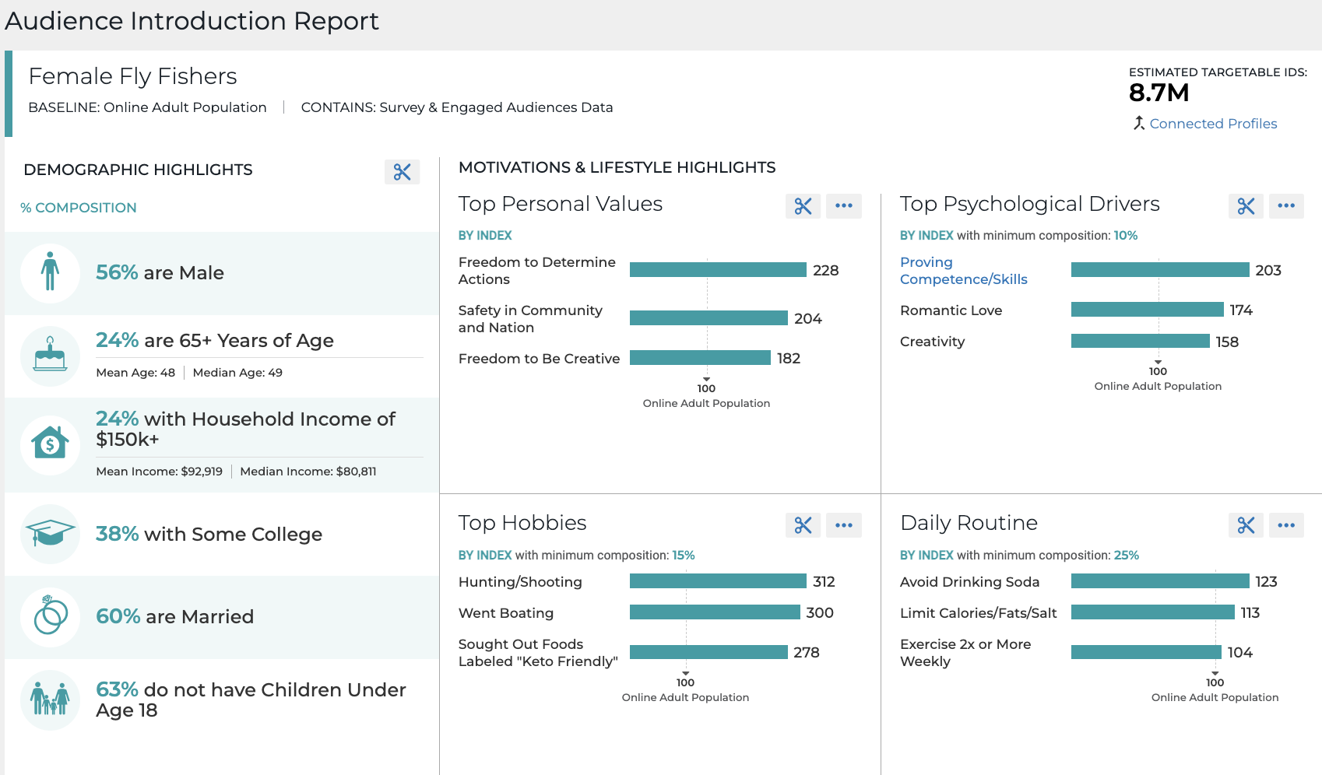
Analyzing Engaged Audiences
Generate curated reports
But cannot view Site Affinity, Category Affinity or Trend Report
Get Survey insights on Behavioral Audiences
But cannot see Behavioral data as insights
Use Audience Crosstab against Behavioral Audiences
But cannot include a Behavioral attribute in a compatible audience for use in Audience Crosstab
Notes:
You cannot pull the Site Affinity and Category Affinity Reports for Behavioral Data because they require survey attributes only
You cannot view the Trend Report for Behavioral Data because it requires a Tag

Slide 19
Activating Engaged Audiences

Slide 20
Activating Engaged Audiences
List Icon – Audiences
Search for Engaged Audience
Click Activate
Select Activation Partner and Destination
Pick Start and End Dates
Choose Retargeting for Delivery Method
Click Start Delivery
You do not have to worry about cookie pool depletion when you activate an Engaged Audience, the platform will always use the latest cookie pool at the time of activation, not when the audience was saved.

Slide 21
Summary
What You Have Learned
Pro Tips
Understand the source of Engaged Audiences
Learn the benefits of Engaged Audiences
Recognize Engaged Audiences
Learn how you can analyze Engaged Audiences
Activate Engaged Audiences
Pay attention to breadcrumbs in the Audience Builder to quickly distinguish survey and Engaged Audiences
Rely on Search heavily to find Engaged Audiences faster
Need additional Engaged Audiences in the Taxonomy? Don’t hesitate to reach out to your CS Manager!
FAQ
For Additional Help
Q: Where do you get your Engaged Audiences?
A: We observe 30,000 behavioral topics via our behavioral data stream that helps inform our predictive models. From our behavioral data feed, we used our Natural Language Processing (NLP) tool to extract a static list of 1,000+ topics that people are consuming online.
Q: How is Standard different from Custom Engaged Audiences?
A: Standard Engaged Audiences are automatically available in your Taxonomy. Custom Engaged Audiences are created for you by Professional Services and loaded into your Resonate account. Learn more
Resonate Knowledge Base
What is Resonate's Behavioral Data?
How to Use Resonate's Behavioral Data?
How Do I Activate Engaged Audiences?

Slide 22
Quiz!
How often are Standard Engaged Audiences refreshed in Resonate?
How many categories does the Resonate Taxonomy have for Standard Engaged Audiences?
Can you include Standard Engaged Audiences in a compatible audience for use in the Audience Crosstab report?
Notes:
It’s refreshed every 7 days
26
No

