Slide 1
Resonate Client Training
Tag and Trend Analysis
Gain a Deep Understanding of Consumers Engaging with your Digital Assets

Slide 2
Tag & Trend Analysis
Pre-Requisites for this Module
Getting Started: Orientation - Getting Your Resonate Account Configured for Success
Getting Started: Audience Building - Build your Custom Audiences or Personas - Build your Custom Audiences or Personas
Audience Analysis & Activation: Audience Analysis - Curated Reports - Quick Answers to Common Questions
Audience Analysis & Activation: Audience Analysis - Deep Analytics - Gain a Thorough Understanding of Consumers
Audience Analysis & Activation: Collections – Organizing Data for Faster Time to Insights

Slide 3
In This Module You Will:
Gain a deep understanding of consumers engaging with your digital assets
Understand Tag Metrics
Understand how to Analyze a Dynamic Site Tag and Dynamic Media Tag
Understand how to Analyze a Custom Tag
Deconstruct your Tag Audiences into segments and isolate shopping cart abandoners
Learn how to see your Tag data trended over time

Slide 4
Understand Tag Metrics

Slide 5
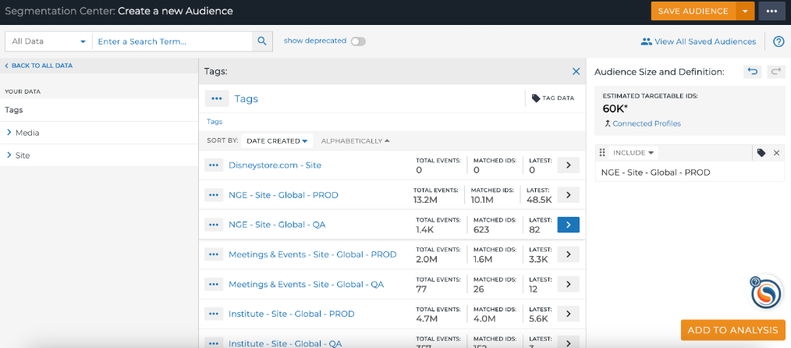
Terminology: Tag Metrics
When looking at Your Saved Tags page (List Icon – Tags)
Total EVENTS - The number of times the tag has fired.
Matched ids - The number of IDs matched to Resonate’s ID graph from your tag hits seen from the time you placed the tag going forward (up to two years)
Latest - The number of times the tag fired on the last day that activity was observed. This date is provided in the “view details” drop down.
ESTIMATED TARGETABLE IDS - The available number of IDs within Resonate’s ID Graph that can be activated for this audience.
Notes:
Here are what the tag metrics mean when looking at your placed tags from the Manage – Tags page.

Slide 6
Refresher: Digital Assets to NOT Tag
International sites - Resonate is a U.S.-based company that delivers insights about U.S. consumers only and does not collect data from outside the U.S.
Mobile Apps - We cannot get enough samples from Mobile Apps to predict insights
Over the Top Devices - We cannot get enough sample on Over the Top Devices to predict insights
Furthermore, we have identified additional properties where we don't recommend tagging because cookies on these digital assets are not persistent and/or stable enough for insights:
Mobile-specific campaigns
Email

Slide 7
How to Analyze Tags

Slide 8
When Can You Analyze
Analyze button is clickable when Tag has seen enough traffic
Usually once the Tag has seen ~ 2,000 Matched Resonate IDs, but could be higher

Slide 9
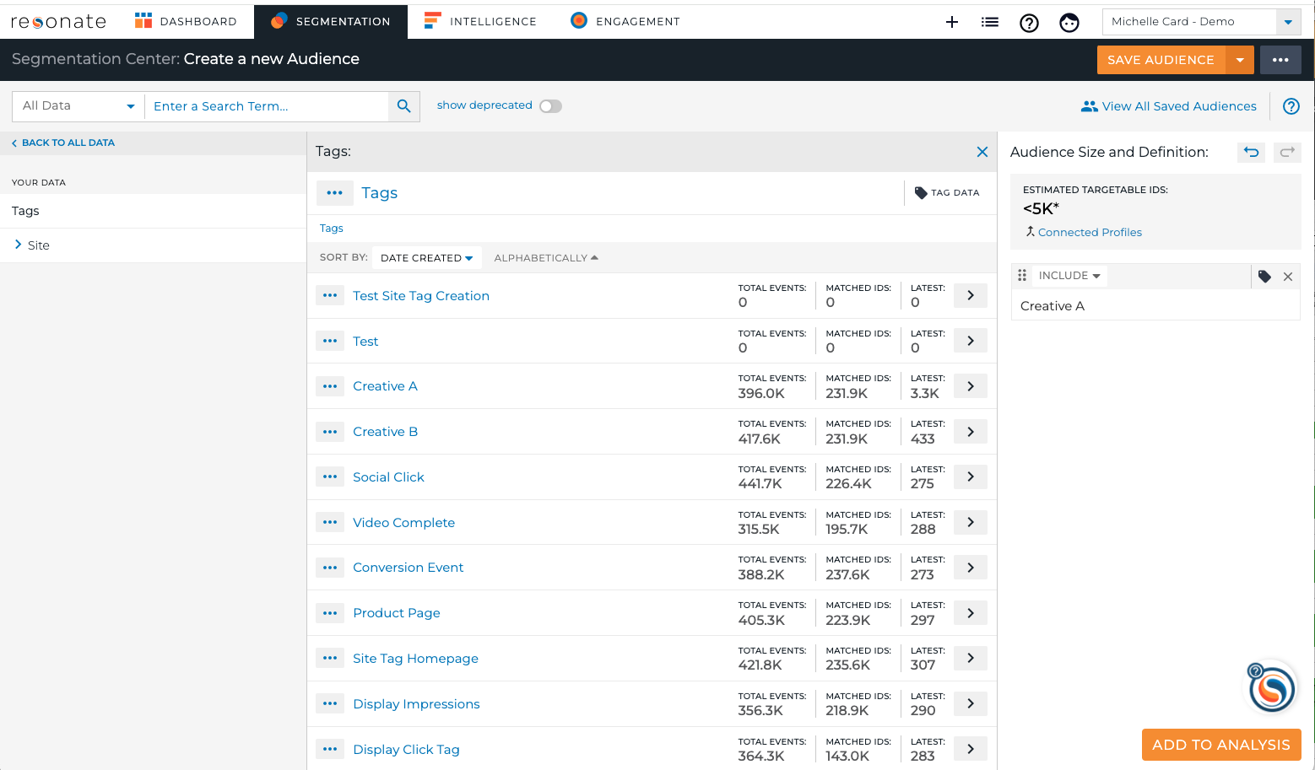
Analyzing a Dynamic Site Tag
To Analyze a Dynamic Site Tag, First Save the Tag as an Audience
Segmentation
Click Tags in taxonomy - Site
Find your Event or Content to analyze
Click to add to audience definition
Click Save
Add to Analysis
Find in List Icon – Audiences

Slide 10
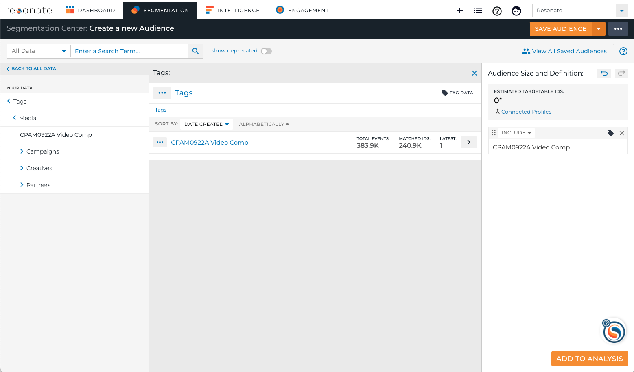
Analyzing a Dynamic Media Tag
To Analyze a Dynamic Media Tag, first save the Tag as an Audience
Segmentation
Click Tags in taxonomy - Media
Find your Event or Content to analyze
Click to add to audience definition
Click Save
Add to Analysis
Find in Manage – Audiences

Slide 11
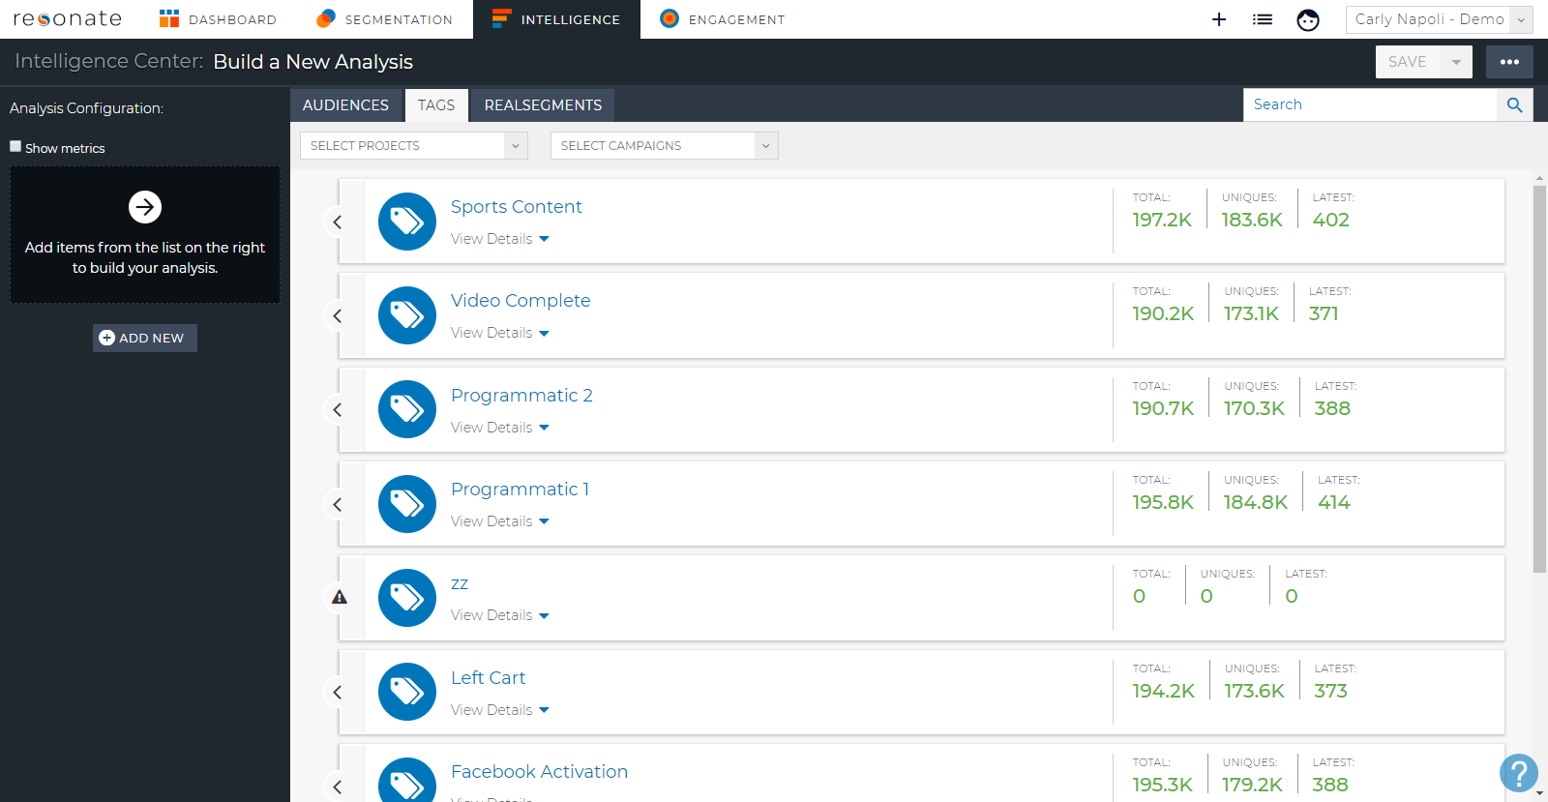
Analyzing a Custom Image Tag
Click Intelligence
Click Tags sub-nav at top
Find your Tag using Search or filter via Projects or Campaigns.
Click the Tag to add to your analysis

Slide 12
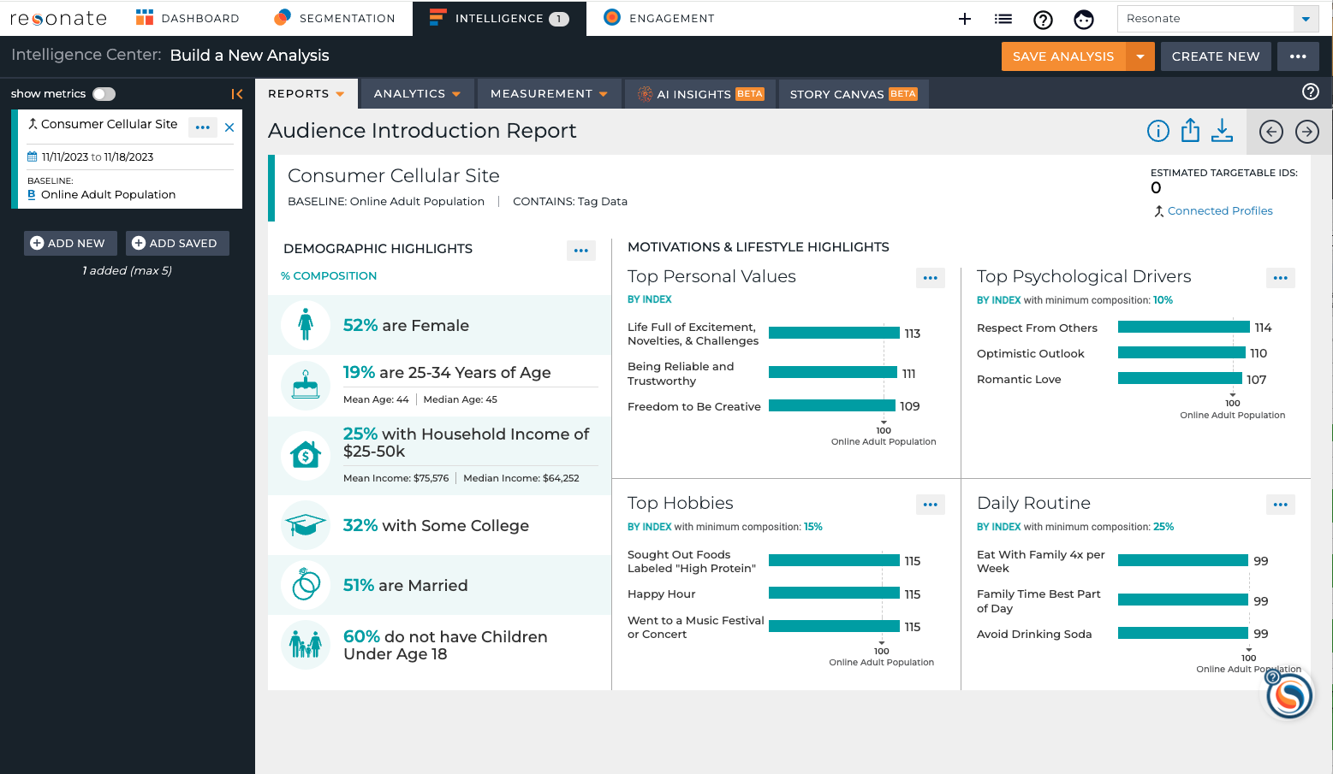
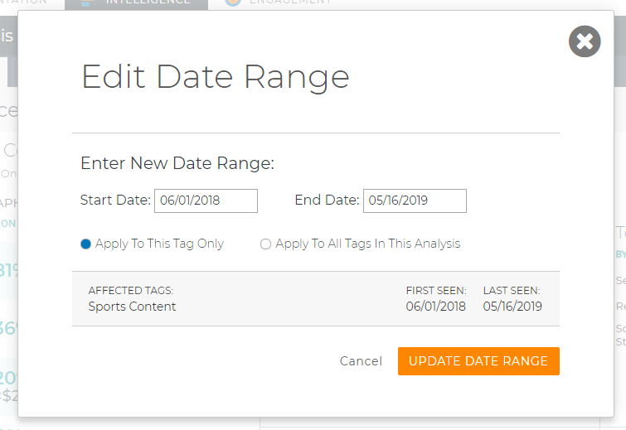
Analyze a Tag Just Like You Analyze an Audience
Adjust the dates in the Tag Audiences in your Analysis
Edit dates via Calendar icon
View Curated Reports
Use the Analysis Visualizations just like an Audience
Pro Tip: Category Affinity Report and Site Affinity Report are not available for Tags in the application – but we can do a custom report for a Tag via Professional Services
Notes:
Notice the dates for the Tag Audiences in your Analysis.
Edit the dates by clicking the calendar icon
Category Affinity Report and Site Affinity Report can only be shown for a Survey Audience.

Slide 13
Segment Tag Audiences

Slide 14
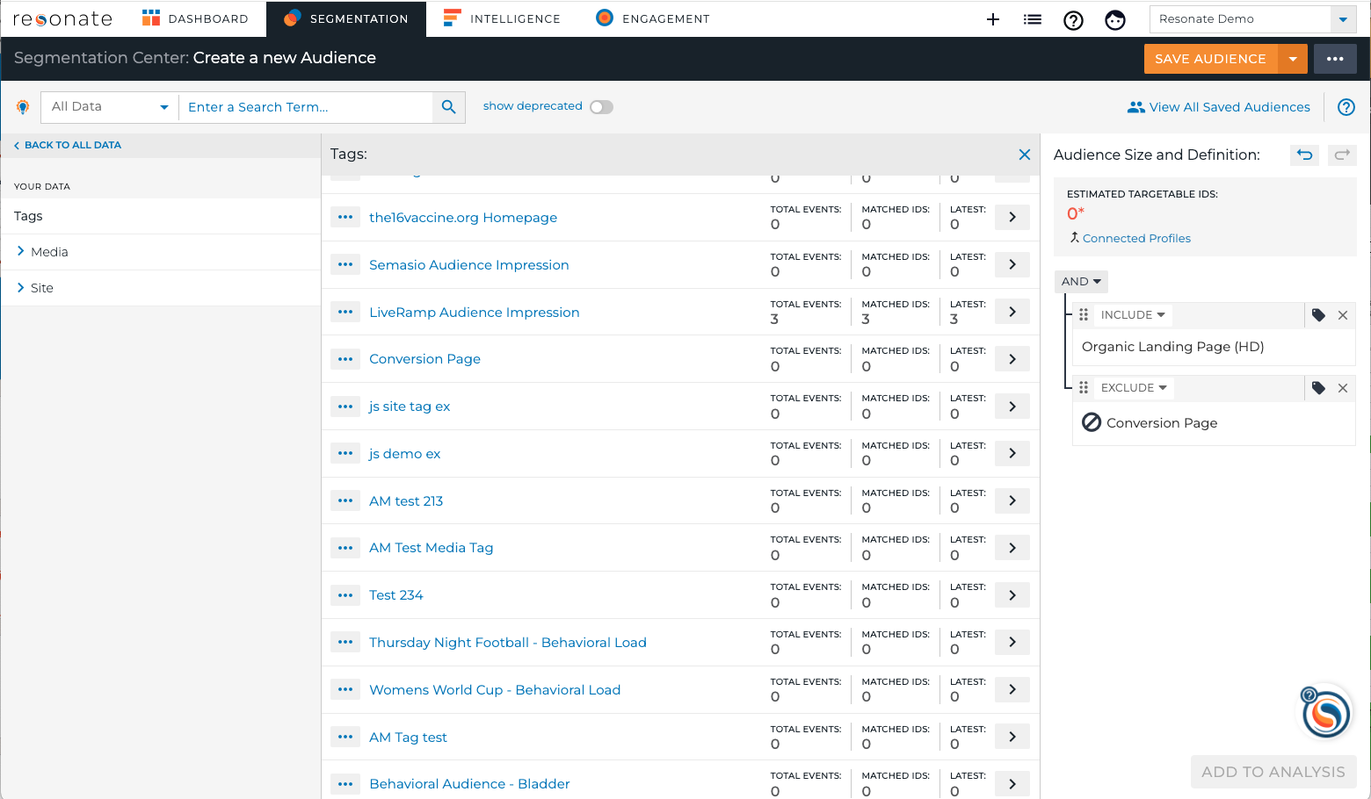
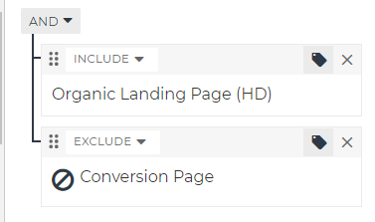
Segment Your Tags
Isolate only Female Purchasers, or Only Male Abandoners
Understand why people abandoned your Shopping Cart
For Ex: To see abandoners, add Landing Page and Exclude Conversion Page in your audience definition
Pro Tip: Add Resonate attributes with your Tags to your audience definition.

Slide 15
View Tag Insights Over Time – Trend Chart

Slide 16
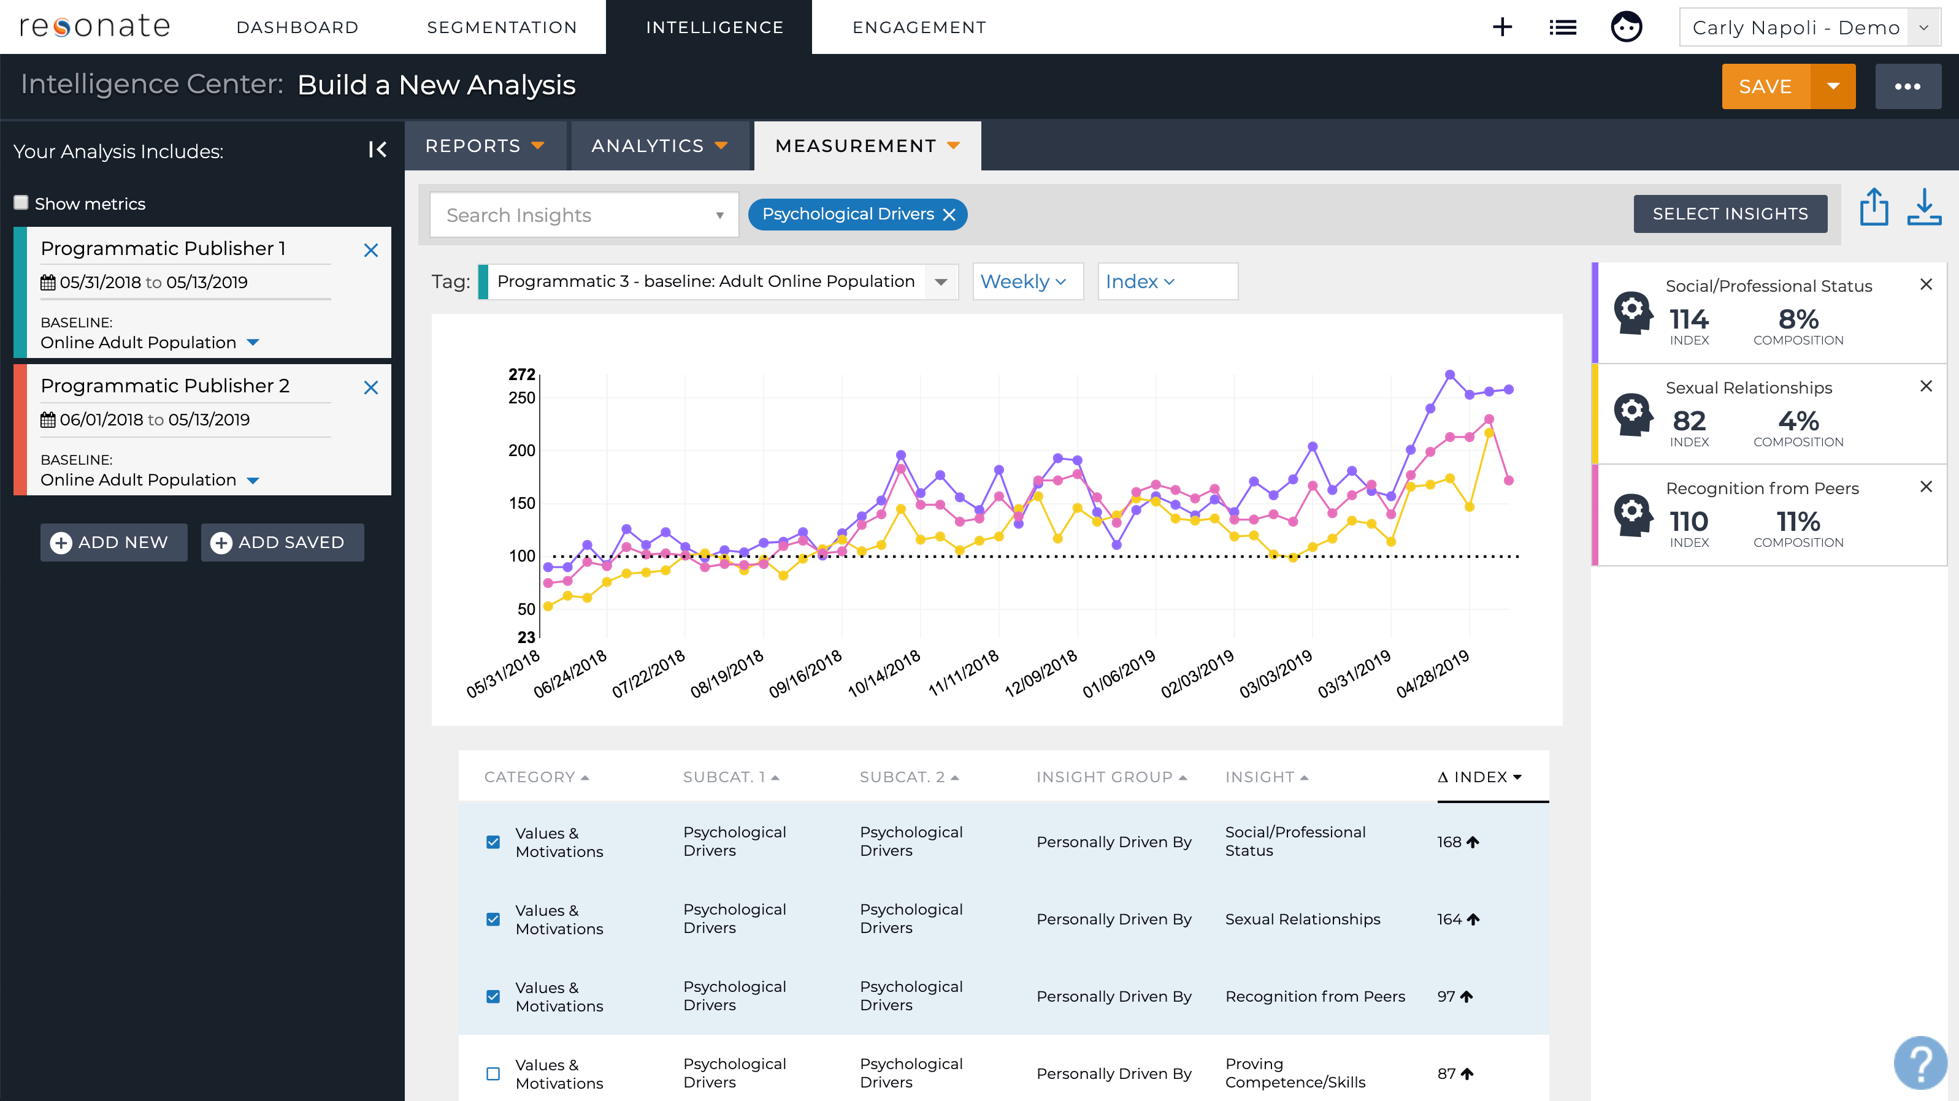
Trending Tag Data
When viewing an Analysis – go to Measurement sub-nav, and select Trend
Choose the Tag to Analyze
You can only trend one tag at a time
View data Monthly, Weekly, Quarterly
Adjust to show either Index or Composition
Select Insights to see specific insights
Share & Export
Pro Tip: Use this report to measure whether people with your desired attributes are hitting your digital properties.
Notes:
Let’s say you’ve tagged your home page in Q1, and in Q2, you’ve updated your messaging to include insights from our values and motivations. Use this report to measure whether your new messaging strategy is working by viewing specific attributes.

Slide 17
Summary
What You Have Learned
Pro Tips
Understand Tag Metrics
How to analyze Tags
Understand Tag insights just like an audience
Segment your Audience to understand Shopping Cart Abandoners
View Tag Insights Over Time – Trend Chart
Category Affinity Report and Site Affinity Report are not available for Tags
Add Resonate attributes with Tags to your Audience Definition to segment your Tags
Use this report to measure whether people with your desired attributes are hitting your digital properties.
FAQ
For Additional Help
Q: I’ve created a tag, how does the data start populating
The tag code must be added to the html of the site or media that you would like to tag, therefore you must send that tag code to whomever manages your websites or tags
Resonate Knowledge Base
Understand Tag Metrics
Trend Tag Data

Slide 18
Quiz!
About how many uniques are needed to analyze a website tag?
What do you need to do first in order to analyze a Dynamic Site Tag?
How do you analyze a Tag?
How would you understand shopping cart abandoners?
How many tags can you trend at once?
Notes:
2,000
Save as an audience
Just like an audience!
Exclude purchasers from your website visitors.
Just one at a time

Slide 19
Next Up
Next Module:
Module 8 – Audience Crosstab: Measure Whether You’re Hitting your Target Personas

