Slide 1
Geography Client Training
PA Clients

Slide 2
Using Geography Data

Slide 3
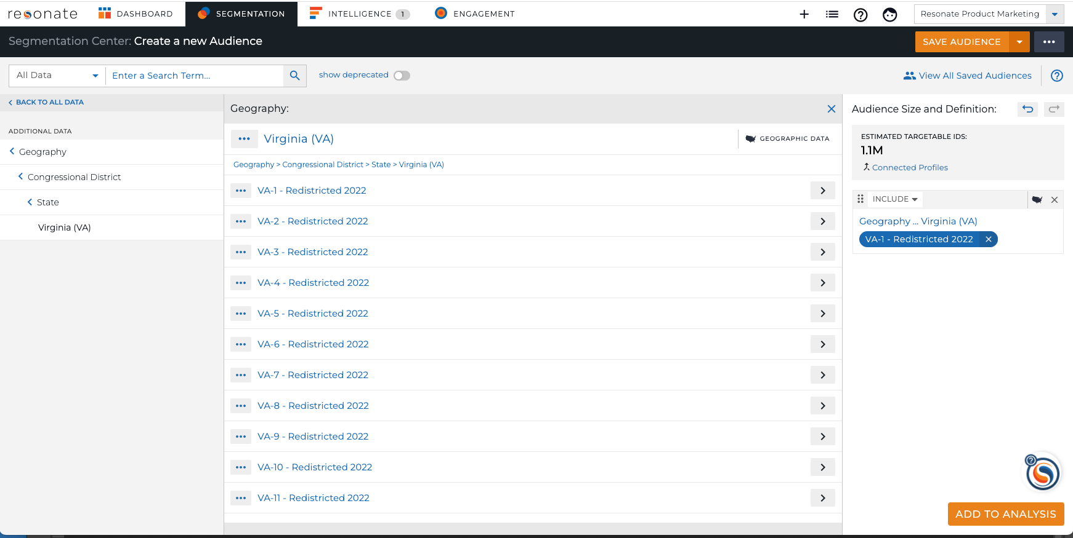
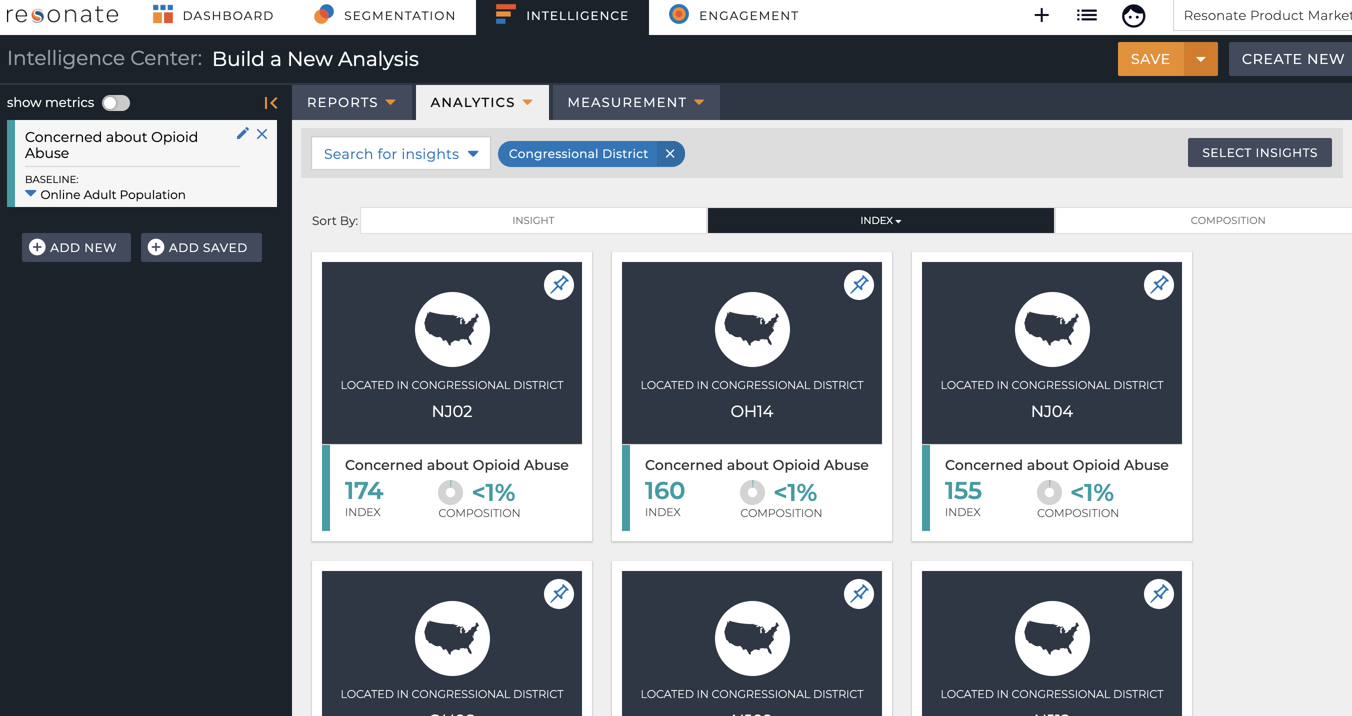
Geography Data
DMA® and Congressional District Data as Attributes and Insights
Learn insights on audiences by specific DMAs ® and Congressional Districts
Build audiences with attributes by DMA® and Congressional District
See and understand geography attributes as insights describing your audiences of interest
Combine geography attributes with Resonate Elements, tags, and behavioral attributes
Scaled deterministic data refreshed nightly

Slide 4
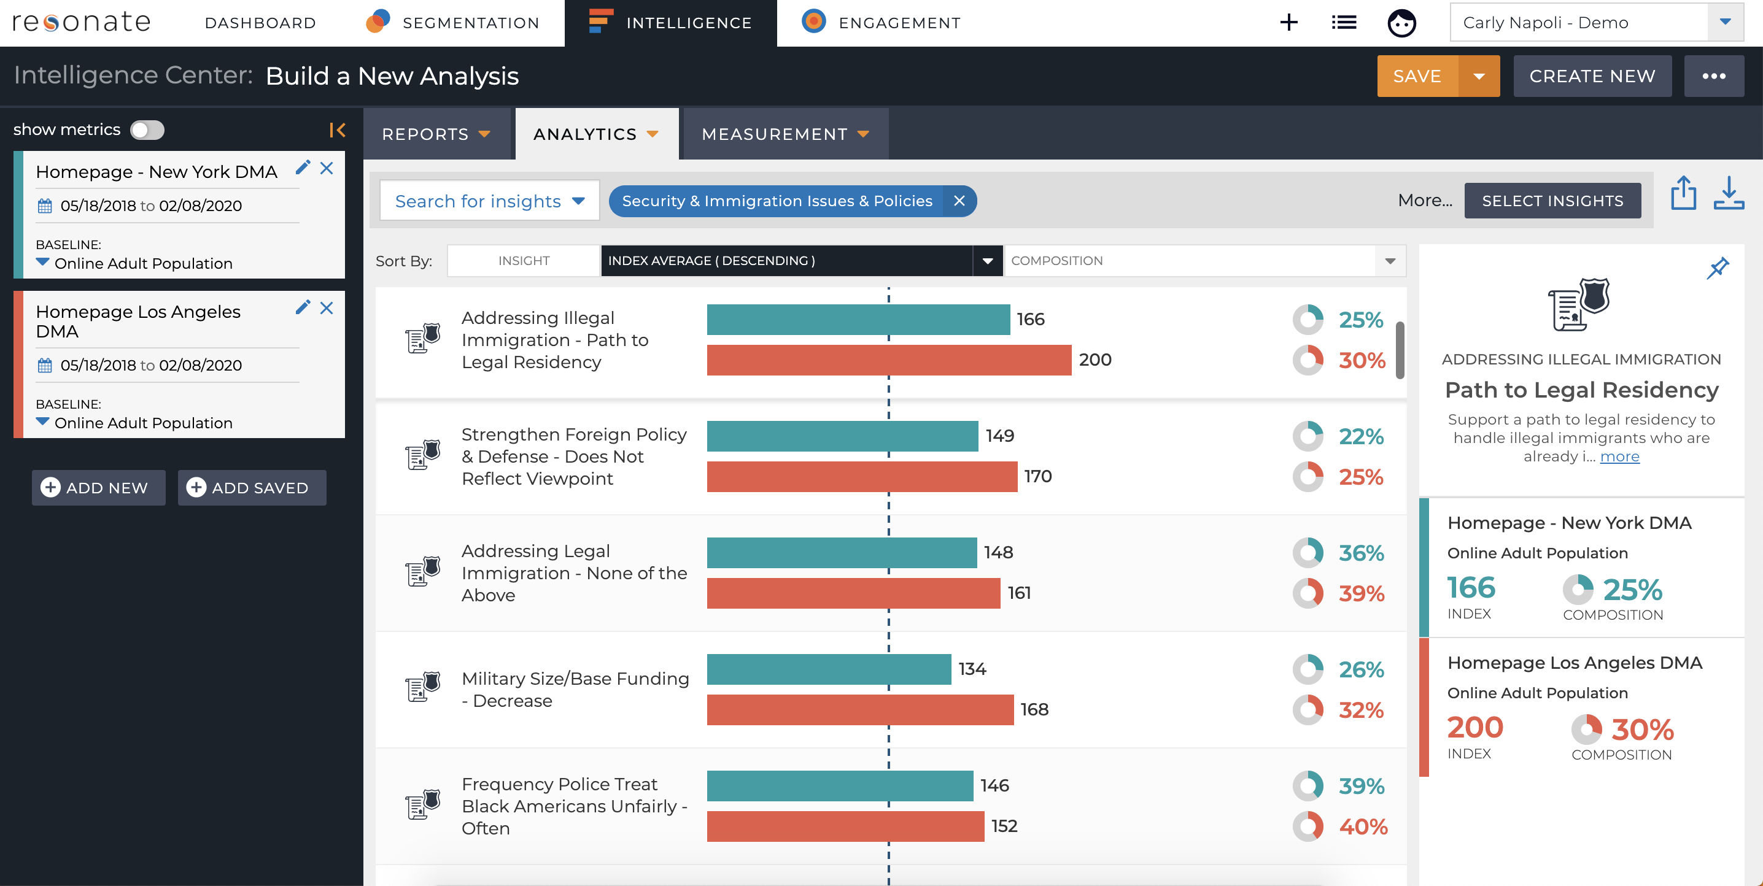
Geography Use Case 1: Insights on Digital Footprint by DMA or CD
Learn insights on your digital footprint by specific DMAs® and Congressional Districts
Include Tag + DMA or Congressional District in your audience definition and view 14k insights
Ex: Segment your homepage visitors into two different DMAs to see where they stand on different policies.

Slide 5
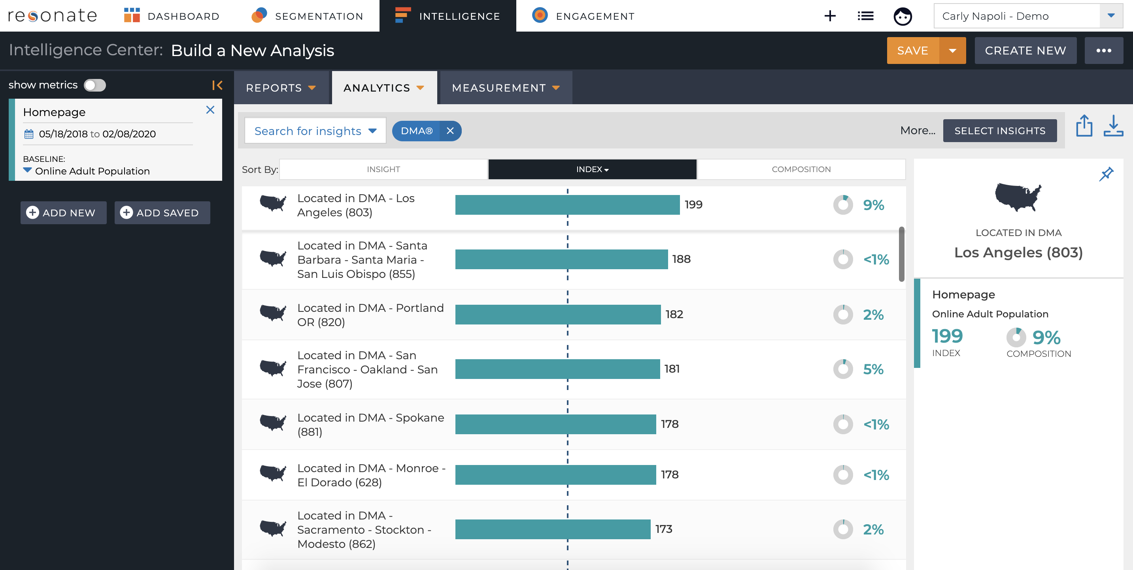
Geography Use Case 2: DMA Insights on Digital Footprint
View DMA insights on your digital footprint and tags
Include a Tag in your audience and understand where people interacting with your digital footprint are located.
Ex: Are people coming to your website homepage more likely to be in LA or San Francisco?

Slide 6
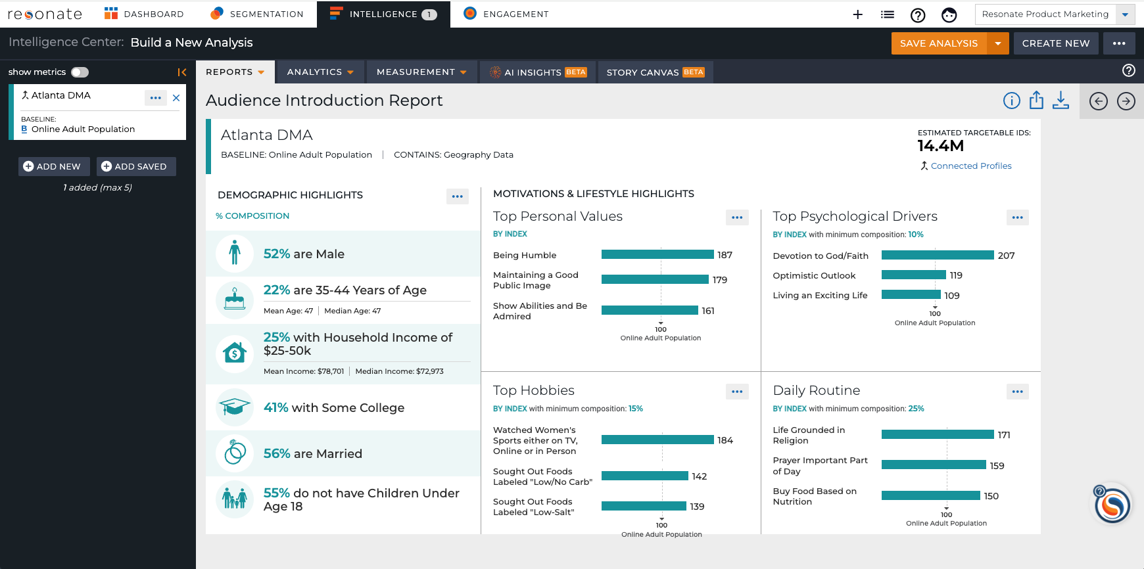
Geography Use Case 3: 13k attributes by DMA
View our 14k attributes by DMA
Include DMA(s) in your audience and view up to 14k insights to understand more about people located in that DMA.
Ex: What people in the Atlanta DMA are like?

Slide 7
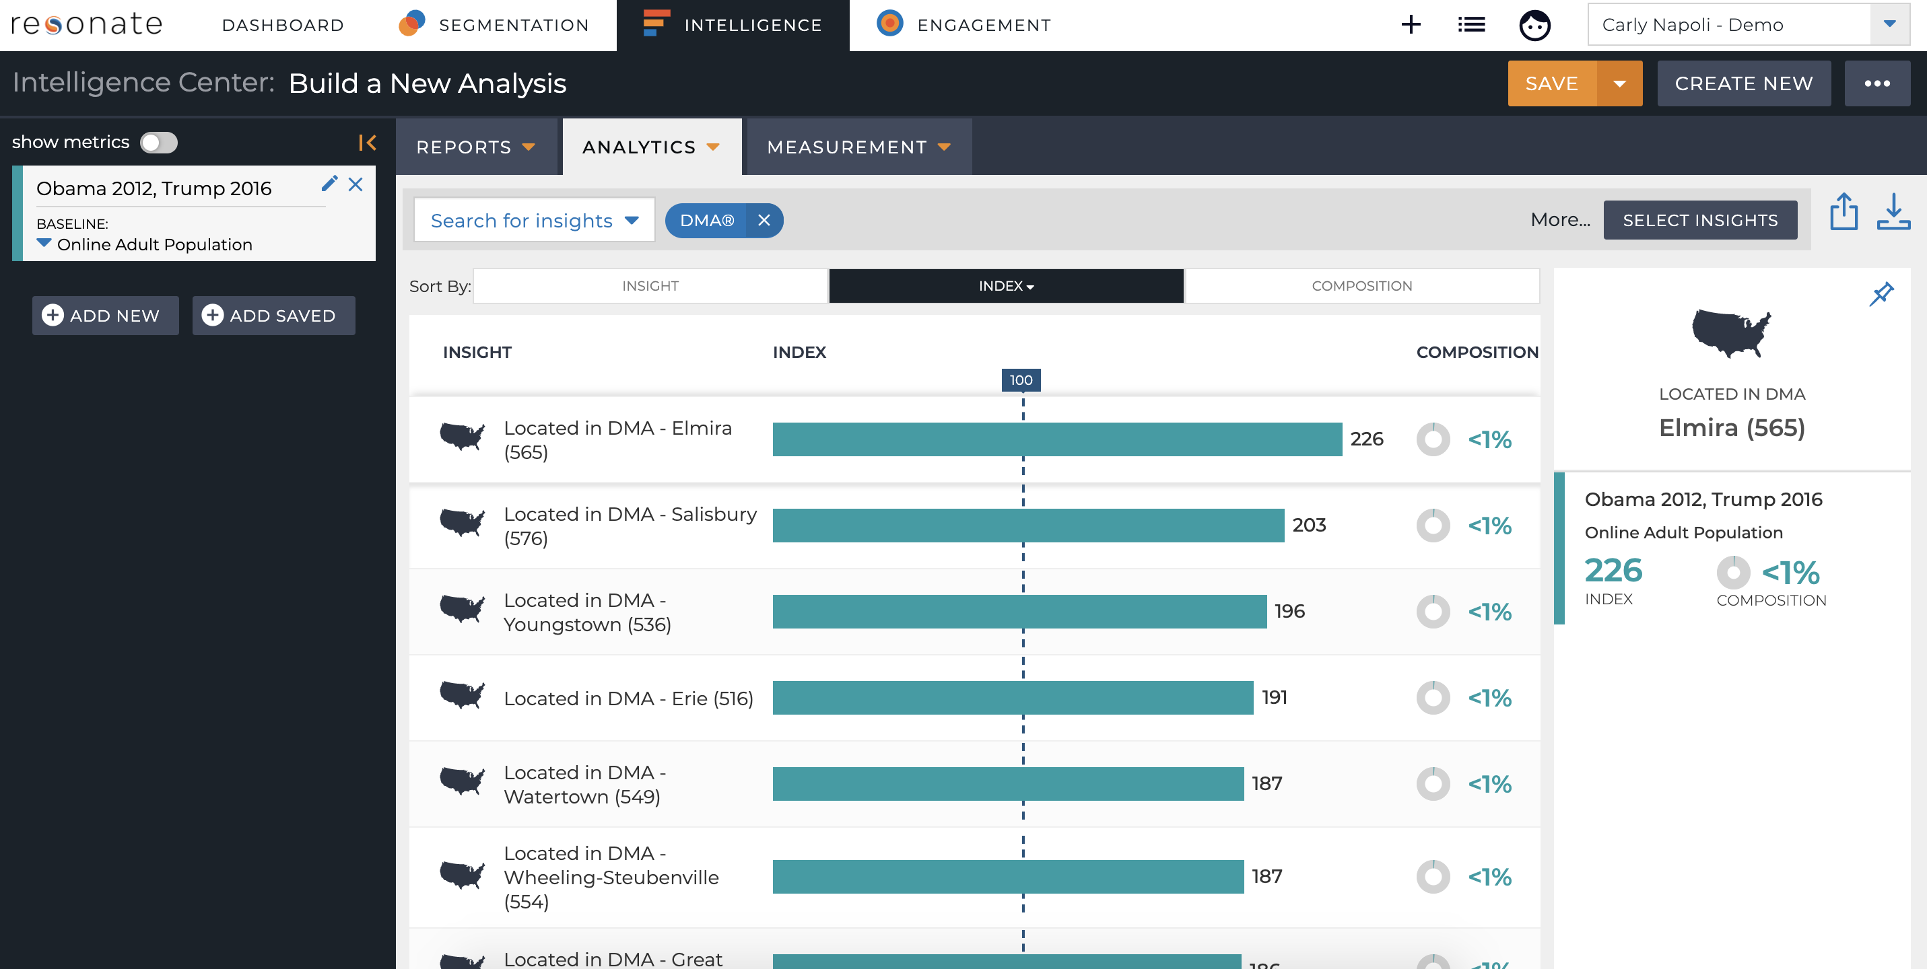
Geography Use Case 4: DMA insights by attribute
View DMA or Congressional District insights by 14k attributes
Include a Resonate Element in your audience and view insights by DMA or Congressional District to understand where people with that attribute are located.
Ex: where are people who voted for Obama in 2012, but Trump in 2016 located?

Slide 8
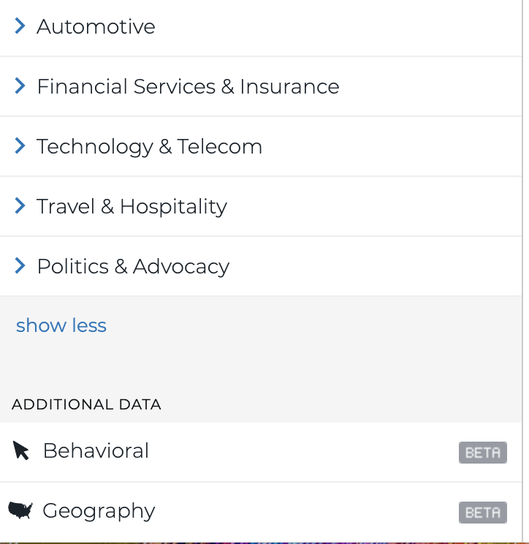
Three Types of Geography Data
For PA clients
Self-reported Region and State
Source: Our research, based on a survey question
Pro: Provides a projected audience size based on self-reported location
Find in: Resonate Elements – Demographics - Demographics- Geography
Use for audience building and insights (for audiences built using Resonate Elements only)
Voter File: State, DMA and Congressional District
Source: L2 & PDI voter turn out data fused with Resonate survey data
Pro: Comes from a trusted source based on deterministic voter turnout
Con: Can run into low sample
Observed DMA & Congressional District
Source: Deterministic observed granular geography data updated nightly based on location
Find in: Additional Data – Geography
Use for audience building and insights
Self-reported
Voter File
Observed

Slide 9
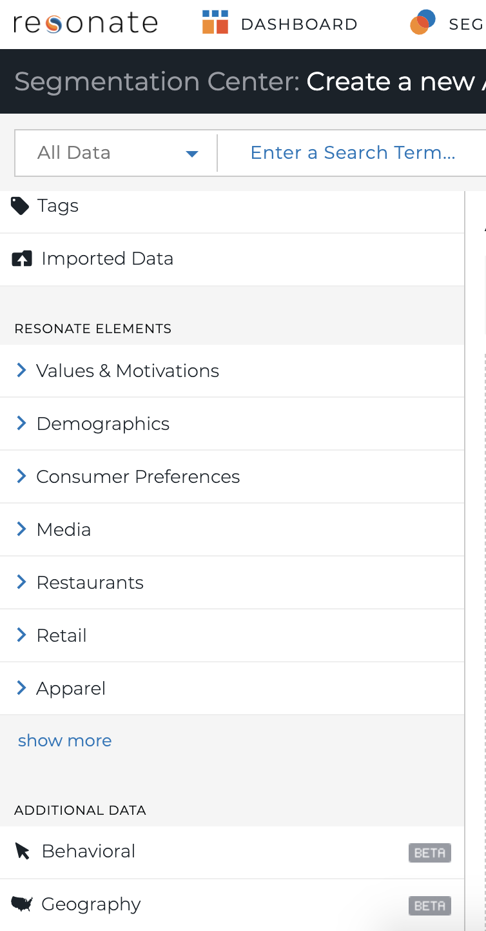
Using Geography data in the platform
Use Resonate’s Geography data in the platform to:
Analyze & Filter audiences by geography
Combine with Tag, Survey, and Behavioral attributes then Analyze
Watch outs:
Cannot combine with 1st party or 3rd party LiveRamp Segments
Cannot save in an audience to be used in Audience Crosstab
Cannot combine with Limited Resonate Elements data
Ex. Can’t cross DMA with a limited cigarette brand survey attribute

Slide 10
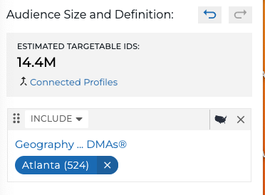
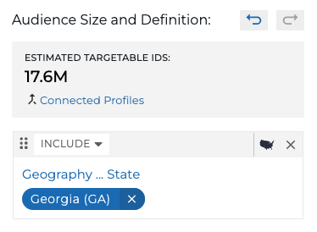
Audience Metrics
Estimated Targetable IDs for both audiences that contain DMA & Region and State attributes
This number is the estimated available number of IDs within Resonate’s ID Graph that can be activated for an audience
Notes:
Estimated Targetable IDs
When building audiences with our granular Geography data, you'll notice that you will not see a projected adult online population number, but rather numbers for Estimated Targeted ID modeled devices.
Since the Geography data is observed and based on location, and this data is not weighted to be representative of the U.S. adult online population, we cannot provide a projected count of how many people are in each geographic area.

Slide 11
Activating Geo Audiences
You can activate audiences using Geo attributes
But! We recommend you use your DSPs geo-targeting for most accurate targeting
Best to use DSP geo-targeting because at time of activation, you could be filtering out people who came into or moved out of that geo if you use our geo attribute

Slide 12
Geography Data
Where does Geography Data come from?
Resonate Geography attributes and insights are derived through a synthesis of observed anonymous online behaviors and geo-location solution providers
Our geo-location providers enrich tag events & pixel syncs with geo-code from the browser's IP address
Geography data is updated nightly using the most recent observations based on where they are now - not necessarily where they live – and allows for more precision than modeled survey geography data

Slide 13
Questions?

