Slide 1
Resonate Client Training
Tag Creation & Deployment
Get Set Up to Understand Consumers Engaging with your Digital Assets

Slide 2
Tag Creation & Deployment
Pre-Requisites for this Module
Getting Started: Orientation- Getting Your Resonate Account Configured for Success

Slide 3
In This Module You Will:
Get an Introduction to Resonate Tags
Learn how to choose the right Tag
Learn how to create Tags
Learn how to place them onto your Digital Assets
KnowledgeBase Link

Slide 4
Intro to Resonate Tags

Slide 5
Why Tag?
Imagine being able to interview every single person who engages with your content.
In a conversation, you can learn a lot about a person. And that’s the depth of understanding a Resonate Tag provides without being obtrusive or annoying. A Resonate Tag applies a deep understanding to every consumer who engages with your digital assets. This includes 10,000 attributes, plus an individual’s values and motivations, the what that drives the why behind their decision-making.
Resonate Clients Improve Performance by Using Resonate Tags
Quickly obtain analytics on campaigns performing across multiple digital channels
Verify they're reaching their target audience
Improve content, creative and messaging to drive better engagement
Identify new audiences
Revise strategies for underperforming channels
Improve website user experience
Digital
Web
Operations
Creative
Research
Brand
Acquisition
Resonate Tags Provide Value Across the Marketing Organization

Slide 6
Understanding Tags
What is a Tag and why is it important?
A Tag, sometimes called a pixel or beacon, collects data from digital properties, such as websites or digital ads. Resonate Tags play an integral role in providing you with deep insights to better understand and engage with the people interacting with your brand and digital footprint.
Do Resonate Tags impact my site performance?
No, Resonate Tags do not alter your site visually and are invisible to visitors. They won’t alter your user experience or page load times.
Website Tags
Media Tags
Use to better understand visitors to your website
Use to better understand people consuming your digital media
KnowledgeBase Link

Slide 7
What Kind of Data Does the Resonate Tag Track and Collect?
No Personally Identifiable Information (PII) or sensitive information is ever collected.
Standard data collected in the Tag logs includes:
Date and time of visit
Resonate pixel id
IP address and standard http header information including user agent, referrer, browser type, etc.
You control Tag placement.
You own the complete right and title to all data.
The Resonate Tag collects anonymous web traffic via a tracking pixel to support deep insights, performance, and analysis of your audiences. It also supports remarketing programs.
KnowledgeBase Link

Slide 8
Tag Strategy Recommendations
Website Tags
Tag Website Channel Traffic
Tag your Media Vendors
Tag your Video Ads
Our Dynamic JavaScript Site Tag allows you to place one tag broadly across your site, then dynamically populate the tag with data about the page category and individual.
View where your customers are coming from when they purchase or convert- via Paid or Organic Social, or via your Search Engine Marketing.
Measure the effectiveness of your various media vendors. Track campaigns, ad impressions, clicks, and video impressions.
Track video ad completion with Resonate Tags.
In order to obtain the most value out of your website tagging strategy with Resonate, your tag strategy should encompass different types of digital content for comprehensive measurement and analysis – enabling you to understand nuances between these different digital touch points.
We recommend tagging various digital properties for a holistic Tag Measurement. We advise placing tags on both your website and paid media channels.
KnowledgeBase Link

Slide 9
Digital Assets to NOT Tag
While we recommend tagging your digital properties to collect data about your audiences, we'd like to note that there are some properties you should not tag:
International sites - Resonate is a U.S.-based company that delivers insights about U.S. consumers only and does not collect data from outside the U.S.
Mobile Apps - We cannot get enough samples from Mobile Apps to predict insights
Over the Top Devices - We cannot get enough sample on Over the Top Devices to predict insights
Furthermore, we have identified additional properties where we don't recommend tagging because cookies on these digital assets are not persistent and/or stable enough for insights:
Mobile-specific campaigns
Email
KnowledgeBase Link

Slide 10
Creating Tags
But First –Strategy!

Slide 11
Overall Best Practices
Don’t pass us all your site data – Resonate is not a Web Analytics tool replacement
Pass us meaningful categories, pages, clicks, events, etc that you want to analyze in Resonate for Audience Insights.

Slide 12
Dynamic Site Tag & Track Method Strategy
In order to obtain the most value out of your website tagging strategy with Resonate, we recommend that you create a Dynamic Site Tag.
Placing a Dynamic Site Tag on your website will not only help you gain a good understanding about the people visiting your website, but it will also allow you to sub-segment your site visitors by the content they engage with or the site actions they take.
Our Dynamic JavaScript Site Tag allows you to place one tag broadly across your site, and then our Track Method snippet will allow you to further categorize your website to acquire in depth analysis in Resonate by:
Capturing the visitation to sections and pages that reflect your site map(Tier1 Navigation, Landing Pages, etc.)
Capturing other user actions or site events like button clicks, add to cart, purchases, form submissions, etc.
KnowledgeBase Link

Slide 13
Developing Your Website Strategy
The Dynamic Site Tag is created in Resonate and is JavaScript code that will then be deployed in your Tag Manager.
The steps are general and apply to every company; there is no specific strategy that needs to be considered by your company.
Once deployed the tag will be populated in Resonate and capture visitation at topline domain level and capture general tag fire on all pages.
On the other hand, before implementing the Track Method strategy we recommend your company first determine your individual strategy and what information from your site you would like to track and populate.
Your company will need to identify which site pages, sections, button clicks, and user actions. will be tracked and populated back to Resonate for further analysis and insights.
It is important to identify your strategy before using the steps to Implement the Track Method.
KnowledgeBase Link

Slide 14
Best Practices for Utilizing the Track Method
Transparent Naming Conventions:
When passing the name of the website section or content category use meaningful labels for the site categories so that your end users will be able to easily identify the parts of the website that correspond to the particular site section.
Granularity of Values:
Avoid passing highly fragmented data values from your website (ex. URLs, unique page names, order-ids, specific cart prices).
You are limited to sending 40,000 values across the whole tag.
Tag Reportability Thresholds:
Tag Values must have at least 5,500-6,500 Matched Resonate IDs in order to be analyzed.
The goal is to create a data taxonomy which results in a large enough sample to achieve useful analysis and insights.
Capturing Key Site Actions that Align with Business Goals:
Look at what types of events you have on your site as well as where you want to capture and create audiences for insights, activation, and measurement.
Decide what type of event information is important to capture and pull into Resonate to measure, gain insight, and activate.
KnowledgeBase Link

Slide 15
Who are your site visitors - Where do they engage?
Once the tags are populated in Resonate, you can then use this data to build Audiences in the Resonate platform for Insights and Activation. You will then be able to analyze and answer the following questions:
“Who are your site visitors?"
What is unique about your most engaged visitors, or those taking valuable actions on the site?
What are their demographics, psychographics, and personal values?
How can you best engage these visitors?
Where can you reach these visitors across media channels?
Are you effectively reaching your target audiences?
What can you discover about your untapped site visitors to further engage them?

Slide 16
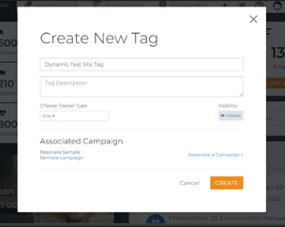
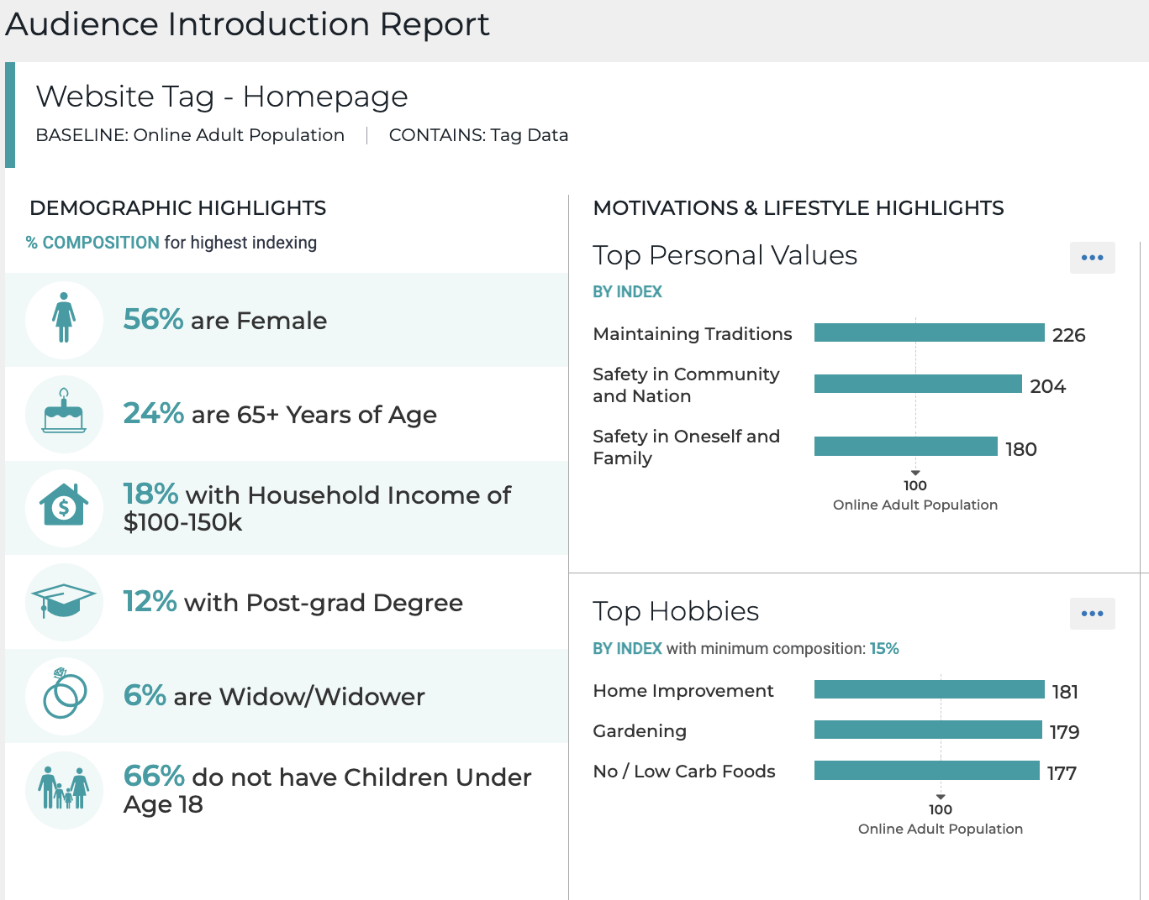
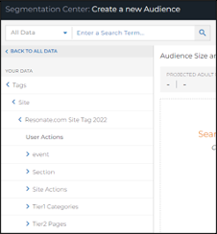
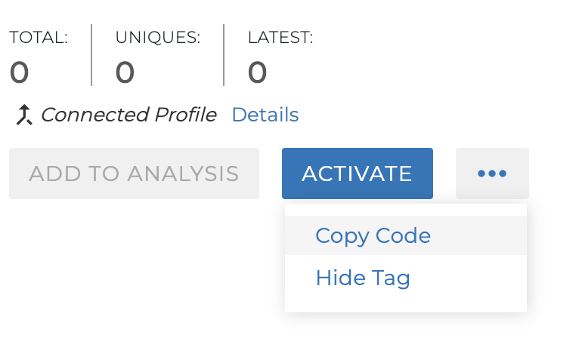
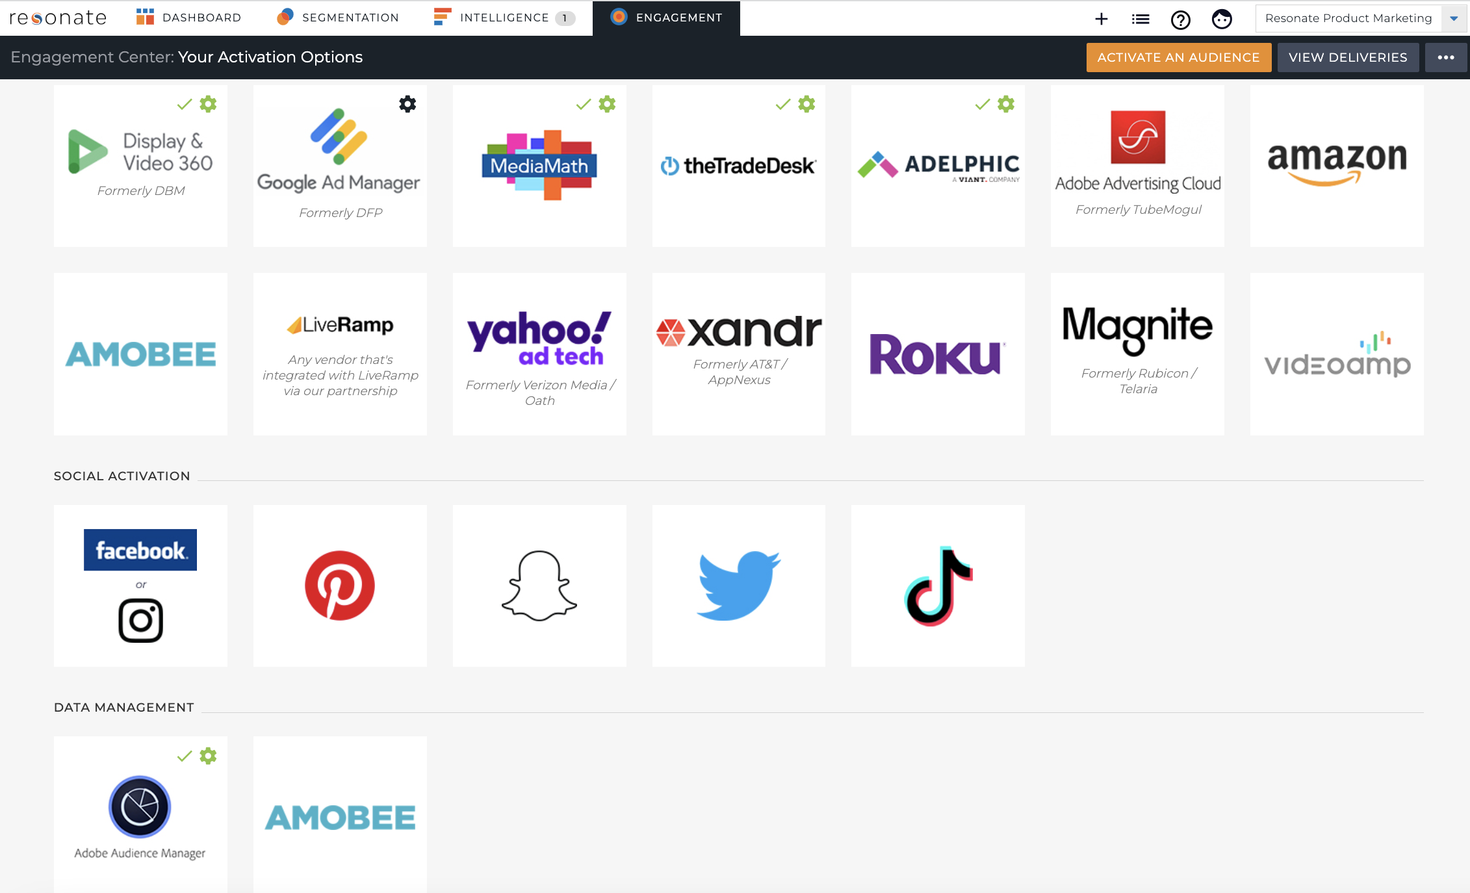
WEBSITE TAGGING TO INSIGHTS
HOW DOES IT WORK?
Create a Dynamic Site Tag from the Resonate Ignite Platform.
Copy the tag code and publish in your preferred tag management system such as Google Tag Manager.
Unique insights on your site visitors will be available once the tag begins to see traffic (approx 5,500-6,500 Matched Resonate IDs).
Optionally further segment your site visitors by using Resonate’s Track Method Snippets to capture visitors by section/page, or other user actions like add to cart events or form submissions.
Personalize your marketing strategy and directly activate across channels

Slide 17
Media Tag Overview
In order to obtain the most value out of your tagging strategy with Resonate, your tag strategy should encompass different types of digital content for comprehensive measurement and analysis – enabling you to understand nuances between these different digital touch points.
We recommend tagging various digital properties for a holistic Tag Measurement. We advise placing tags on both your website and paid media channels.
Once the tags are populated in Resonate, you can then use this data to build Audiences in the Resonate platform for Insights and Activation. You will then be able to analyze and answer the following questions:
Who are your media engagers
What are the demographics, psychographics, and personal values?
How can you best engage these visitors?
Where can you reach these visitors across media channels?
Are you effectively reaching your target audiences?
What can you discover about your engagers that you did not previously know?
KnowledgeBase Link

Slide 18
Media Tag Strategy
Resonate Dynamic Media Tags provide three customizable variables designed to dynamically track the digital advertising:
Partner Name or Partner ID
Campaign Name or Campaign ID
Creative Name or Creative ID
Once trafficked, Resonate Media Tags capture advanced details of your digital advertising campaign and will be displayed in the Resonate taxonomy. Once your Tag has seen at least 5,500- 6,500 Matched Resonate IDs, you will see those attributes in the Resonate taxonomy under "My Tags."
The Resonate Media Tag provided is used as you configure digital ads in your favorite ad server. In most cases, you will want to rely on the built-in macro capabilities of your ad server to dynamically replace the placeholder values found in our Media Tags with the actual values from your traffic.
You are limited to sending 40,000 values across all three parameters in the media tag.
KnowledgeBase Link

Slide 19
Impression & Click Tracking
Resonate offers Dynamic Media Tags for impression tracking and click tracking.
Impressions Tags capture data about users who are exposed to your media. They can help you evaluate your targeting strategy to determine if you’re effectively reaching the right people through all your platforms.
Click Tags give you the ability to learn more about the people who are actually engaging with your media. They can help you understand why they are engaging with your content so that you can find new audiences that share similar characteristics.
Dynamic Click tracking tags are similar to the impression tracking tag but add support for a redirect parameter which must come at the end of the tag code. You can create dynamic Click tracking tags for the click event in media campaigns and redirect the user to an advertiser landing page.
KnowledgeBase Link

Slide 20
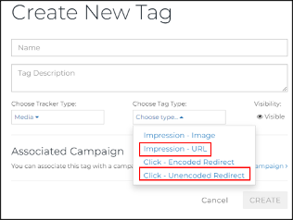
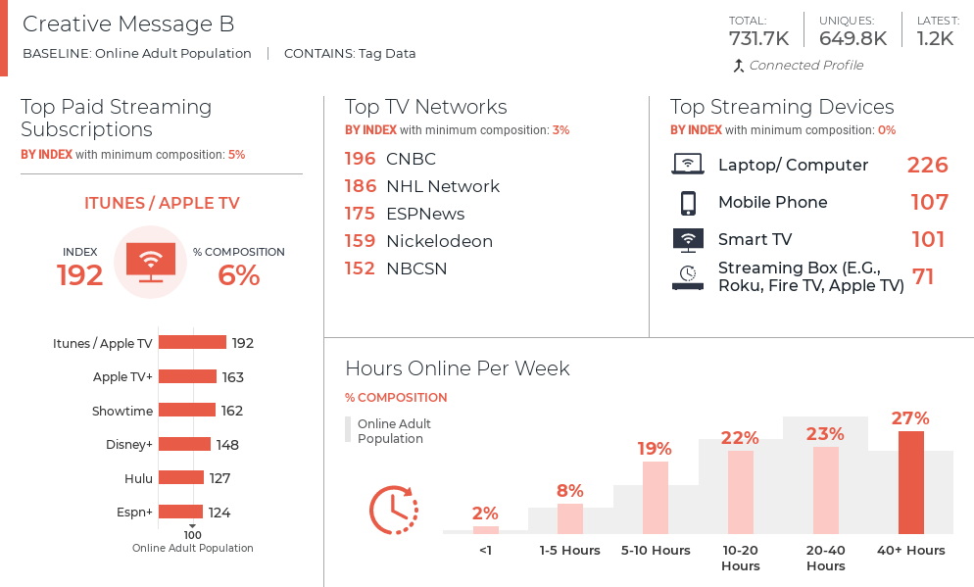
MEDIA TAGGING TO INSIGHTS
HOW DOES IT WORK?
Create a Dynamic Media Tag for impression or click tracking from the Resonate Ignite Platform.
Before placing your tag in the appropriate media channel, customize your parameters available for tracking the dynamic values of your media campaigns.
Copy the tag code and publish in your preferred tag management system such as Google Campaign Manager.
Unique insights on your media engagers will be available once the tag begins to see traffic (approx 5,500-6,500 Matched Resonate IDs).
Personalize your marketing strategy and directly activate across channels
Parameters include:
Cachebuster = [cache_buster] (optional)
PartnerID = [partner_id] (recommended)
CampaignID = [campaign_id] (recommended)
CreativeID = [creative_id] (recommended)

Slide 21
Creating Tags in the Platform

Slide 22
Creating Resonate Tags
From the Resonate Dashboard, click the + sign at the top of the page, then choose Create a Tag.
Select Create a Tag from Dashboard
KnowledgeBase Link

Slide 23
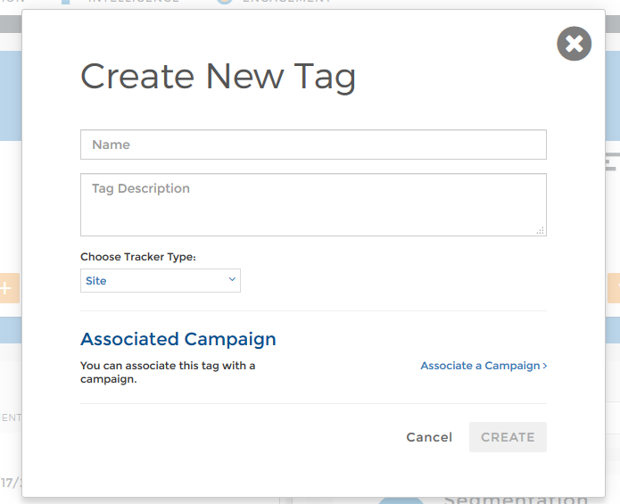
Create New Dynamic Site Tag
Give the tag a Name: We recommend creating a naming convention for your tags You may add a Description: This is optional but may help you define and further organize your tags.
Choose Tracker Type: Site
Click Associate a Campaign to assign a tag to a campaign: This will present a list of campaigns associated with your account. If you do not have a campaign to select, alert your Customer Success Manager.
Select a Campaign. Campaigns are an organizational mechanism for your Tags and do not interact with any platforms outside of Resonate Ignite. Reach out to your Resonate Customer Success Manager to create additional Campaigns. You can create multiple tags off a single basic campaign
Click Create to save the new Dynamic Site Tag
Enter the New Dynamic Site Tag Information

Slide 24
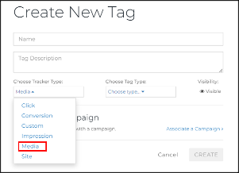
Create New Media Tag
Enter the following information for your new Media Tag:
Give the tag a Name. Names can include numbers and/or special characters. Example “Yahoo! Home Page Summer Promo Leaderboard.”
You may add a Description (this is optional). Descriptions can include numbers and/or special characters. Example “For placement in Yahoo! Network on Summer Widget Promotion leaderboards.”
Choose Tracker Type: Media
Enter New Media Tag Information
KnowledgeBase Link

Slide 25
Select Appropriate Media Tag Type
Select the appropriate Tag Type. In the Choose Tag Type drop-down list control select one of the Tag Type options. For Impression Tags, we recommend Impression - URL. For Click Tags, we recommend Click -Unencoded Redirect.
Click Associate a Campaign to assign a tag to a campaign. This will present a list of campaigns associated with your account. If you do not have a campaign, alert your Resonate Client Partner Manager or Customer Success Manager.
Select a Campaign. Campaigns are a foldering mechanism for your Tags. Reach out to your Resonate Customer Success Manager to create additional Campaigns.
Click Create to save the new Media Tag
Select Tag Type

Slide 26
Deploying Tags

Slide 27
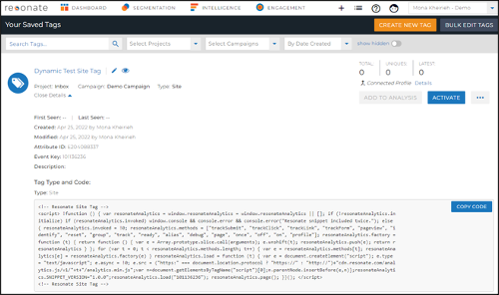
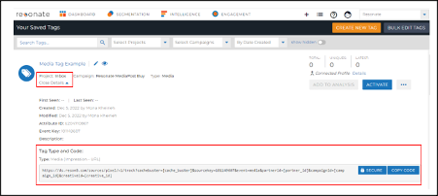
View your New Tags and Copy Code
On the Dashboard, click on the List icon - Tags.
The platform will navigate you to the Your Saved Tags page. Your newly created Tags will be on top.
When you need to copy the Tag code:
Within the tile for tag, click on View Details link to expand and display the code.
It changes to Close Details and the Tag details, type, and code are displayed.
Click the Copy Code button to have the Tag code copied to your clipboard.
Dynamic Site Tag Code Detail
KnowledgeBase Link
Media Tag Code Detail

Slide 28
Deploy Dynamic Site Tag & Track Method Strategy
Deployment of Dynamic Site Tag into Google Tag Manager (GTM) and firing it on all pages can quickly capture visitation at your website's topline domain level. This provides the foundation for overall site analysis.
But in order to gain further value in the Resonate platform with deep insights into your users, it requires more meaningful groups of data to be returned. You may accomplish this by creating the required Track Method Snippets for site mapping and/or user events. The format and details are outlined in the Create Track Method Snippets article.
For site mapping objectives, clients may also need to create Regex Table Variables in Google Tag Manager that send back to Resonate 'categories' of pages by using RegEx pattern matching on the specific page URLs. This solution requires creating Regex Tables and an adequate understanding of Regular Expressions to categorize pages based off the section page URL.
For capturing user event objectives, you will need to pair a Resonate Track Method snippet with the appropriate user event trigger action(s) when creating your snippets. The snippets are then used to Create and Deploy Tags in Tag Manager.
KnowledgeBase Link
Notes:
.

Slide 29
Media Tag Implementation
After Creating/Copying the Media Tag the next step is to customize your parameters before placing your tag in the appropriate media channel.
How to Add Media Tags to Google Campaign Manager
Google Campaign Manager allows placing tags at the Advertiser, Campaign or Placement level. In most cases campaign level tagging will be preferable.
Resonate tags will capture whatever parameters are passed through the tag. If using macros, only the ids passed by the macros will be visible in the Resonate platform. We recommend you maintain a dictionary on your end to translate GCM ids to readable names.
Tag Capabilities in Social Media
Resonate is unable to directly pixel/place a tag in a Twitter, Facebook or a YouTube ad on the impression. However, we can pixel users who click on outbound links from the ad (Standard Click-Through). Any ad linking to an exterior landing page can be tracked via a Resonate Click Redirect. In order to do this, we use a standard Resonate Click Redirect tag.
Facebook Tag Implementation Create your click redirect tags the usual way in Resonate, copy the code from the Resonate platform, add your landing page URL, and include a question mark at the end. You only need to do this for click redirect tags used in Facebook.

Slide 30
Tag Creation & Deployment Summary
What You Have Learned
Key Steps
Strategy for which data to collect via Resonate Tags
How to create a Dynamic Site Tag
How to create a Media Tag
How to copy the tag code
Click on Create - Create a Tag
Give Tag a name, and choose appropriate tag type
View the Tag
Copy the code
Place the tag on site
FAQ
For Additional Help
Knowledge Base Articles – All About Tags
Resonate Tags play an integral role in providing you with deep insights to better understand and engage with the people interacting with your brand and digital footprint.
Client Administrator users and Analyst users in Resonate have the ability to create and manage their own Resonate Analytics Tags.
These Tags can be placed on websites and media properties.
All About Site Tags
All About Media Tags
Creating Your Dynamic Site Tag
Viewing/Copying Your Tag Code
Deploying Your Site Tag
Creating Your Media Tag
Implementing Your Media Tag

Slide 31
Quiz!
What tag does Resonate recommend that all clients create and place on their website?
What is the strategy to implement with the Dynamic Site Tag that allows tracking the sections and pages of your site, as well as user event actions, that will provide the best insights in the Resonate platform?
What are the two different Media Tag types?
Notes:
Site Tag
Track Method
Impression and Click Tags

Slide 32
Next Up
Module 7: Tag Analysis and Trend Analysis: Gain a Deep Understanding of Consumers Engaging with your Digital Assets

