Slide 1
Resonate Client Training
Audience Analysis & Activation – Audience Analysis – Curated Reports​
Quick Answers to Common Questions

Slide 2
Audience Analysis – Curated Reports
Pre-Requisites for this Module
Getting Started: Orientation- Getting Your Resonate Account Configured for Success
Getting Started: Audience Building- Build your Custom Audiences or Personas

Slide 3
In This Module You Will:
Analyze your Male Millennial audience
Understand Audience Metrics
Understanding Analytics Metrics
Get quick answers to common questions with our 9 Curated Reports
Understand the Human Element of your audience
Understand why they buy, endorse or abandon
Understand why they make decisions

Slide 4
Analyze Male Millennials

Slide 5
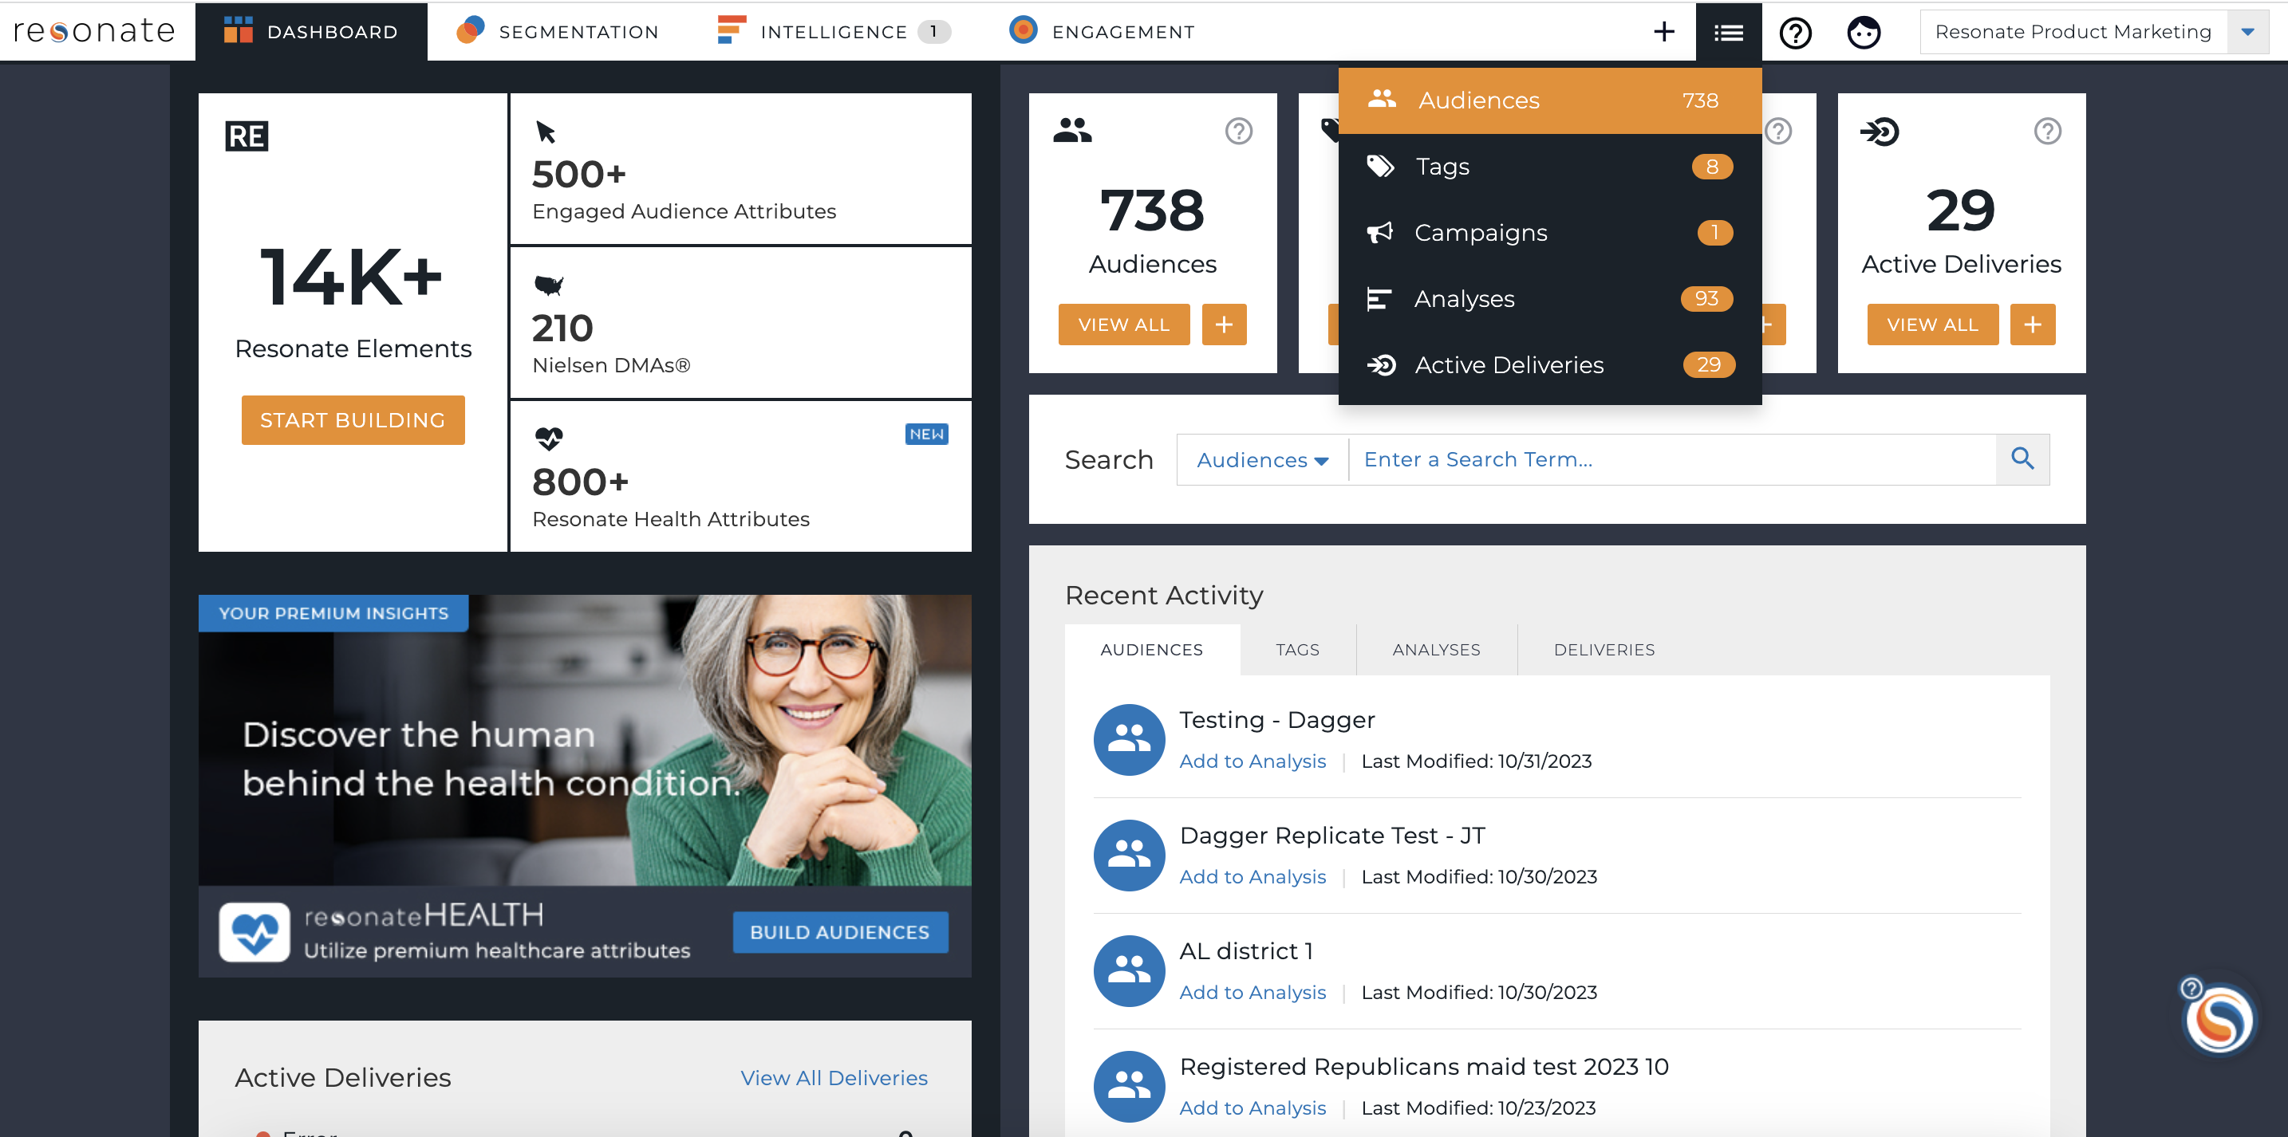
Your Saved Audiences
Navigate to your Saved Audiences
Click List icon in the navigation menu and select Audiences
Notes:
Do this along with me.
First, let’s find our previously saved Male Millennial audience.
Click Manage – then Audiences

Slide 6
Refresher: Understanding Audience Metrics
Estimated targetable ids:
Estimated Targetable is the available number of IDs within Resonate’s ID Graph that can be activated for this audience.
Projected Adult Population
The number of unique people in the audience. The percentage represents the share of the total online adult population (18+) that fits into your audience definition.

Slide 7
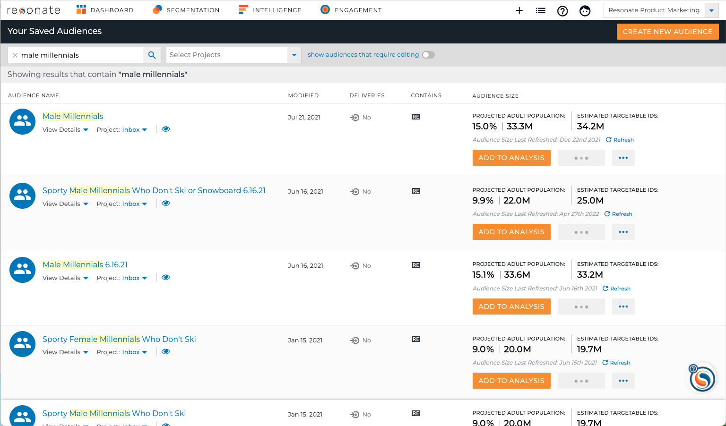
Add Audience to Analysis
Use the Search to find Male Millennials
Click Add to Analysis
Notes:
Search to find the Audience that you want to analyze. Click Add to Analysis.

Slide 8
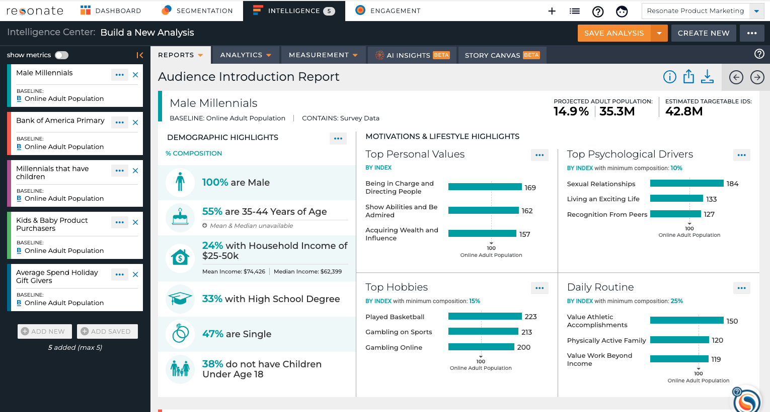
Analyze
Select additional Audiences
Add up to 5 saved or new audiences in your Analysis
All Audiences in your Analysis appear on the left
Notes:
You can have a total of 5 audiences in your analysis.
You can add saved audiences and tags to your analysis using these tabs, or add a new audience.
For now let’s just analyze our Male Millennial audience.

Slide 9
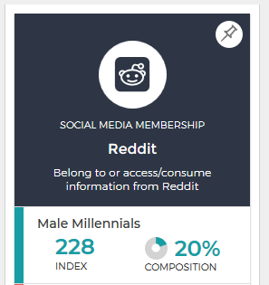
Refresher: Index and Composition
Index scores report how more or less likely your specific audience is to possess a trait or attribute relative to the baseline audience, with 100 representing average. Any attribute indexing at higher than 100 is unique to your audience; if it is below 100, that attribute is less present among your audience than the baseline audience.
Ex: An index of 228 for Reddit means Male Millennials are 128% more likely than the average adult online to use Reddit.
Composition: The proportion of those in an audience who have that specific trait.
Ex: A composition of 20% for Reddit means 20% of people in my Male Millennials audience belong to or access/consume information from Reddit.
Pro Tip: As a guideline, we look for attributes with an Index of 120 or above to identify attributes that are unique and meaningful to the audience and attributes with an index of 80 or below to identify attributes that are not important or distinctive about the audience.

Slide 10
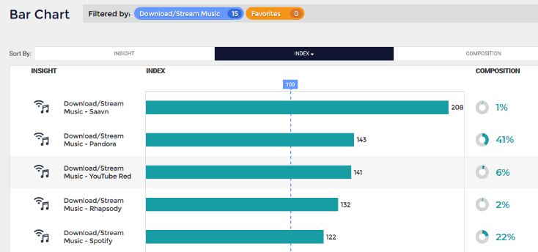
Refresher: Index vs Composition
When to use which metric?
Depends on your business needs
Focus is Scale – pay attention to Composition
Focus is Precision – rely on Index
Using a mix of both provides best results
Pro Tip: In the image above, if we rely solely on index, and decide to run ads on Saavn Music, we’d only be reaching 1% of our audience. The YouTube Red insight is interesting and tells us our audience is 41% more likely to listen to YouTube Red, and there are 6% of them in my audience. If YouTube Red isn’t part of our music/radio advertising strategy, perhaps it should be.
Notes:
There are two sides to the Index/Composition coin, and the correct way to interpret an attribute value's Index and Composition ultimately depends on the business needs, the use case and the subject you want to learn about.
If the focus of your research is scale, pay attention to Composition. Watch out, though, because if Composition is your sole metric for finding insights, you may only find things you already know, such as “Lots of Millennials use Instagram."
On the other hand, if it’s precision and efficiency you’re looking for, rely on Index. It will tell you interesting things about your audience that you may not already know and help you differentiate your approach.
We’ll go over this topic in more depth as we learn how to analyze audiences and tags, but we have a great Guide to Understanding Index and Composition in our Knowledge Base on this topic.
https://support.resonate.com/hc/en-us/articles/360004006033-The-Definitive-Guide-to-Understanding-Index-and-Composition

Slide 11
Quick Answers to Common Questions with Curated Reports

Slide 12
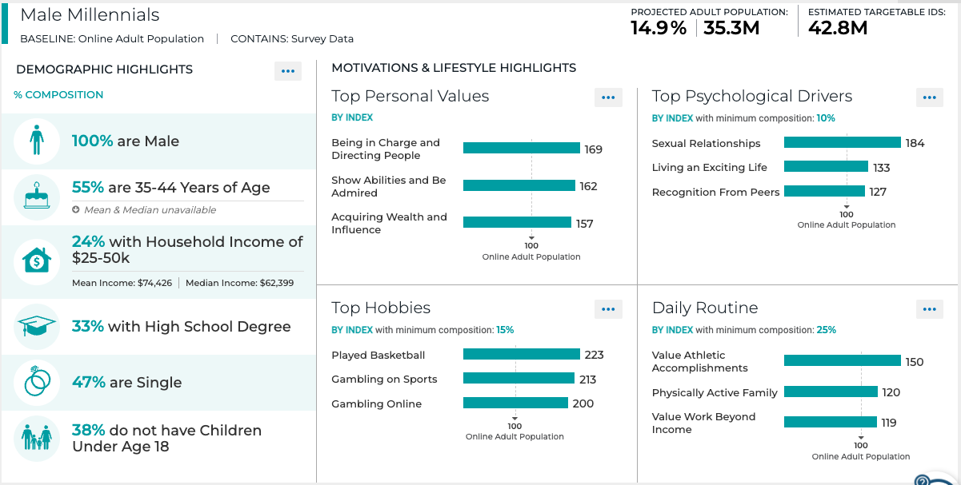
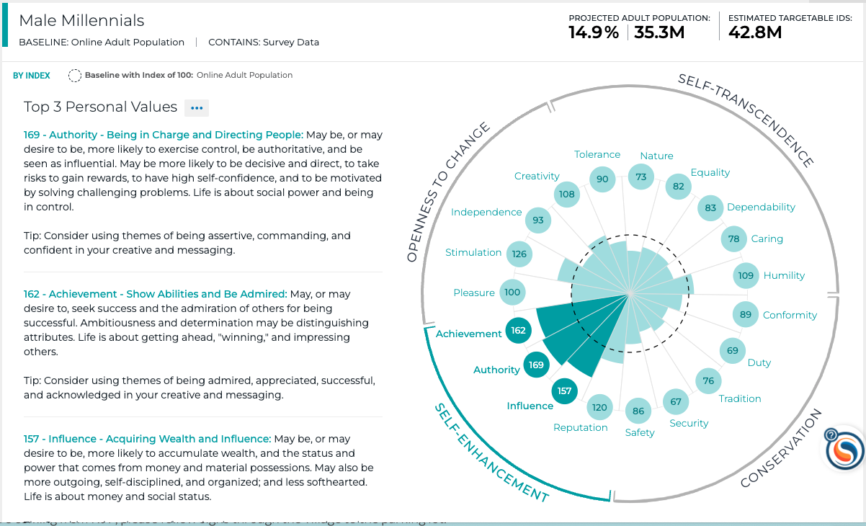
Working with Curated Reports
9 Curated Reports
Designed to make it easy to tell a story with your data
Provide quick answers to common questions
What does your audience look like demographically?
What do they value?
Where do they shop?
What restaurants do they prefer?
Easily sharable and exportable
Insights to drive your marketing and creative strategy
Notes:
Our product, engineering and professional services team partnered together to develop 9 curated reports to make it easier for you to tell a story with your data.
They allow you to gain a deep understanding about your audiences quickly and easily.
They’re designed to provide quick answers to common questions such as
What does your audience look like demographically? What are their hobbies?
What do they value?
Where do they shop?
What restaurants do they prefer?
Etc.
They’re designed to be easily shared and exported so you can include them in presentations or creative briefs.
Armed with these powerful insights, you will find that developing your marketing and creative strategy is much easier.

Slide 13
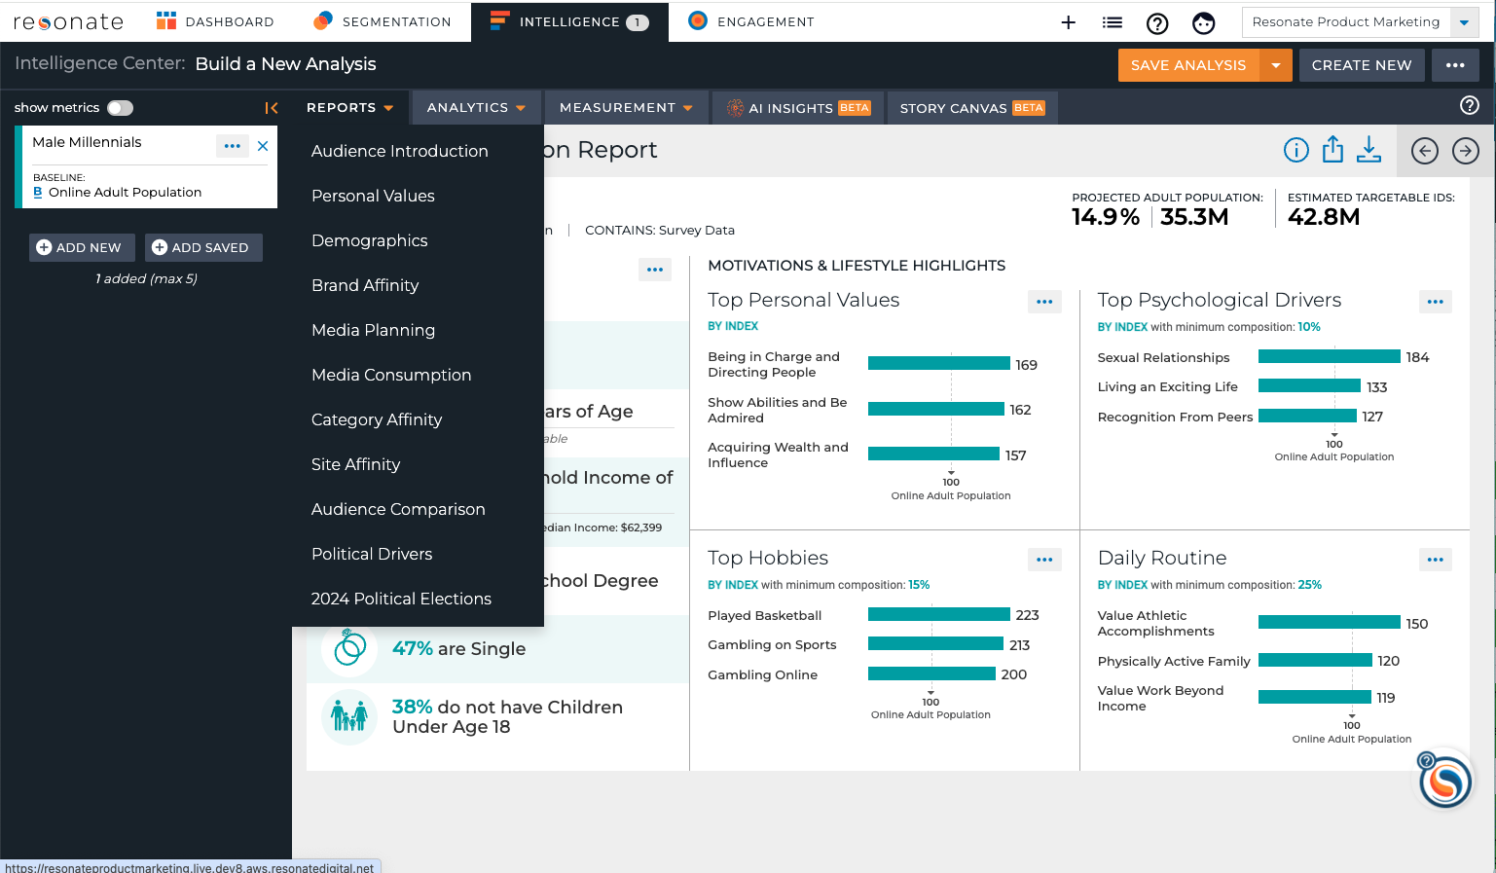
Viewing the Curated Reports
Under the Reports Tab when viewing an Analysis
Click arrow keys to move from report to report
Political Drivers Report enabled for Political clients
Pro Tip: Use your keyboard’s arrow keys to move from report to report.
Notes:
You will find all curated reports under the Reports tab when viewing an Analysis.
Switch between reports anytime by opening the Reports tab and clicking on any report.
You can also use the Arrow buttons to flip to the next report, or even use your keyboard arrow keys to flip to the next report.
Note that some reports, such as the Site Affinity Report and the Political Drivers Report, come at additional cost.

Slide 14
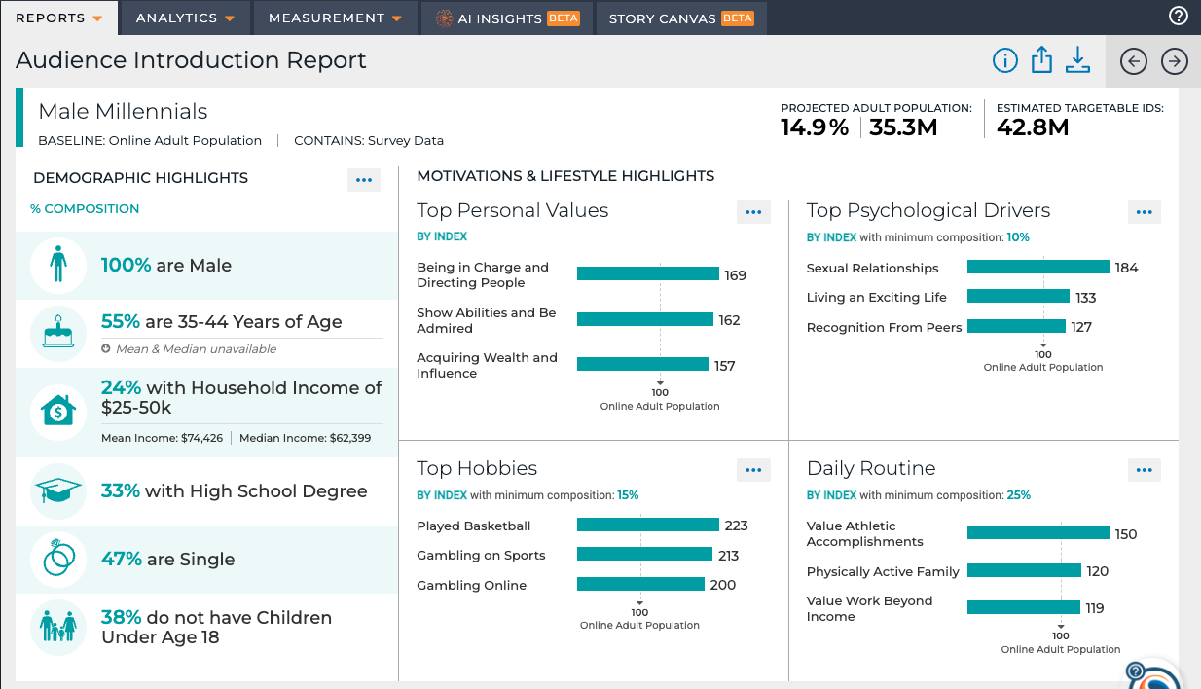
Working with Curated Reports
Each report section has an Index or Composition threshold
Helpful Explanations in the Report Glossary
Share via Email – even with non-Resonate users!
Presentation-friendly exports
Notes:
Index or Comp threshold for each report section used to display the insights. Noted under each section header.
All curated reports come with helpful explanations. And you can share them with ease.
The Report Glossary: When looking at any curated report, click on the i icon to view the Glossary. It will explain how to best use each report.
Share via Email: You can easily share reports with your coworkers or external non-Resonate users by clicking on the blue Share icon.
Export Report: Get a presentation-friendly version of your report by downloading it as a .png file.

Slide 15
Interpreting the Audience Introduction Report
Who makes up my audience?
Who are they demographically?
What are their Top Personal Values & Psychological drivers?
What are their hobbies and what’s their daily routine look like?
Pro Tip: Use this report to gain a base understanding of your audience and to help identify interesting insight areas to dive deeper via the Analytics visualizations.
Notes:
The Audience Introduction Report provides you with an overview of your audience.
Get Demographic highlights and a glance into your audience’s values, motivations and lifestyle habits.
Use the insights in this report to inform your market research on an audience, customer segmentation and creative and messaging for advertising. This report also helps identify interesting insight areas where you want to take a deeper look via the Analysis visualizations.

Slide 16
Interpreting the Personal Values Report
What does my audience value?
Paints a picture of the Human Element and the why behind your audience’s everyday decisions
19 personal values
Validated cross-culturally
Consistent with Purchase Outcomes
Tips for messaging that will resonate
Pro Tip: Use the insights in this report to inform everything – your go-to-market strategy, your customer segmentation or persona strategy, your creative and messaging strategy, etc.
Notes:
The Personal Values Report paints a picture of the human element of your audience and the why behind your audience’s everyday decisions.
This report identifies and explains 19 personal values in four quadrants in a circular structure of human values that has been validated cross-culturally and proven to be consistent with purchase outcomes.
Develop a better understanding of the values that drive those in your audiences
Tips for messaging and creative that will resonate with your audience based on the things they value most.
Use the insights in this report to inform everything – your go-to-market strategy, your customer segmentation or persona strategy, your creative and messaging strategy, etc. Focus on the personal values that your audience over-indexes on and consider these as themes for your outreach. For example, you may have an audience that over-indexes on “caring for family.” So, your messaging should include a family-focused theme. Also, pay attention to the personal values that are under-indexed by your audience. You’ll want to avoid those themes in your campaigns because they won’t resonate with your audience.

Slide 17
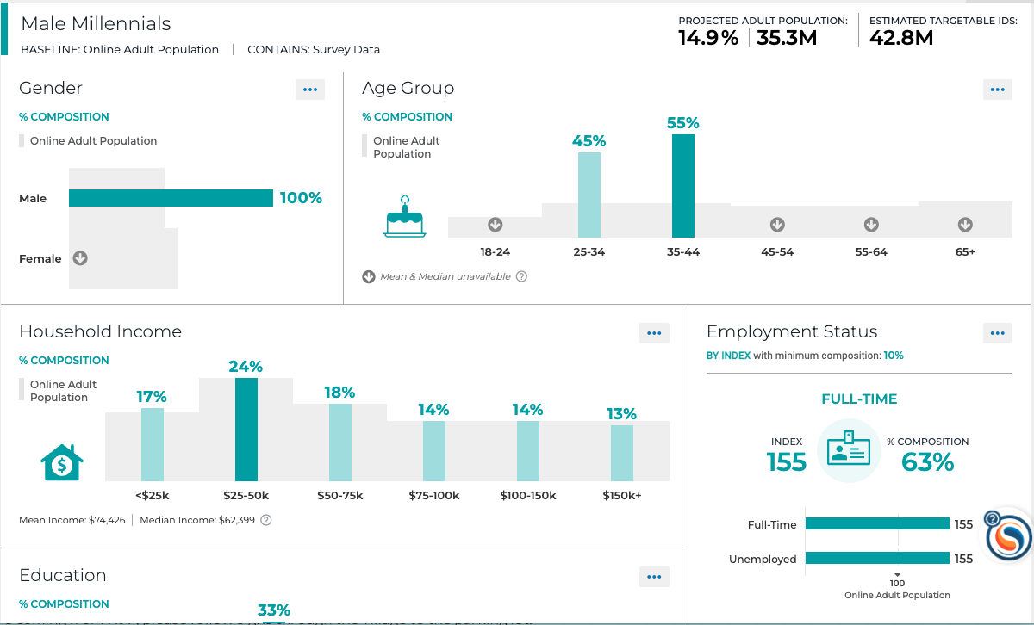
Interpreting the Demographics Report
What are the demographics of those in my audience?
What is their Household Income?
What is their Education Level?
What is their Marital Status?
Do they have children?
Pro Tip: Use this report to validate whether your target audience matches your assumptions demographically and potentially uncover new target audiences.
Notes:
The Demographics Report provides a full demographic breakdown to explain more about who makes up your audience.
Gain comprehensive insights into your audiences’ demographic composition
Develop a better and deeper understanding of your target audience
Gender
Age Group
Household Income
Employment Status
Education
Marital Status
Number of Children under 18 years
Use the insights in this report to inform your market research on an audience, customer segmentation and targeting strategy. Validate whether your target audience matches your assumptions demographically and potentially uncover new target audiences.

Slide 18
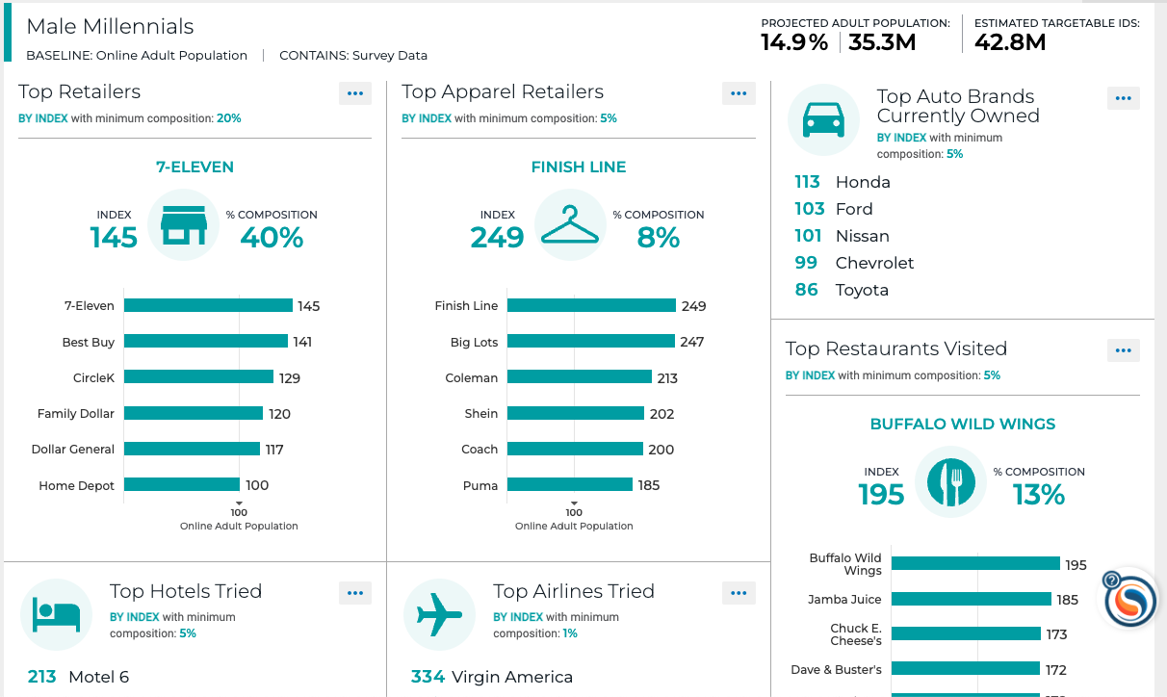
Interpreting the Brand Affinity Report
What brands does my audience value and trust?
What car do they drive?
Where do they shop?
What restaurants do they prefer?
What are their hotel and airline preferences?
Pro Tip: Use this report to understand where your consumers are shopping and to identify partners for marketing.
Notes:
The Brand Affinity Report provides you with a list of brands that are popular with and loved by your audience.
Understand where your, or your competitors’, consumers are shopping
Identify partners for marketing
Learn what brands your target audience trusts and values
Use the insights in this report to inform your market research on an audience, customer segmentation and creative and messaging for advertising. With these insights, you can identify potential partners for marketing, and learn even more about where to find your audience, both online and offline. You don’t necessarily have to be in the Retail industry to find this report useful! People’s affinities for particular brands express who they are and what names they trust and value.

Slide 19
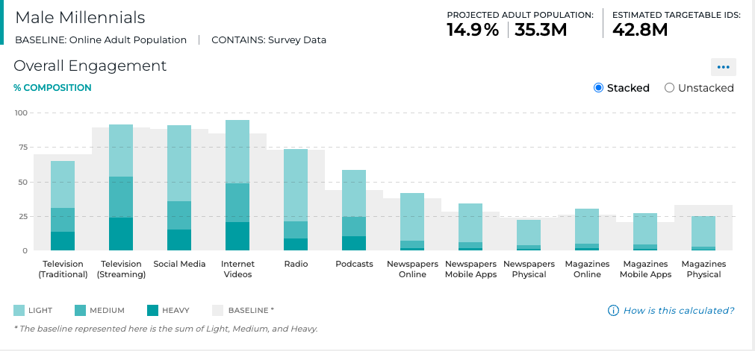
Interpreting the Media Planning Report
What media channels are my audience most engaged with?
What is their level engagement across various channels?
Traditional TV
Streaming TV
Social Media
Internet Video
Radio
And more
Pro Tip: Use this report as a starting point to make better targeting and ad-buying decisions by gaining a better understanding of your Audience's media engagement at the channel level, allowing you to easily identify where you should focus your targeting efforts.
Notes:
The Media Consumption Report helps you understand what an audience watches (show & networks, streamed shows), how much time they spend online, on social media and in front of their TVs, and what apps they use on their mobile devices.
Uncover where to find your consumers
Use this report to improve your targeting and ad-buying strategy and to understand your audience better
Use this report to make better targeting and ad-buying decisions and gain a better understanding of your audience. Determine which magazines and newspapers to run ads in - either in print or online. Confirm your social media marketing strategy is encompassing the highest indexing social networks for your audience. And understand what sort of mobile apps your audience uses regularly.

Slide 20
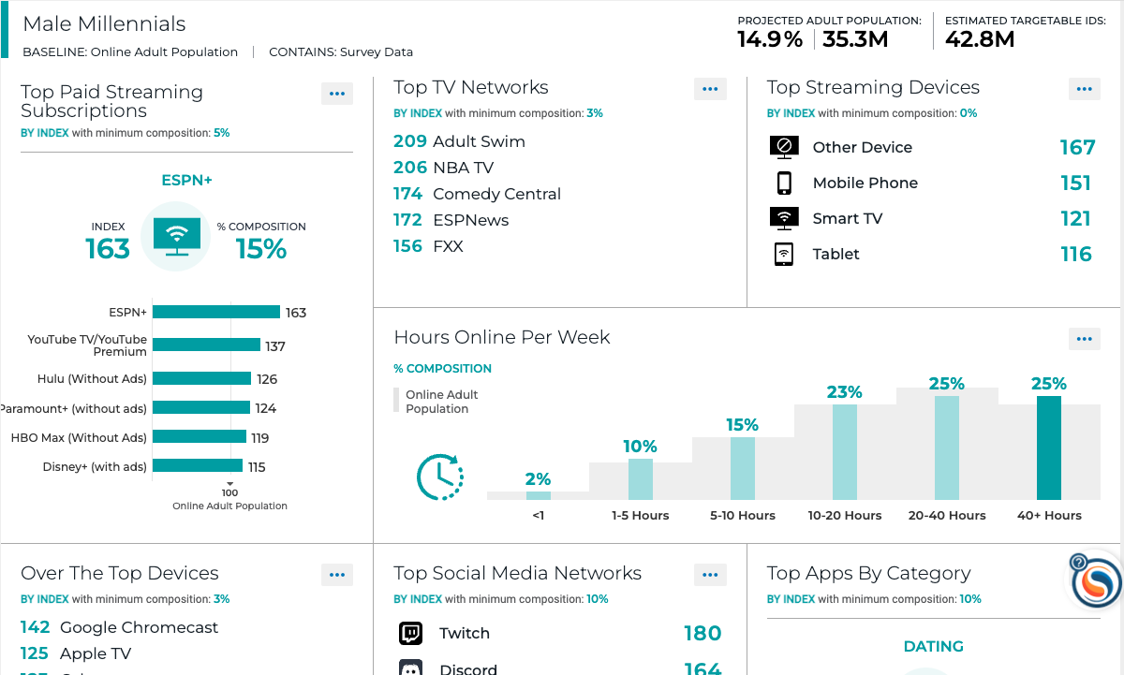
Interpreting the Media Consumption Report
Where do I find my audience online and offline?
What are their Top TV Shows and Top TV Networks?
How do they watch TV?
How much time do they spend online?
Which social networks do they use?
What magazines and newspapers do they read?
Pro Tip: Use this report to improve your targeting and ad-buying strategy and better understand your audience’s media habits.
Notes:
The Media Consumption Report helps you understand what an audience watches (show & networks, streamed shows), how much time they spend online, on social media and in front of their TVs, and what apps they use on their mobile devices.
Uncover where to find your consumers
Use this report to improve your targeting and ad-buying strategy and to understand your audience better
Use this report to make better targeting and ad-buying decisions and gain a better understanding of your audience. Determine which magazines and newspapers to run ads in - either in print or online. Confirm your social media marketing strategy is encompassing the highest indexing social networks for your audience. And understand what sort of mobile apps your audience uses regularly.

Slide 21
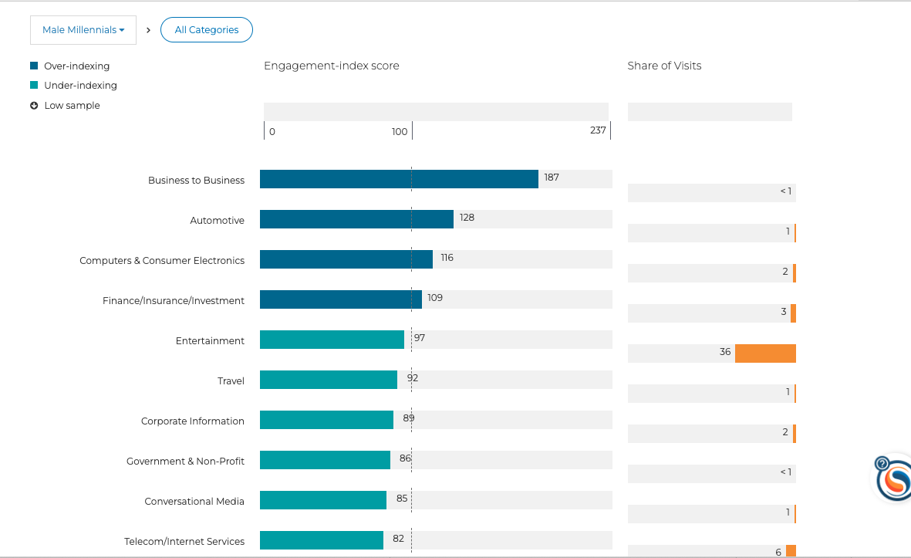
Interpreting the Category Affinity Report
What types of websites does my audience engage with?
How much of their overall online behavior those groups of sites account for?
High Engagement-Index Score and High Share of Visits indicates an extremely strong areas of the interest that can be targeted
Pro Tip: Use this report to understand where to find your audience online.
Notes:
The Category Affinity Report provides you with an understanding of the type of websites your audience is engaged with, and how much of their overall online behavior those groups of sites account for.
See the types of content your audience over-indexes for when constructing a media plan or defining your customer/voter segments
Understand where to find your audience online
This report is derived from our behavioral data stream and lists the categories of websites that people in your audience frequently visit.
Use the Category Affinity Report to see what types of content your audience over-indexes for when constructing a media plan or defining your customer/voter segments.
The Engagement-Index Score provides the verticals for which your audience is engaged, including over- and under-indexing categories. This is calculated using a combination of time spent on, repeat visitation to and number of visits per visitor to websites in the category. This shows how much more or less engaged the audience is with sites in the category than the average online adult population.
High Engagement-Index Score and High Share of Visits indicates an extremely strong area of the interest that can be targeted.
Share of Visits, when available, provides another level of engagement metric. It shows the percentage of visits spent on websites within the category compared to all time spent online.
Low Sample data is represented by a down-arrow icon.
A higher Share of Visit means a large portion of your audience visits those sites, but if the Engagement-Index Score is lower—that indicates that that category is not particularly unique to your audience compared to the online population.
A lower Share of Visits number means less of the total audience visits those sites, but a high Engagement-Index Score means that a small portion of the audience is more likely to visit those sites (so it’s a niche unique area to precisely target those people).

Slide 22
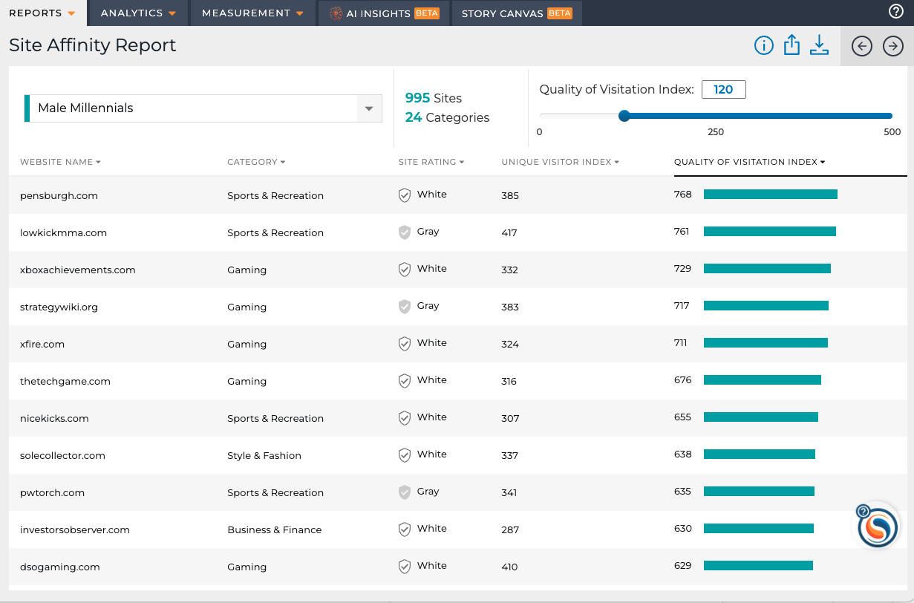
Interpreting the Site Affinity Report
What specific websites does my audience visit online?
Make better-informed decisions for targeting and ad-buying strategy
Activate at scale via your DSP
Note: the Site Affinity Report comes at an additional cost and is available for survey audiences only
Pro Tip: We recommend that you filter for websites that are white and have a Unique Visitor Index of at least 120 to ensure that you find your target audience on the websites.
Notes:
The Site Affinity Report shows you a list of websites survey audiences frequently visit.
Identify where to find your audience online to make better-informed decisions for targeting and ad-buying strategy
Gain an additional understanding of what types of content people in your audience are interested in
Note: the Site Affinity Report comes at an additional cost and is available for survey audiences only
This report is derived from our behavioral data stream and lists the domain name, category, Trust Metrics rating, Unique Visitor Index, and Quality of Visitation Index of websites that people in your audience frequently visit.
Keep in mind that you cannot generate a Site Affinity Report for audiences containing attribute values with sensitive medical conditions, sexual orientation, or transgender identity.
Trust Metrics is a third party that scores sites on category fit, content, safety, site design and layout. "White" is the highest rating, while "Silver" is a unique flag for political content.
Unique Visitor Index refers to an audience's likelihood to visit the site relative to the total, average online population. UVI scores report how more or less likely your specific audience is to visit the site relative to the total online population, with 100 representing average. (Example - a UVI score of 152 means your audience is 52% more likely than the average adult online to visit the site.)
Quality of Visitation Index (QVI) is an engagement score that shows site engagement by measuring whether visitors are spending more time on the site, viewing multiple pages and coming back to the site.
We recommend that you filter for websites that are white and have a Unique Visitor Index of at least 120 to ensure that you find your target audience on the websites.

Slide 23
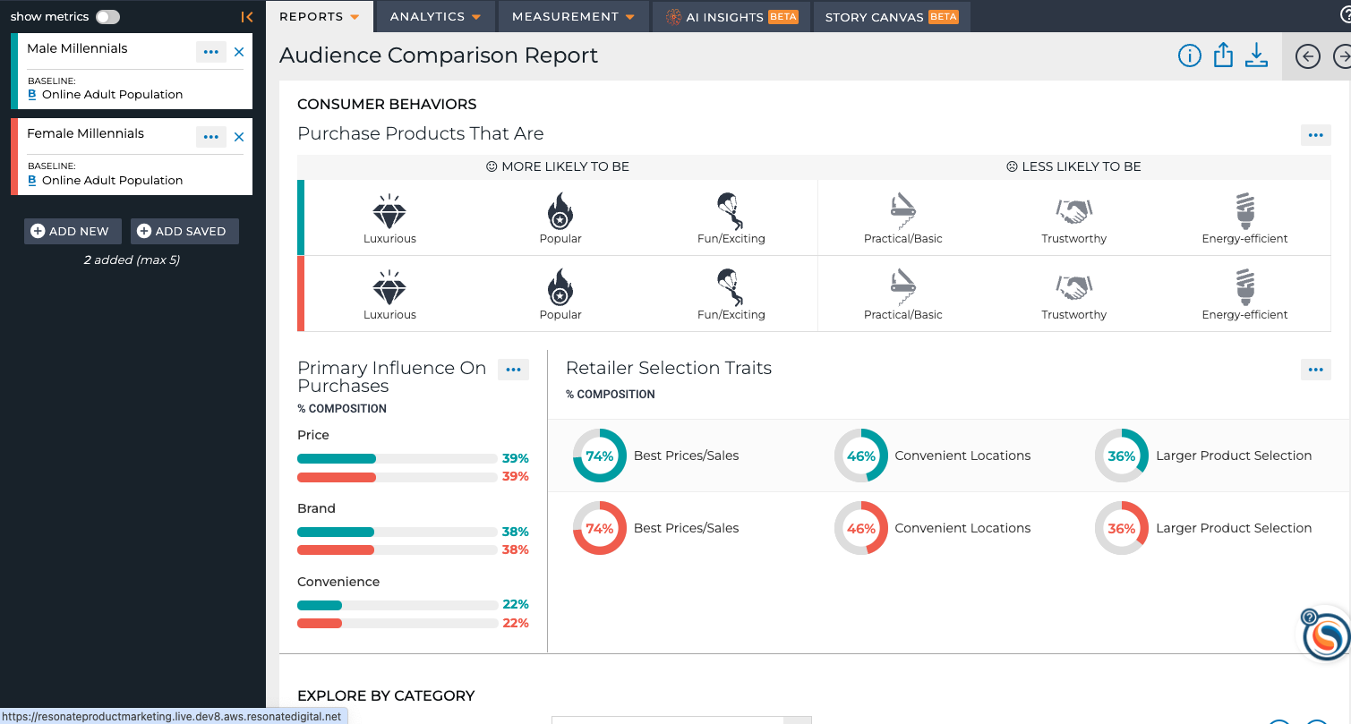
Interpreting the Audience Comparison Report
How do my audiences compare to each other?
Quick, at-a-glance overview of how audiences compare and differ
Inform market research, customer segmentation and creative/messaging
Identify interesting insight areas to deep dive into via the Analysis visualizations
Pro Tip: Use this report to easily compare two or more audiences to each other.
Notes:
The Audience Comparison Report provides additional demographic and psychographic insights that speak to the why behind a purchase or action, so you can further understand who makes up your audience, and the drivers behind their decisions.
Get a quick, at-a-glance overview of audiences
How to use it? Use the insights in this report to inform your market research on an audience, customer segmentation and creative and messaging for advertising. This report also helps identify interesting insight areas where you want to take a deeper look via the Analysis visualizations.

Slide 24
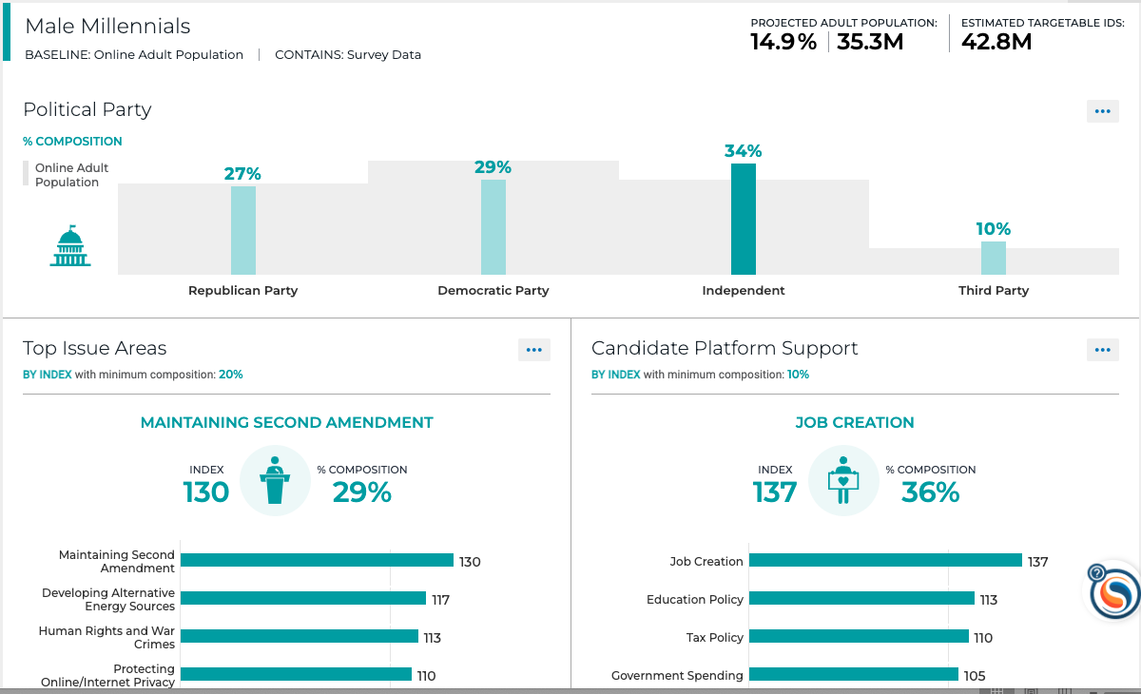
Interpreting the Political Drivers Report
What are my audience’s political drivers?
What’s their political party?
What candidate platforms do they support?
What’s their social and fiscal ideology?
Note: the Political Drivers report is only enabled for our Political clients
Pro Tip: Use this report to inform your campaign strategy and engage your voters and constituents.
Notes:
This report is only provisioned for our Political & Advocacy clients.
The Political Drivers Report provides a quick overview of an audiences’ political affiliation, engagement, ideology and the societal issues they care about.
Inform your campaign strategy and engage your voters and constituents
Use this report to develop a well-rounded view of your audiences
What’s their political party?
What candidate platforms do they support?
What’s their voting frequency?
What’s their social and fiscal ideology?
Note: the Political Drivers report is only enabled for our Political clients

Slide 25
Module 3 Audience Analysis – Curated Reports Summary
What You Have Learned
Key Steps
Navigating to a saved audience
Adding an audience to an analysis
Understanding audience metrics
Interpreting curated reports for quick insights
Understanding Index and Composition
Navigate to Your Saved Audiences
Add Audiences to Analysis
Switch between reports
Interpret insights in curated reports
FAQ
For Additional Help
Q: What’s more important, Composition or Index?
Both are the most important!
Composition is important to look at when determining scale – how many people possess this trait?
Index is important when trying to understand what differentiates an audience and makes them unique.
Q: What’s more important, Composition or Index?
Both are the most important!
Composition is important to look at when determining scale – how many people possess this trait?
Index is important when trying to understand what differentiates an audience and makes them unique.
The Definitive Guide to Understanding Index and Composition
Using our Curated Reports

Slide 26
Quiz!
Can you share the curated reports with people who don’t have a Resonate login?
How can you put these reports into your presentations or creative briefs?
Which report would you use to understand the why behind audience’s decisions?
Which report would you use to find where to target your audience online and offline?
Should you use Index or Composition to help drive decisions?
Notes:
yes! Via the share button on each report.
Export via the export button on each report.
Personal Values Report
Media Consumption Report
A mix of both is best.

Slide 27
Next Up
Next Module:
Module 4 – Audience Analysis: Deep Analytics – Gain a Thorough Understanding of Consumers

