Slide 1
Resonate Client Training
Custom Flash Models
Custom data on issues truly relevant to you

Slide 2
In This Module You Will:
Understand the benefits and use cases of Custom Flash Models
Get familiar with the process of running a Custom Flash Model with Resonate
Learn the limitations and caveats of using Custom Flash Models
Understand the differences between Custom Flash Models and Custom Spark Models

Slide 3
What are Custom Flash Models?

Slide 4
What are Custom Flash Models?
Custom Flash Models are short (typically up 5 minutes), custom surveys with up to 4K respondents
On any topic not included in Resonate’s core Survey
  “Who are the three types of people interested in my new TV show?”
Fielded outside of Survey Wave schedule
  Survey a more specific audience
  Get responses back within weeks
Notes:
These are short, standalone, custom surveys on any topic you care about. We run these surveys separately from our core survey and they take up to 5 minutes, which allows us to return the findings to you much faster – in 4-6 weeks. An added benefit of these surveys being standalone is that they allow you to focus on and survey a particular audience.

Slide 5
The Benefits & Use Cases
of Custom Flash Models

Slide 6
Benefits to Custom Flash Models
Speed – Quick turnaround
  No need to wait for our next survey wave
  Get responses back within weeks
Survey a specific audience – Focus on audiences truly relevant to you
  Your brand, your latest campaign, your services compared to your competitors, or your new product
Activation - Engage with audiences online
  Connect with and convince persuadables
Segmentation Replication – Bring offline research online
  Use as a typing tool
  Take predefined segments and recreate them at scale for activation
Fully Integrated - Resulting audiences are tied to our 14K insights and 230M profiles
  Create more refined audiences by enriching Custom Flash Model audiences with survey, tag, and behavioral data
Deliverable beyond a raw file – Resulting audiences available in the platform

Slide 7
Custom Flash Model Use Cases
Activation
  Activate audiences of people who are persuadable on anything
    E.g. Going to see a movie, a political issue, etc.
  View insights against the audiences before activation as a way to understand how and where to message them. Focus on Media insights, Personal Values. Answer ”What would resonate with them?”
Insights for understanding how to engage audiences successfully
  Gain 14K insights on the new audiences resulting from your Custom Flash Model before you activate
Replicate a Segmentation / Typing Tool
  Bring your existing research online
  Take predefined segments and recreate them at scale for activation
  Results in audiences of people who fall into each segment

Slide 8
Custom Flash Models for Activation
Who would watch my new TV show and who wouldn’t?
We ran a Custom Flash Model that asked whether respondents were familiar with our TV show already
Respondents watched a trailer of the TV show
Based on their responses, respondents were categorized into 4 segments:
  Aware: Interested
  Aware: Not Interested
  Not Aware: Interested
  Not Aware: Not Interested
Aware of TV show?
Watch trailer
Aware: Interested
Not Aware: Interested
Aware: Not Interested
Not Aware: Not Interested
Notes:
For our first use case, let’s imagine that we’re working for a Premium TV channel and we’d like to understand who would be interested in watching our new TV show, and who wouldn’t.
We ran a Flash Survey with Resonate not only to activate segments interested in our TV show – we also want to use Resonate’s insights to see how we could persuade non-interested segments to watch our show.
In the questionnaire itself, respondents had been asked whether they were already aware of our TV show. Afterwards, they watched a trailer for it and had to state if they were interested in watching the show or not. Based on their responses, people participating in the Flash Survey were segmented into four buckets:
Aware: Interested
Now Aware: Interested
Aware: Not Interested
Not Aware: Not Interested

Slide 9
Custom Flash Models for Activation
Now we can engage with the two Interested segments online and at scale with the right messaging.
However, we still need persuade the Not Interested segments to watch our TV show!
  Focusing on their Personal and Psychological Values and Media Consumption, we’ll analyze these segments and develop a messaging and creative strategy that will resonate with them
Notes:
Compared to our Not Interested segments, we’re probably more likely to succeed in engaging with our two Interested segments. Before we could win over our Not Interested segments, we need to understand them better. When we’re analyzing our Flash Survey audiences, we should focus on insights that will aid in activation. So we’ll focus on these segments’ Personal and Psychological Values and Media Consumption. Our goal is to develop a messaging and creative strategy that will convert them into viewers of our new TV show.

Slide 10
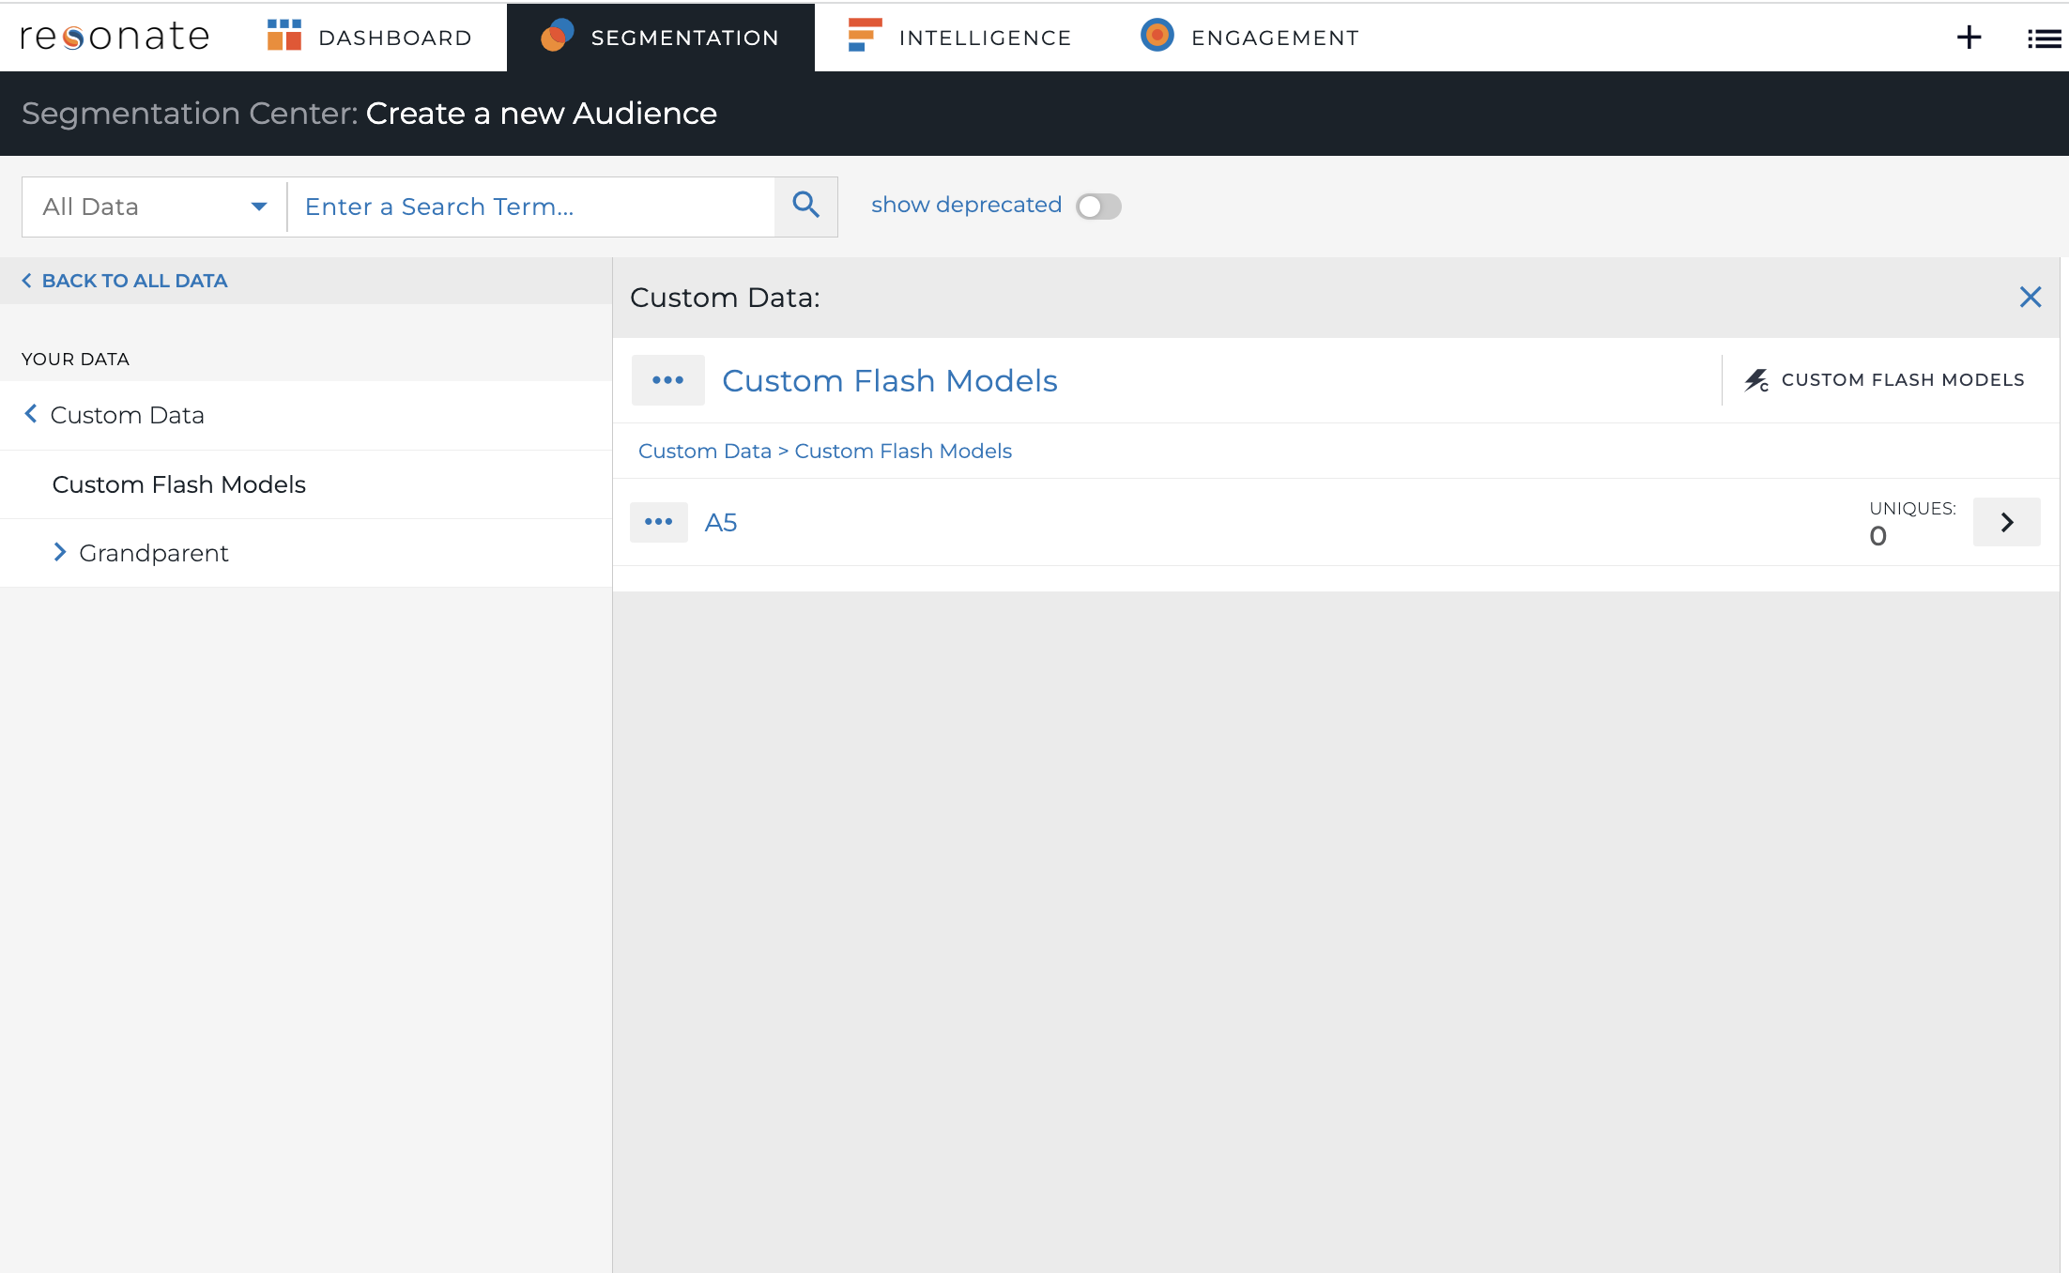
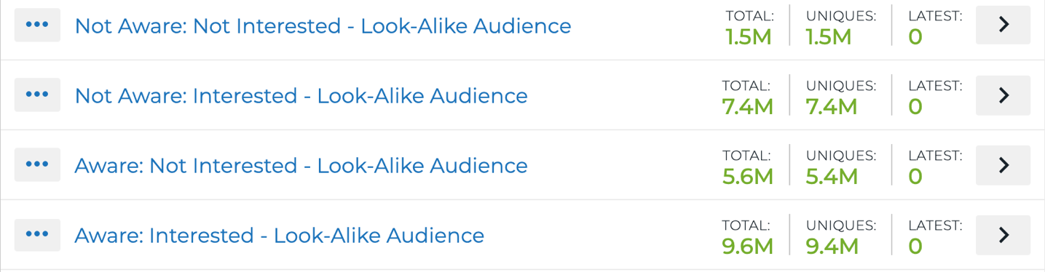
Custom Flash Models for Activation
Insights for understanding how to engage an audience successfully
Let’s gain a deep understanding of our two Not Interested segments:
Segmentation – Your Data – Custom Data – Custom Flash Models
Add Not Aware: Not Interested to audience definition
Save audience
Click Add to Analysis

Slide 11
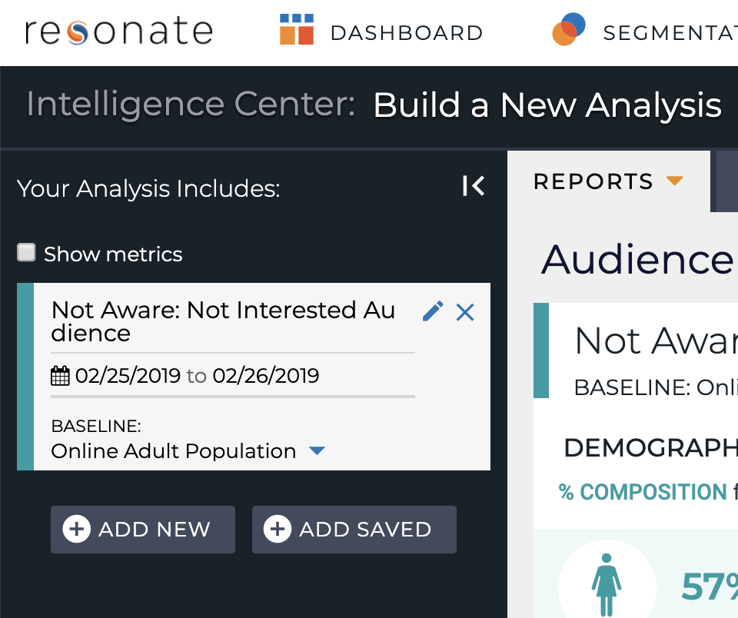
Custom Flash Models for Activation
Insights for understanding how to engage an audience successfully
Click Add New button in audience sidebar
Segmentation – Your Data – Custom Data – Custom Flash Models
Add Aware: Not Interested to audience definition
Save audience
Click Add to Analysis

Slide 12
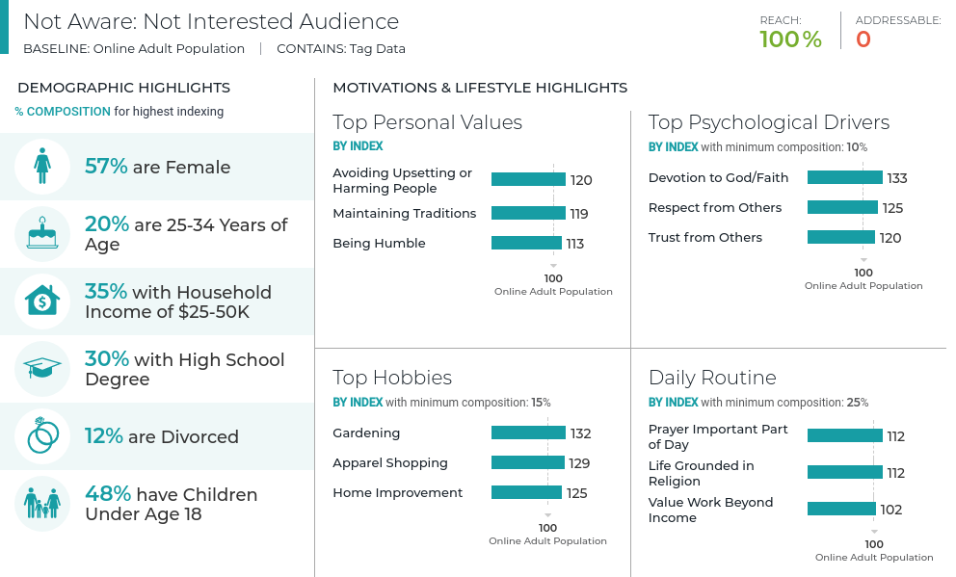
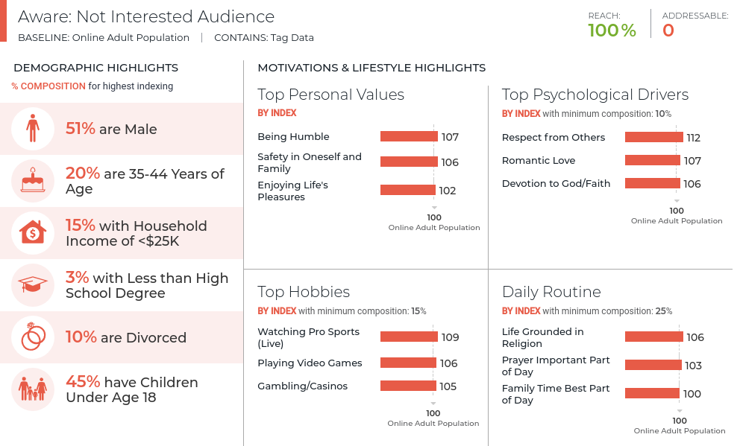
Custom Flash Models for Activation
Insights for understanding how to engage an audience successfully
Start developing an idea of who people in these segments are
Intelligence – Reports - Audience Introduction Report
Not Aware: Not Interested Segment:
  57% Female, 20% Age 25-34
  Enjoys gardening, shopping, home improvement
  Faith is important and values work beyond income
Aware: Not Interested Segment:
  51% Male, 20% Age 35-44
  Enjoys sports and going to casinos
  Faith and family are important

Slide 13
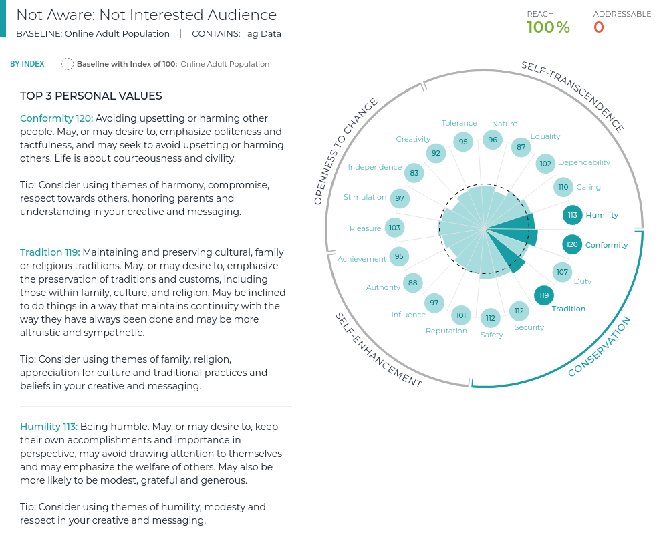
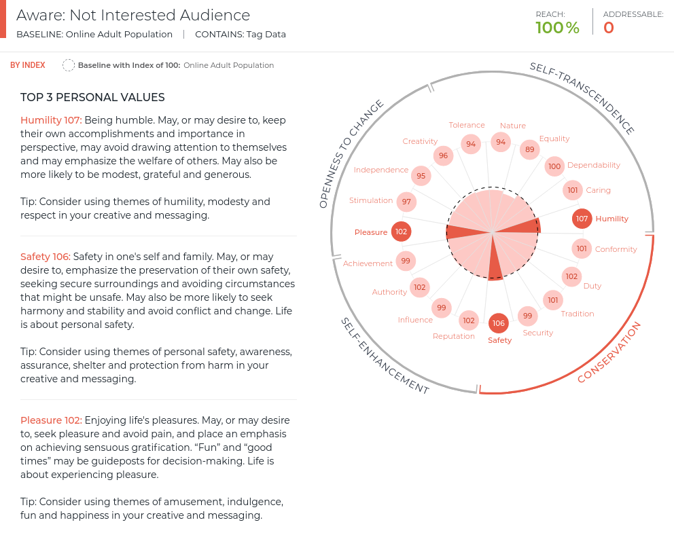
Custom Flash Models for Activation
Insights for understanding how to engage an audience successfully
Switch to Personal Values Report
Not Aware: Not Interested Segment:
  Driven by Conformity, Tradition & Humility
Aware: Not Interested Segment:
  Driven by Humility, Safety & Pleasure
Use the Glossary for additional messaging tips!

Slide 14
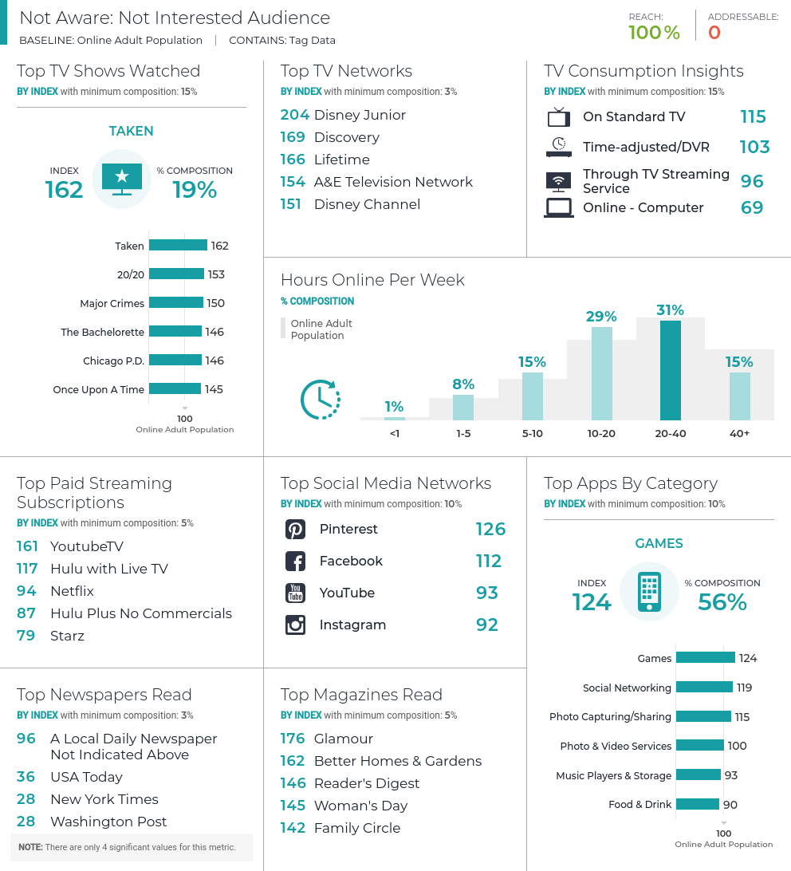
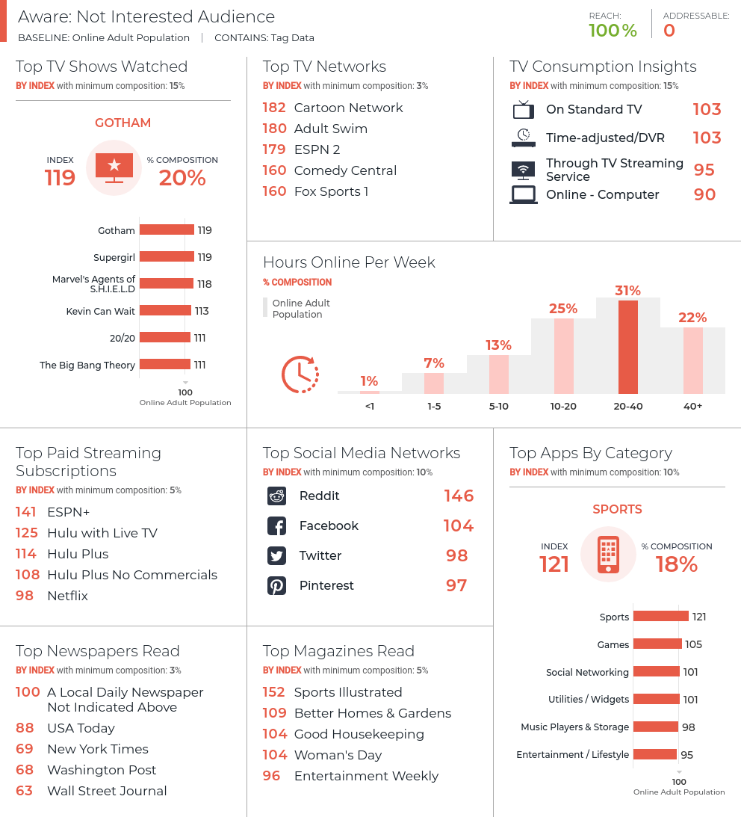
Custom Flash Models for Activation
Insights for understanding how to engage an audience successfully
Switch to Media Consumption Report
Not Aware: Not Interested Segment:
  Watches TV Shows Taken, 20/20 and Major Crimes
  Streams of YouTubeTV
  Uses Pinterest
Aware: Not Interested Segment:
  Watches TV Shows Gotham, Supergirl and Marvel’s Agents of S.H.I.E.L.D.
  Streams on ESPN+
  Uses Reddit

Slide 15
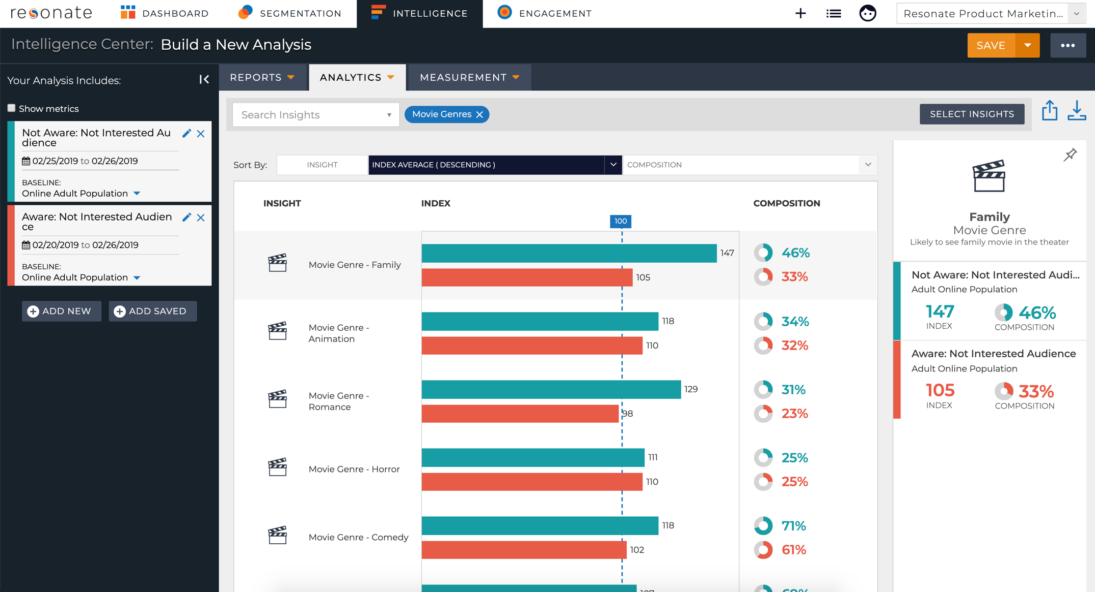
Custom Flash Models for Activation
Insights for understanding how to engage an audience successfully
What types of movies are they likely to enjoy?
Intelligence – Analytics – Bar Chart
Select Insights – Search for Movie Genres
Click Done
Not Aware: Not Interested Segment:
  Family, Romance, Comedy
Aware: Not Interested Segment:
  Sport, Animation, Horror

Slide 16
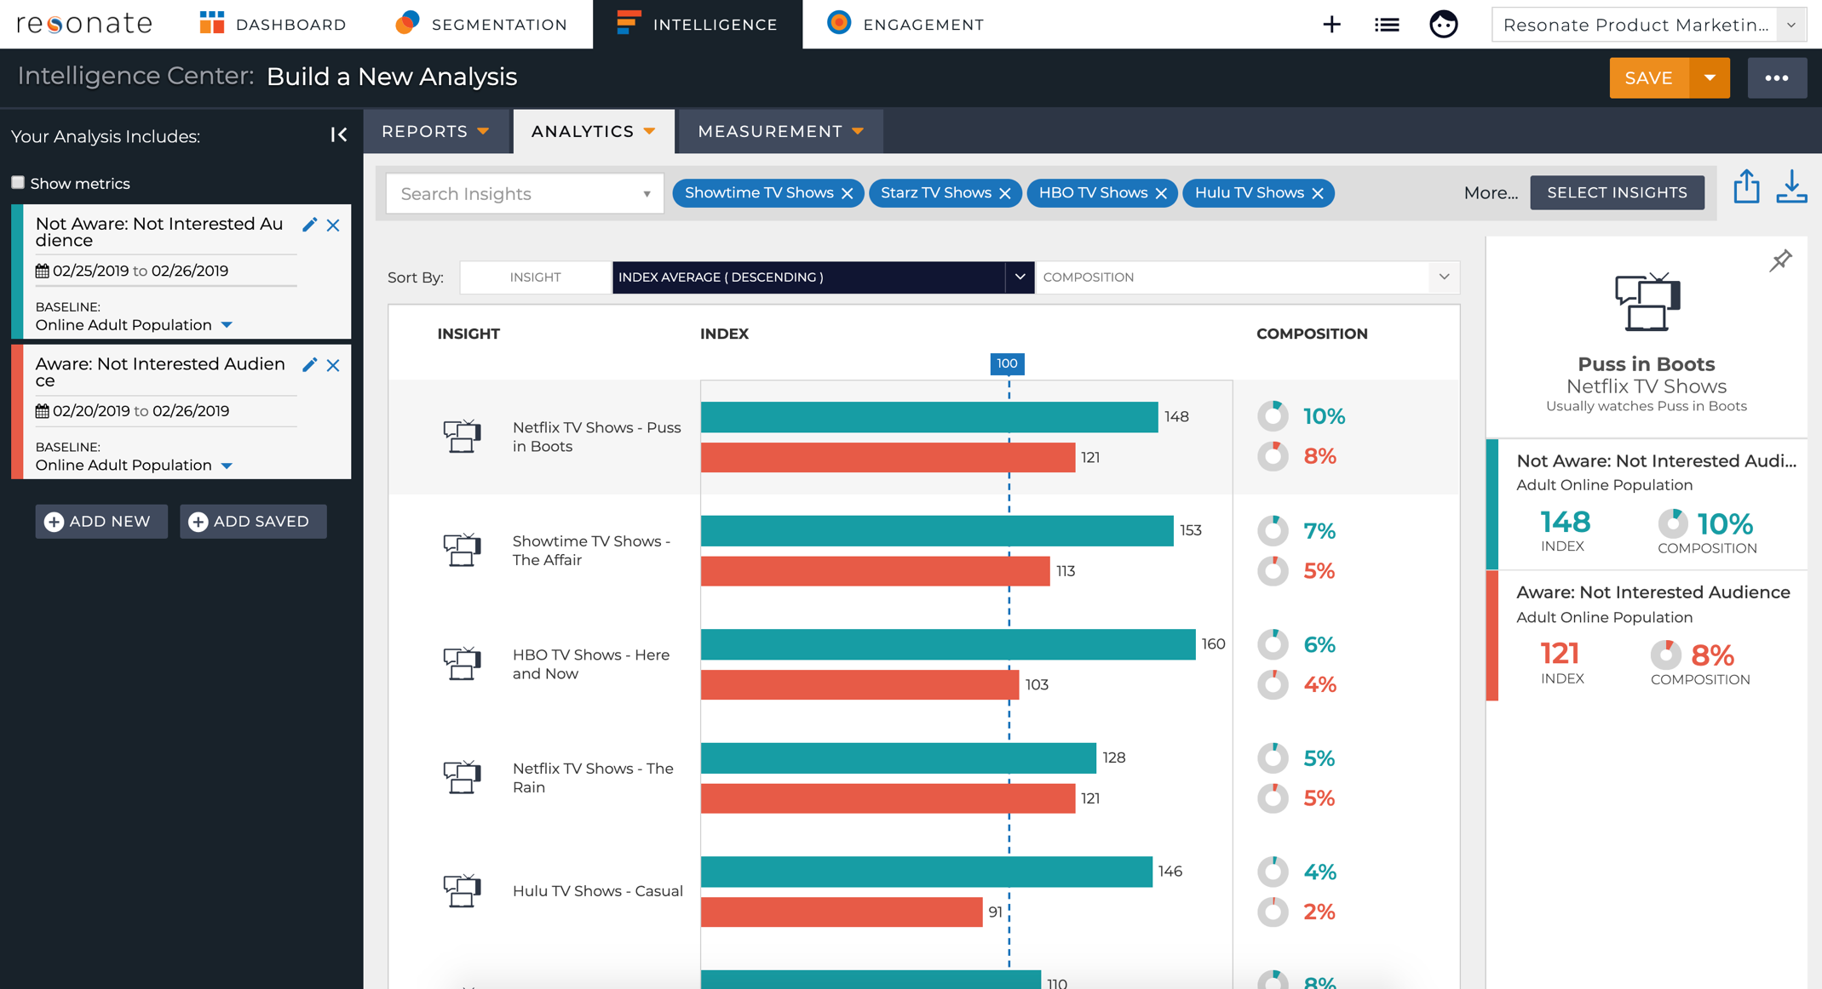
Custom Flash Models for Activation
Insights for understanding how to engage an audience successfully
What types of Premium TV shows are they likely to watch?
Select Insights – Media – Media Consumption – Television Shows – Add HBO TV Shows, Showtime TV Shows, Starz TV Shows, Amazon Prime TV Shows, Hulu TV Shows, Netflix TV Shows
Click Done
Not Aware: Not Interested Segment:
  The Affair (Showtime), Puss in Boots (Netflix), Here and Now (HBO)
Aware: Not Interested Segment:
  Ash vs. Evil Dead (Starz), Runaways (Hulu), Hard Knocks (HBO)

Slide 17
Custom Flash Models for Activation
Summary: Insights for better engagement
 | Not Aware: Not Interested | Aware: Not Interested
Driven by | Conformity, Tradition & Humility | Humility, Safety & Pleasure
Preferred Movie Genres | Family, Romance, Comedy | Sport, Animation, Horror
Most Watched Premium TV Shows | The Affair (Showtime), Puss in Boots (Netflix), Here and Now (HBO) | Ash vs. Evil Dead (Starz), Runaways (Hulu), Hard Knocks (HBO)
Scenes to include in our messaging | Tight-knit family sitting around a dining table. Children learning from their elders. A wisecracking grandmother lectures our hero about the intricacies of love. | Our TV show is not the genre this audience likes and doesn’t have the themes that would appeal to this audience!
Deep-diving into these insights allows us to see how to message our Aware: Not Interested segment the right way
We even uncover that the Aware: Not Interested segment is not worth our investment because our TV show is very different from what they enjoy watching
Notes:
Now let’s summarize what we learned from our curated reports and analyses. Side-by-side, it’s easier to see how to use this information to persuade our audiences. We see how we could message our Aware: Not Interested segment to convert them into viewers. On the other hand, looking at insights about the Aware: Not Interested segments, we realize that this segment is not worth our efforts! They over-index for genres very different from ours and the shows they enjoy watching are not at all similar to ours.

Slide 18
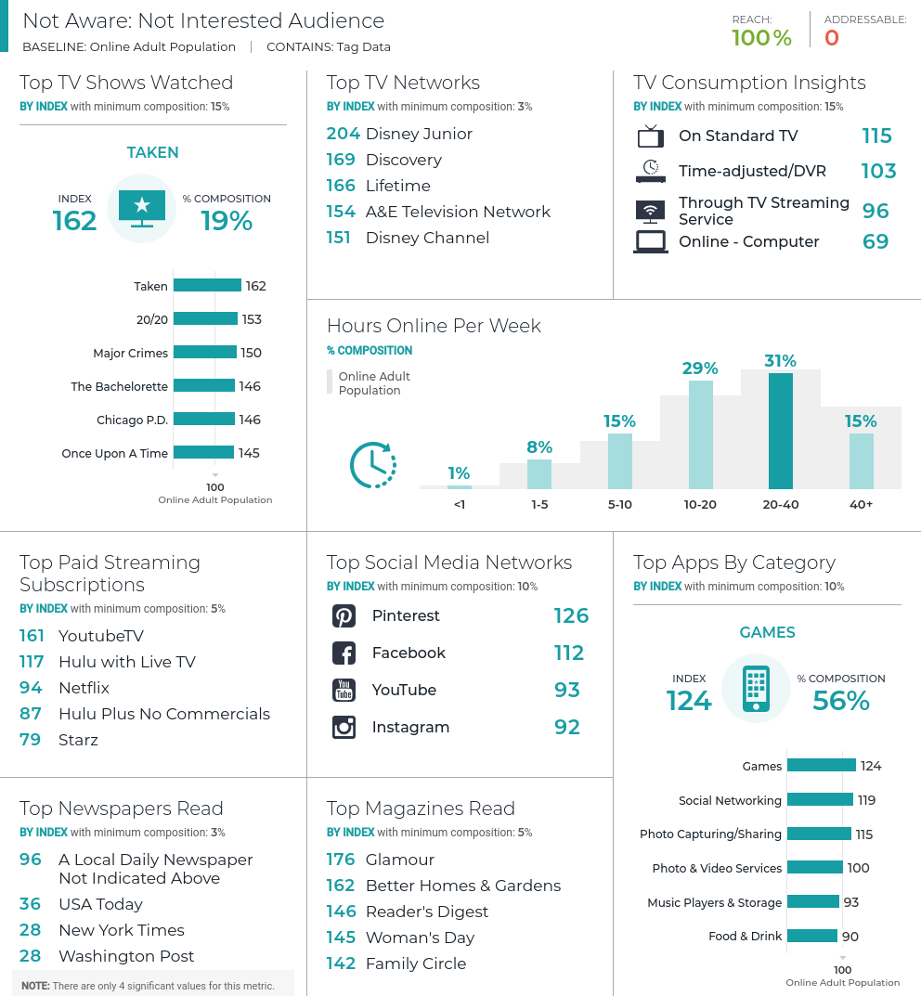
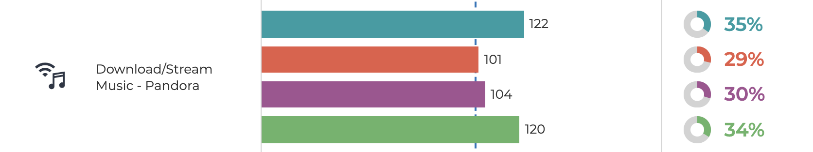
Custom Flash Models for Activation
Where to Find Segments Online & Offline
Use Resonate’s curated reports and insights to develop a strategy for
engaging your segments efficiently:
How much time do they spend online per week?
  Media Consumption Report
How heavy are their levels of Social Engagement and on which Networks can we find them?
  Media Consumption Report for Social Networks
  Audience Comparison Report for Social Media Engagement
Where to they listen to music?
  Insights for “Download/Stream Music”
What mobile apps do they use?
  Media Consumption Report
What magazines and newspapers do they read?
  Media Consumption Report
Where do they stream their shows and which networks?
  Media Consumption Report
Notes:
The next question we need to ask ourselves is where to find these segments online and offline. To gather data that will answer this question, we’ll look at the Media Consumption Report, the Audience Comparison Report and some additional insights under the Analytics tab.

Slide 19
Custom Flash Models for Activation
Summary: Where to Find Segments Online & Offline
 | Not Aware: Not Interested | Aware: Not Interested | Not Aware: Interested | Aware: Interested
Hours online per week | 20-40 hours per week | 20-40 hours per week | 20-40 hours per week | 20-40 hours per week
Social Engagement & Networks | Light Pinterest, Facebook | Medium Reddit, Facebook | Medium LinkedIn, Instagram, Snapchat, Pinterest | Medium Snapchat, Instagram, Pinterest, Facebook
Listen to Music on | Don’t Download/Stream Music | Don’t Download/Stream Music | Pandora | Pandora
Mobile Apps | Games, Social Networking, Photo Capturing/Sharing | Sports, Games | Health & Fitness, Business Tools / Productivity, Travel | Health & Fitness, Food & Drink, Entertainment / Lifestyle
Magazines & Newspapers (Print, online, mobile) | Glamour, Better Homes & Gardens, Reader's Digest | Sports Illustrated, Better Homes & Gardens, Good Housekeeping | Los Angeles Times, New York Times, Washington Post, Time, Cooking Light, National Geographic | Cosmopolitan, O, The Oprah Magazine, Us Weekly
Streaming & TV Networks | YouTube TV, Hulu with Live TV Disney Junior, Discovery, Lifetime | ESPN+, Hulu with Live TV, Hulu Plus Cartoon Network, Adult Swim, ESPN 2 | Amazon Prime Video, HBO Now, Hulu Plus No Commercials MSNBC, PBS, CNN | Hulu Plus No Commercials, Hulu Plus, Hulu Live TV E!, MTV, BET
Notes:
Once again, we pulled together the information we gleaned from these reports and insights. Here, we see how much time each segment spends online per week, how engaged they are on social media and with what channels, where they stream or download music, what types of apps they are likely to have on their mobile devices, what newspapers and magazines they read and where, and what, they stream.

Slide 20
Custom Flash Models for Activation
We’ve identified the right messaging for the segments we want to engage online
  We might even want to persuade our Aware: Not Interested segment with updated content that will appeal to them better
We also know where we can reach them efficiently
Let’s go ahead and activate against these segments!
Notes:
All this information allows us to identify the right channels to find these segments on and the right messaging that will help us convert them into viewers.
So let’s go ahead and activate against these segments.

Slide 21
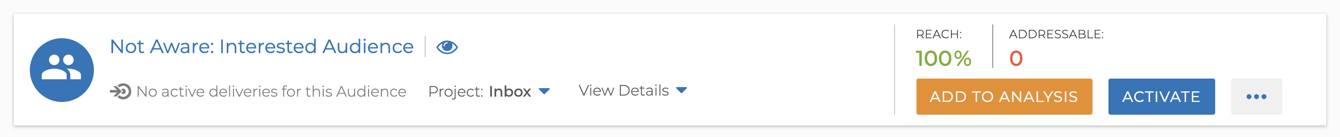
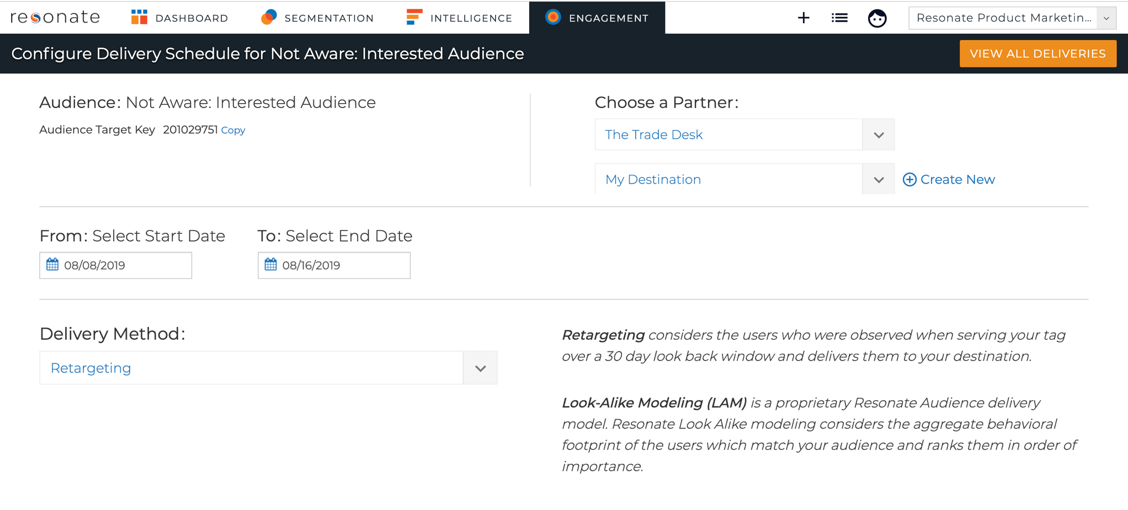
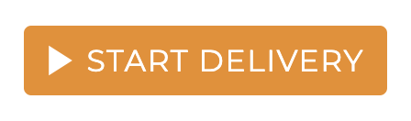
Custom Flash Models for Activation
Tags need to be saved as Audiences if you want to activate them
Segmentation – Your Data – Custom Data – Custom Flash Models
Click Save Audience
Now find you new Tag Audience on the Your Saved Audiences page
Click Activate
Select Activation Partner and Destination
Choose Start and End Dates
Select Retargeting as the Delivery Method
Click Start Delivery
Notes:
As you start activating your Flash Survey audiences, remember that all Tags need to be saved as Audiences first, in order for you to activate against them.
In this example, we’ve seen two use cases for Flash Surveys combined: First, we analyzed insights aiding us in activation, which helped us engage with our audiences more efficiently. Second, we actually engaged with our audiences online at scale.

Slide 22
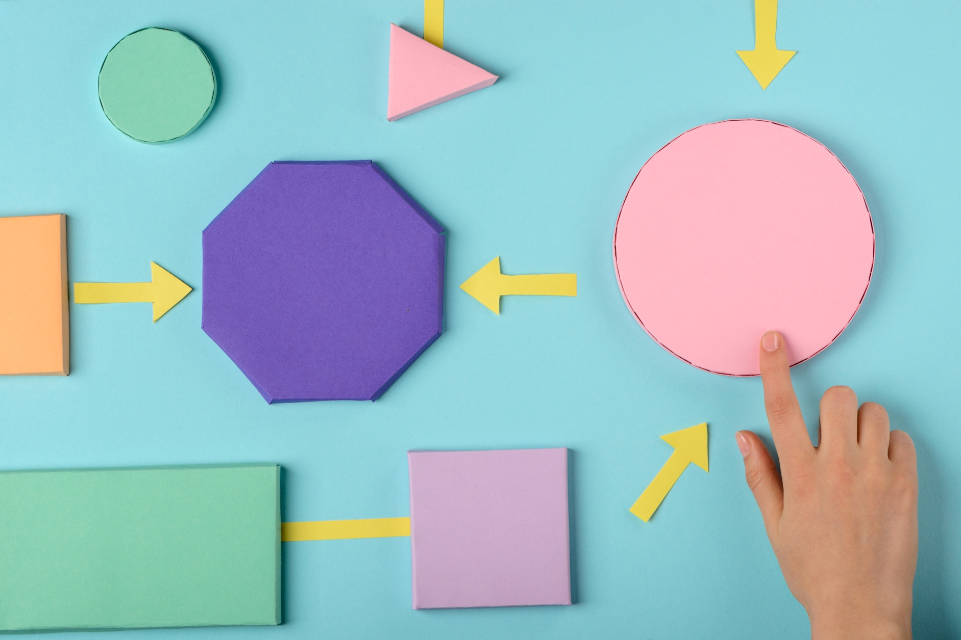
Custom Flash Models as a Segmentation / Typing Tool
What is a Typing Tool?
Set of questions that places consumers into one of several pre-defined segments based on their answers
  A set of formulas (Algorithm/logic) maps a respondent to one of several pre-defined segments based on how they answered the survey
Notes:
Now let’s look at our third use case, when we’re using Flash Surveys as a segmentation or typing tool.
But first, let’s understand what a typing tool is: It’s a set of questions that places consumers into one of several pre-defined segments based on their answers. This is made possible by a set of formulas that maps a respondents into one of the several pre-defined segments based on how they answered the survey.

Slide 23
Custom Flash Models as a Segmentation / Typing Tool
Who are my 5 known types of vacationers?
We created Custom Flash Models that allowed us to bring our 5 known vacationer segments online:
  Adventure Travelers
  Luxury Lovers
  History Buffs
  Family Fun
  Relaxing Retirees
Offline Segments
Adventure
Travelers
Luxury
Lovers
History
Buffs
Family Fun
Relaxing
Retirees
Custom Flash Models
containing questions that help us map respondents to our pre-defined segments
Adventure
Travelers
Luxury
Lovers
History
Buffs
Family Fun
Relaxing
Retirees
Actionable, Online Segments
Notes:
Imagine that we’re working for a cruise line brand. We previously ran a segmentation study. From that, we know that we have 5 segments representing the types of people who buy vacation packages from us:
Adventure Travelers
Luxury Lovers
History Buffs
Family Fun
Relaxing Retirees
We ran a Flash Survey that allowed us to take these predefined segments and recreate them at scale for activation. The resulting audiences are available in our Resonate account, under Tags. We can use these Tag audiences to engage with our segments.

Slide 24
How Custom Flash Models Work

Slide 25
How Custom Flash Models Work
We work closely with you to formulate survey questions and answers
We field the Survey -
4-6 weeks turnaround from survey design sign-off
We apply high-performing look-alike models to extend your reach
The goal is to create 3 audiences
to uncover information about your
target audience
We aim to collect
4K responses
3 audiences available in your Resonate account for insights and analysis
Use Resonate’s deep insights to identify the right creative and
messaging strategy for your audiences and engage with them online.
Notes:
When you purchase a Flash Survey, our Research team will work with you to formulate the questions and responses for the survey. The goal of these questions is to help us construct three audiences that, when analyzed in the Resonate platform, will answer your questions about your target segments. We tie the data we collected from your Survey to Resonate’s 13 thousand insights and 200 million profiles.
Flash Surveys have a quick turnaround rate – you can expect to have your audiences in your Resonate account 4-6 weeks after survey design sign-off. In general, we aim to collect 4 thousand responses. However, if you have low incidence questions in your survey and/or need to survey a unique audience, we expect to be in field longer to gain enough responses. And these low incidence questions may require additional costs. What does this mean?
Let’s say you want to target Single Male Millennials with your flash survey to understand what are the three main types of vacations they enjoy taking. Because the audience of single Male Millennials is harder to come by, we might have to keep the Flash Survey in field longer.
Before we load your Flash Survey Data into your account, we take the audiences resulting from your survey and create high-performing look-alike models in order to identify hundreds of thousands to millions of consumers that look like the survey respondents who met the criteria that you've defined for your audiences. This process ensures that your audiences have enough scale.
You get 3 audiences included in the price of your Flash Survey, and you can buy additional audiences if you like.
Another important thing to note is that you do NOT get all Flash Survey answers as attributes in your Resonate Account. Rather, we use the answers from your survey to build your audiences. However, if some of the answers to your flash survey questions reach our sample threshold – meaning that enough people answered that question – then we will include that answer as a Tag in your Resonate account. However, this is not the norm, so you shouldn’t expect or anticipate this to happen.

Slide 26
Custom Flash Model Limitations

Slide 27
Limitations to Custom Flash Models
You cannot see Custom Flash Models as insights
  E.g. You have a Custom Flash Model audience of people who will watch a movie. You can see all Resonate insights against this audience. But you cannot look at an audience of Female Millennials and see how they index for watching the movie.
Cannot combine Tag + 1st Party Data
Cannot combine Tag + Limited Survey Attribute
Cannot measure against Digital Touchpoints
  This means you cannot measure against digital touchpoints in the Audience Crosstab visualization either

Slide 28
Keep in mind:
Custom Flash Models are representative of a targeted group you’d like to engage online
  NOT representative of the Online Adult Population
Insights you get for a Custom Flash Model audience are about the large, modeled audience
  NOT about the core survey audience that responded to the survey
When looking at insights, focus on the ones aiding in activation

Slide 29
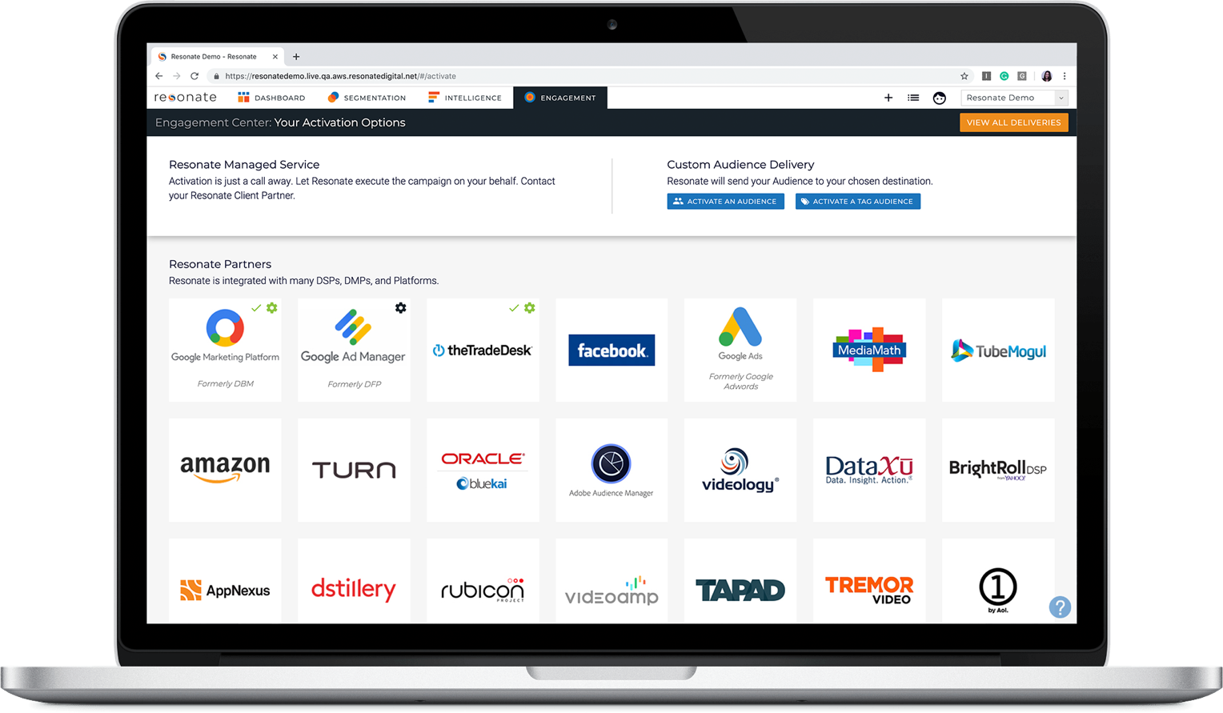
Custom Flash Models
Actionable
Targeting & activation for up to one year
Client-Specific
Insights Into Action
4-6 Weeks
Turn-around time from Resonate Research from survey design sign off to deliverable
Unique
Brand-specific, fast insights for activation, leveraging industry-leading research and modeling
Representative
Survey a targeted group you wish to explore more deeply

Slide 30
Resonate Custom Research
 | Custom Flash Models
Timing | Proprietary custom questions fielded in a standalone survey Fast turnaround, can receive data in 4-6 weeks from survey design sign off
Insights | csv of raw research questions and answers for your analysis Responses not available as insights
Activation | Leverage proprietary profiles for targeting & activation for up to one year
Measurement | Measure in Audience Crosstab Not available to measure against digital touchpoints
Representative | Representative of a targeted group you wish to explore more deeply
*upon reaching significant threshold to be modeled
Notes:
Although Flash Surveys and Custom Questions both serve to answer specific questions and provide you with unique insights about your audiences, these two solutions have different benefits and use cases.

