Slide 1
Media and entertainment
First-party data use cases

Slide 2
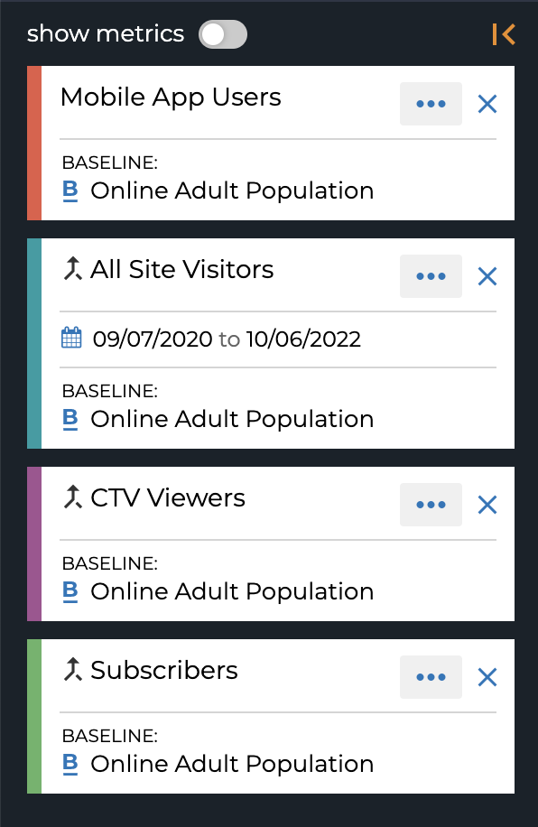
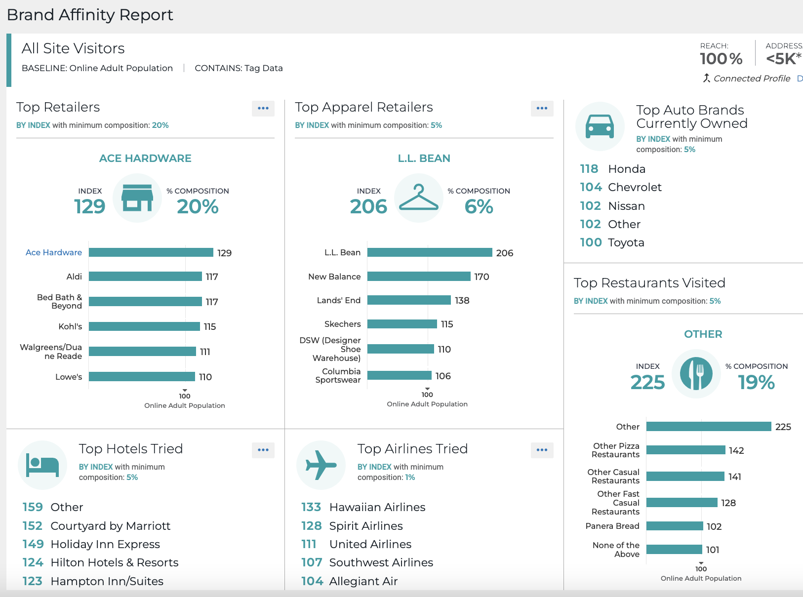
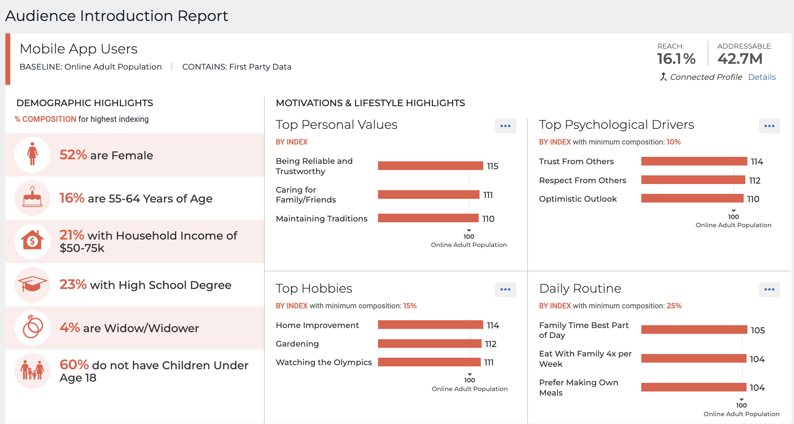
RESONATE
MEDIA & ENTERTAINMENT
CRM INSIGHTS & WEBSITE INSIGHTS USE CASES
Step 1: Onboard your first-party data across any data set – such as your mobile app users, site visitors, CTV viewers, newsletter subscribers, and more.
Step 2: Use Resonate’s Curated Reports to quickly get an overview of your audiences across demographics, personal values, media consumption habits, brand affinity, and more. Provide potential advertisers an overview of who your audience is and where to find them and discover the brands that should be a top priority for your advertiser partnerships.
Step 3: Dive deeper into industry-specific data to find insights that are relevant and meaningful to advertisers. Choose from thousands of insights across all key advertiser industries, then showcase the unique value of your audience and how your audience aligns with theirs.
UNCOVER NEW AUDIENCES FOR AD SALES
Sell your audiences to advertisers by leveraging your first-party data for audience intelligence.

Slide 3
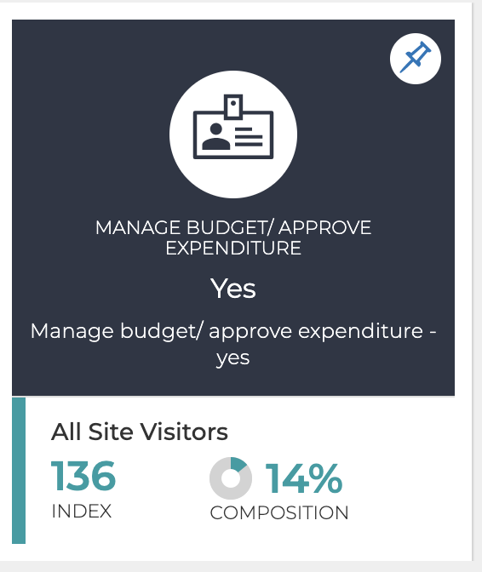
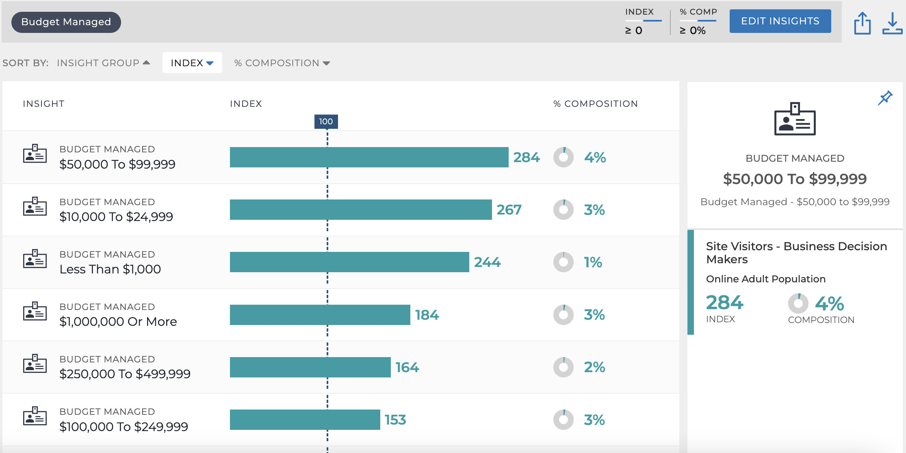
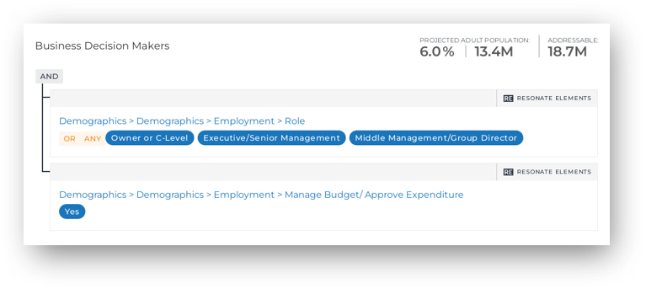
RESONATE
MEDIA & ENTERTAINMENT
WEBSITE INSIGHTS
USE CASES
Step 1: Identify the overlap between your advertiser’s target audiences and your first-party data set. For example, you received an RFP from a financial services company looking to target business decision makers. You can show this advertiser that 14% of your website visitors are decision makers that manage budgets / approve expenditures.
Step 2: Add this attribute to your site visitor audience definition to enhance your proposal with unique insights to capture the advertiser’s attention and position your publication as a consultative partner. Show your advertisers that you are a category expert in their vertical. ​For example, understand the amount of budget this audience is managing, or look at what industries they over-index for.
GROW AD SALES
Identify, analyze & reach advertiser target audiences that exist on your O&O properties.
Step 3: Once you’ve secured your advertiser, you can fuel your owned and operated campaigns by connecting the custom audiences you’ve created and studied to your ad server. For example, build and activate an audience of executives that manage budgets.
Support advertising sales efforts by building compelling stories that incentivize advertisers to tap into your core audience and advertise against their target audience on your O&O properties.

